Slide 1
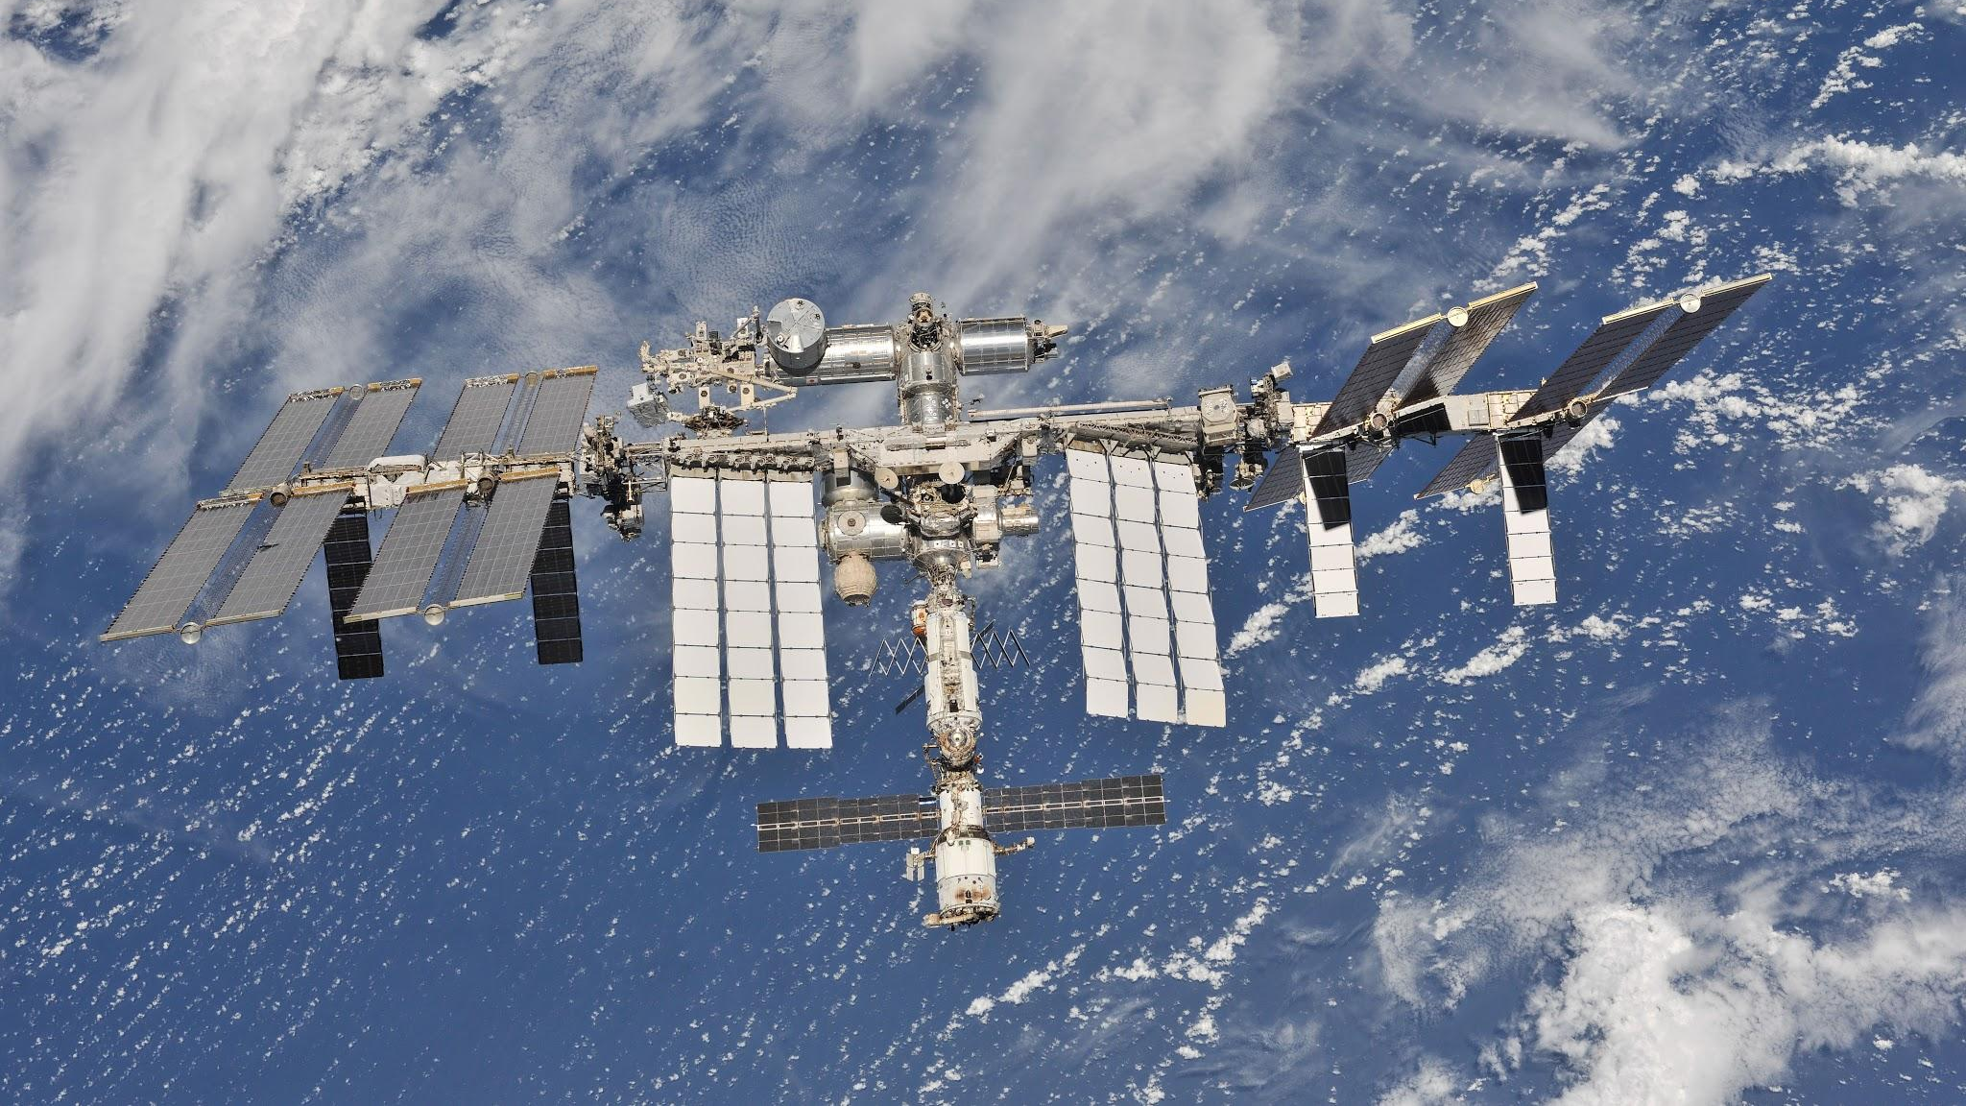
When the Sky is No Longer the Limit!
Using IoT Technology to make a Weather Station that will FLY IN SPACE“
Presenter Melissa Pore, M.Ed. KM4CZN
Co-Presenter Mark Stenglein KN4IJZ

Slide 2
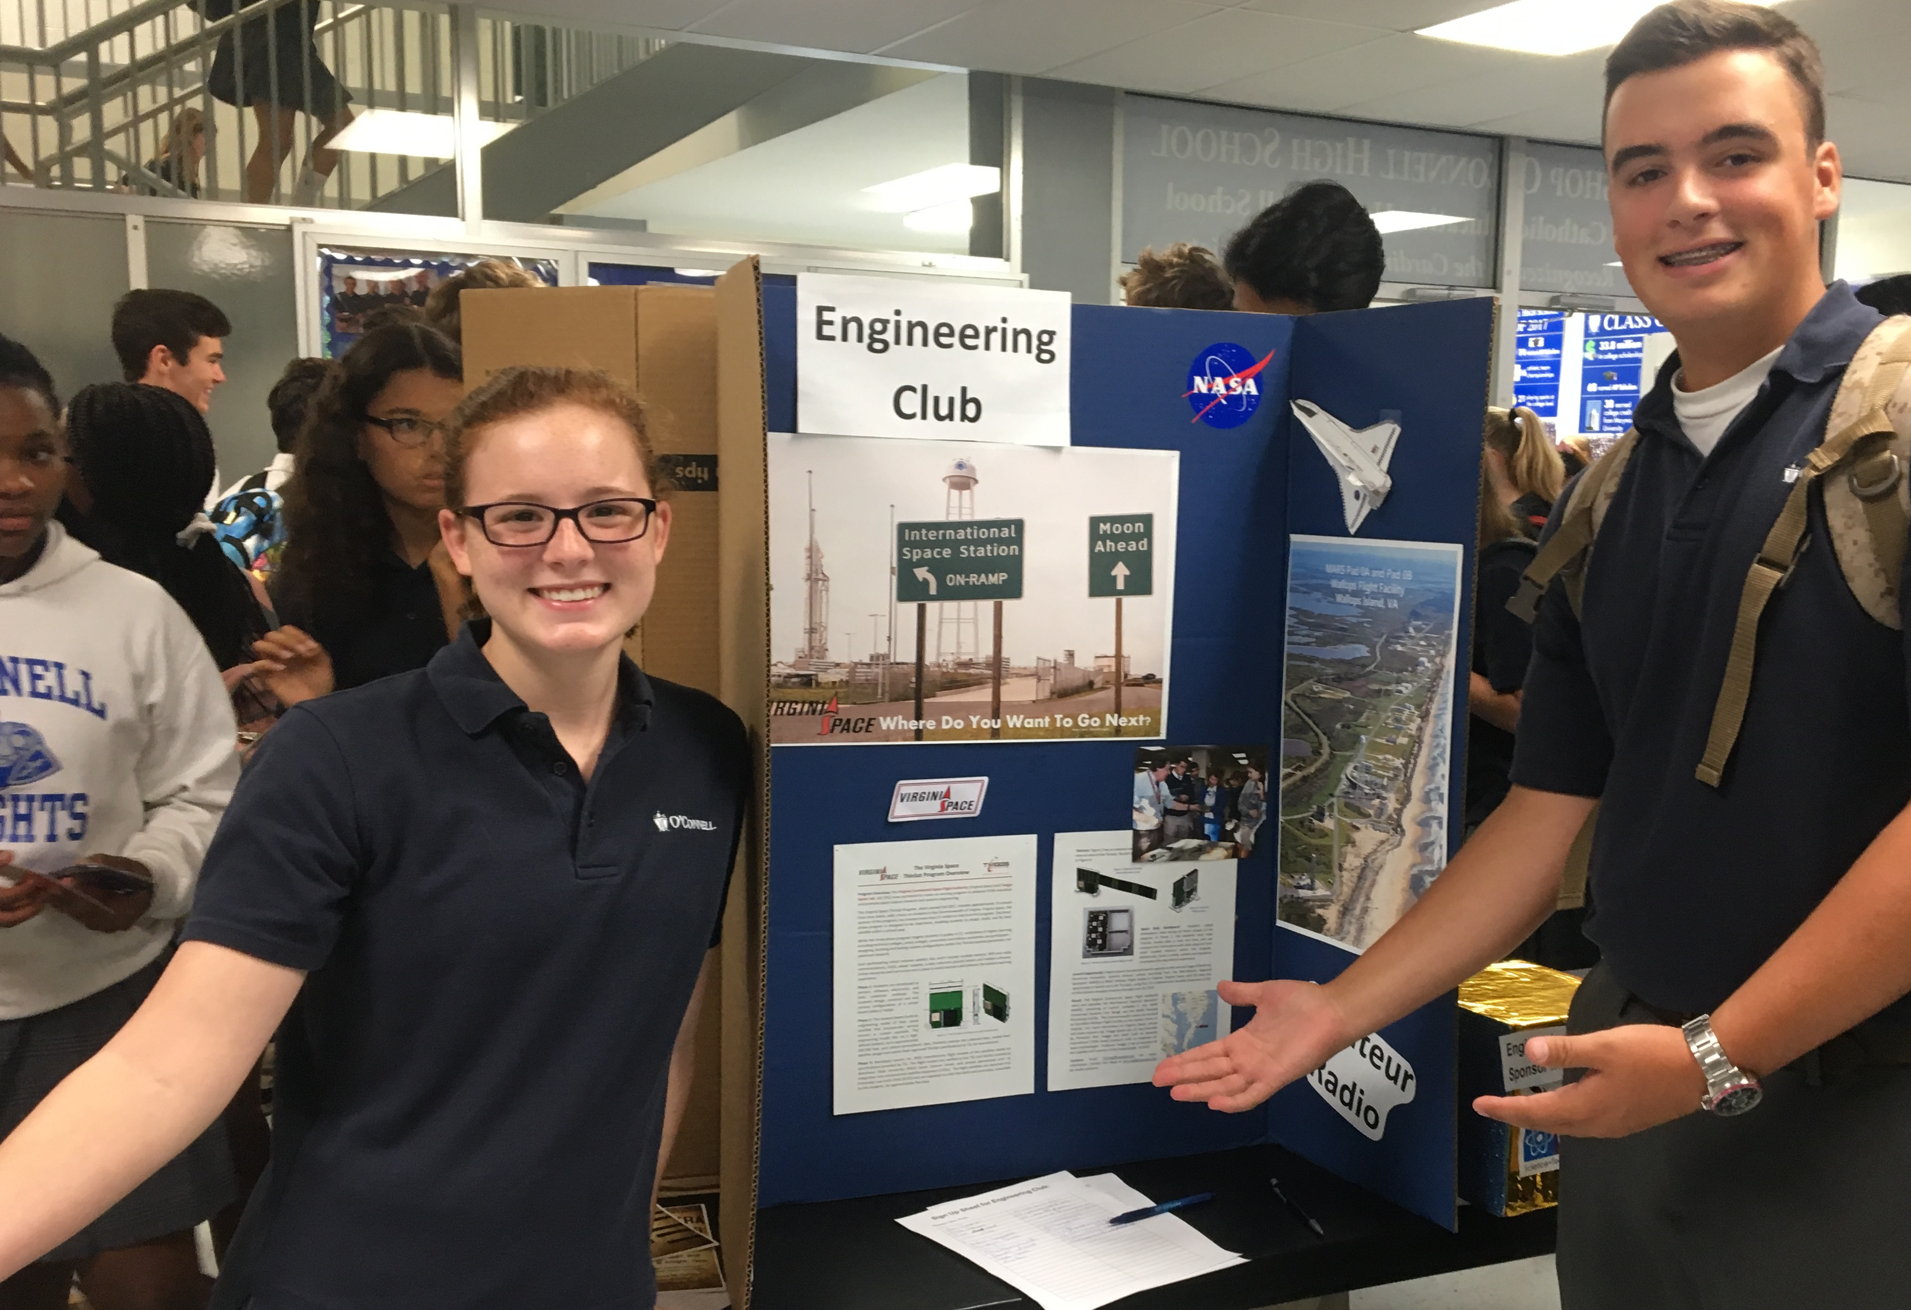
Presenter Melissa Pore, M.Ed. de KM4CZN
High School Engineering and Cyber Security
Project Lead the Way (PLTW)
Amateur Radio Club
US-Ed Delegate for ARISS
ARISS Ops for NASA Goddard
CASIS Ambassador
USNA STEM and SeaPerch
NASA CubeSat Launch Initiative
ThinSat
XinaBox

Slide 3
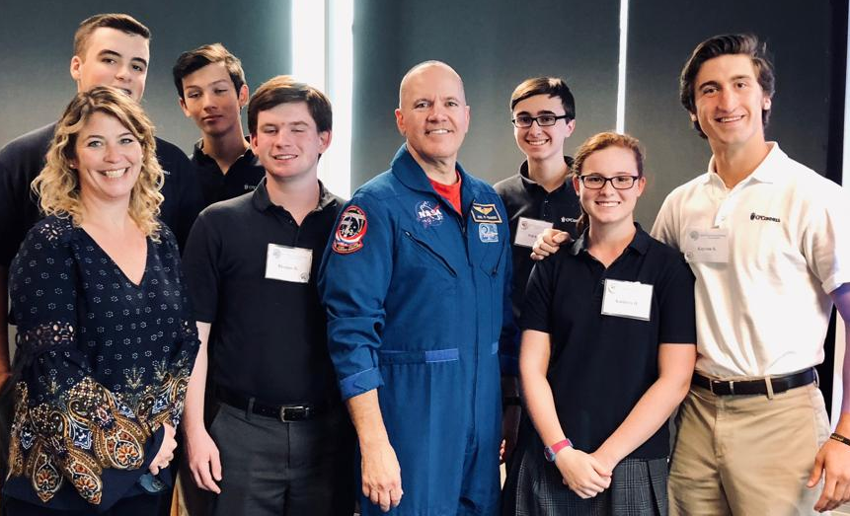
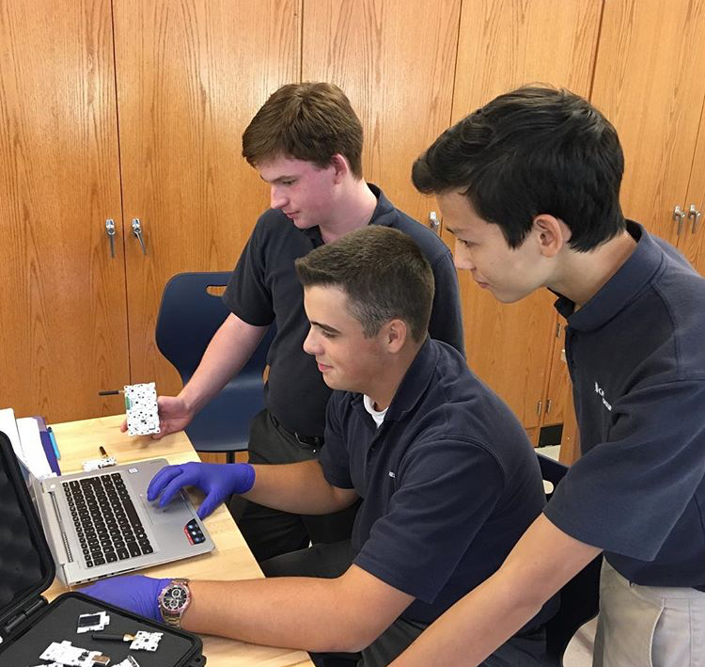
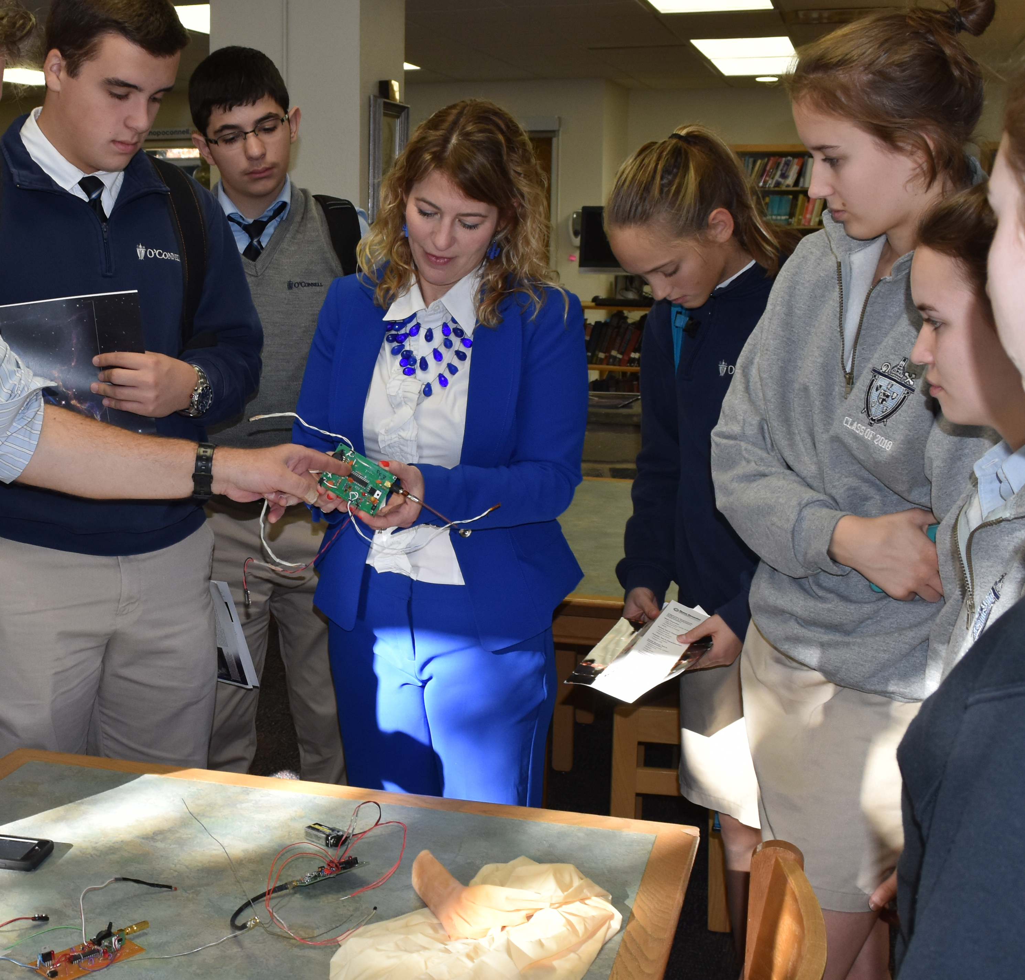
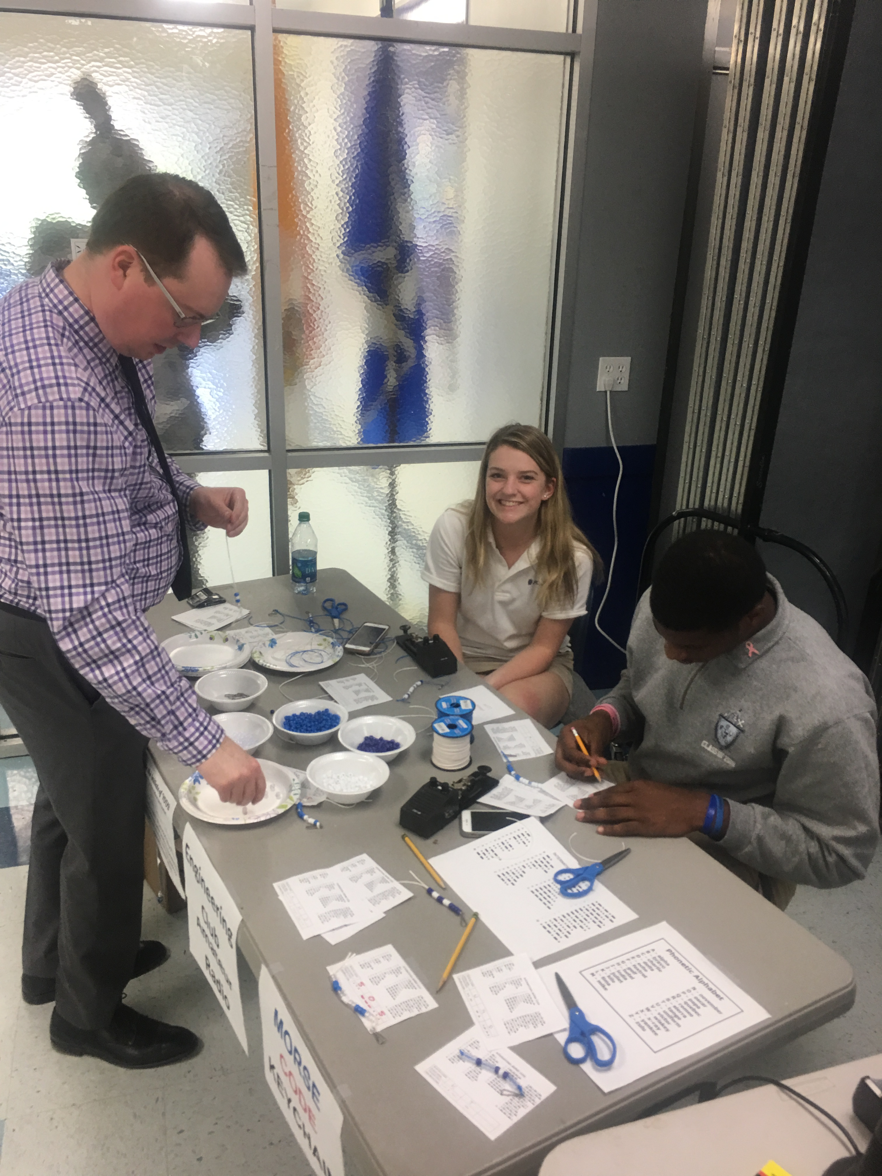

Slide 4
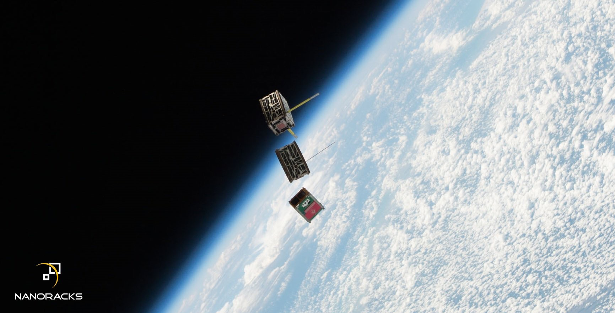
STM Mission Possible to Space
This launch was made by possible by a very excited teacher and group of students (and by the generosity of parents and the NASA CubeSat Launch Initiative).
STMSat-1 launched from Kennedy Space Center in December 2015
onboard a Cygnus CRS-4 on an ISS Resupply Mission.
It was deployed into orbit on May 16, 2016 from the Japanese Service Module.
It reentered the earth’s orbit on about April 17, 2017.
https://www.youtube.com/watch?v=8W5RhA5LCvY

Slide 5
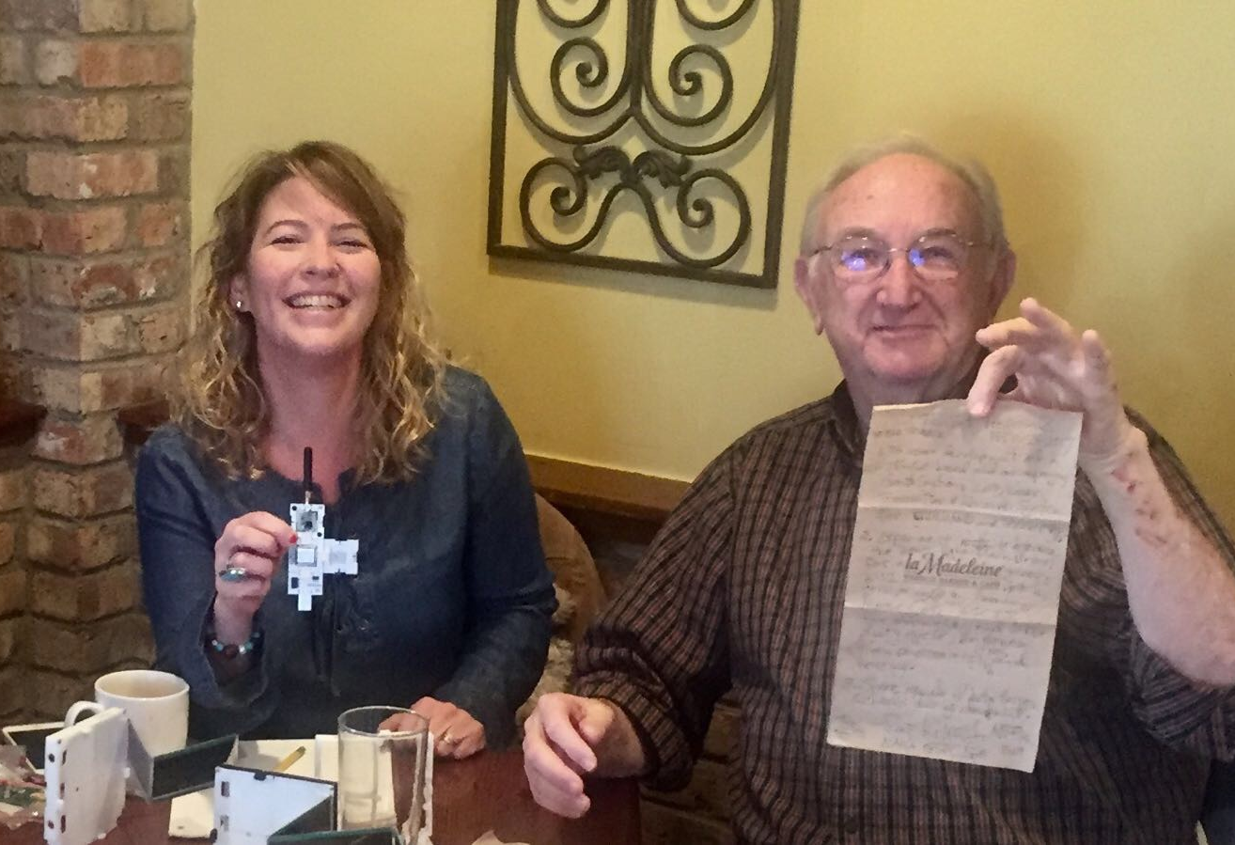
Welcome ThinSat to our DJO Space Mission!
Partners include:
Virginia Space
Mid-Atlantic Regional Spaceport (MARS)
Twiggs Space Labs (TSL)
XinaBox

Slide 6
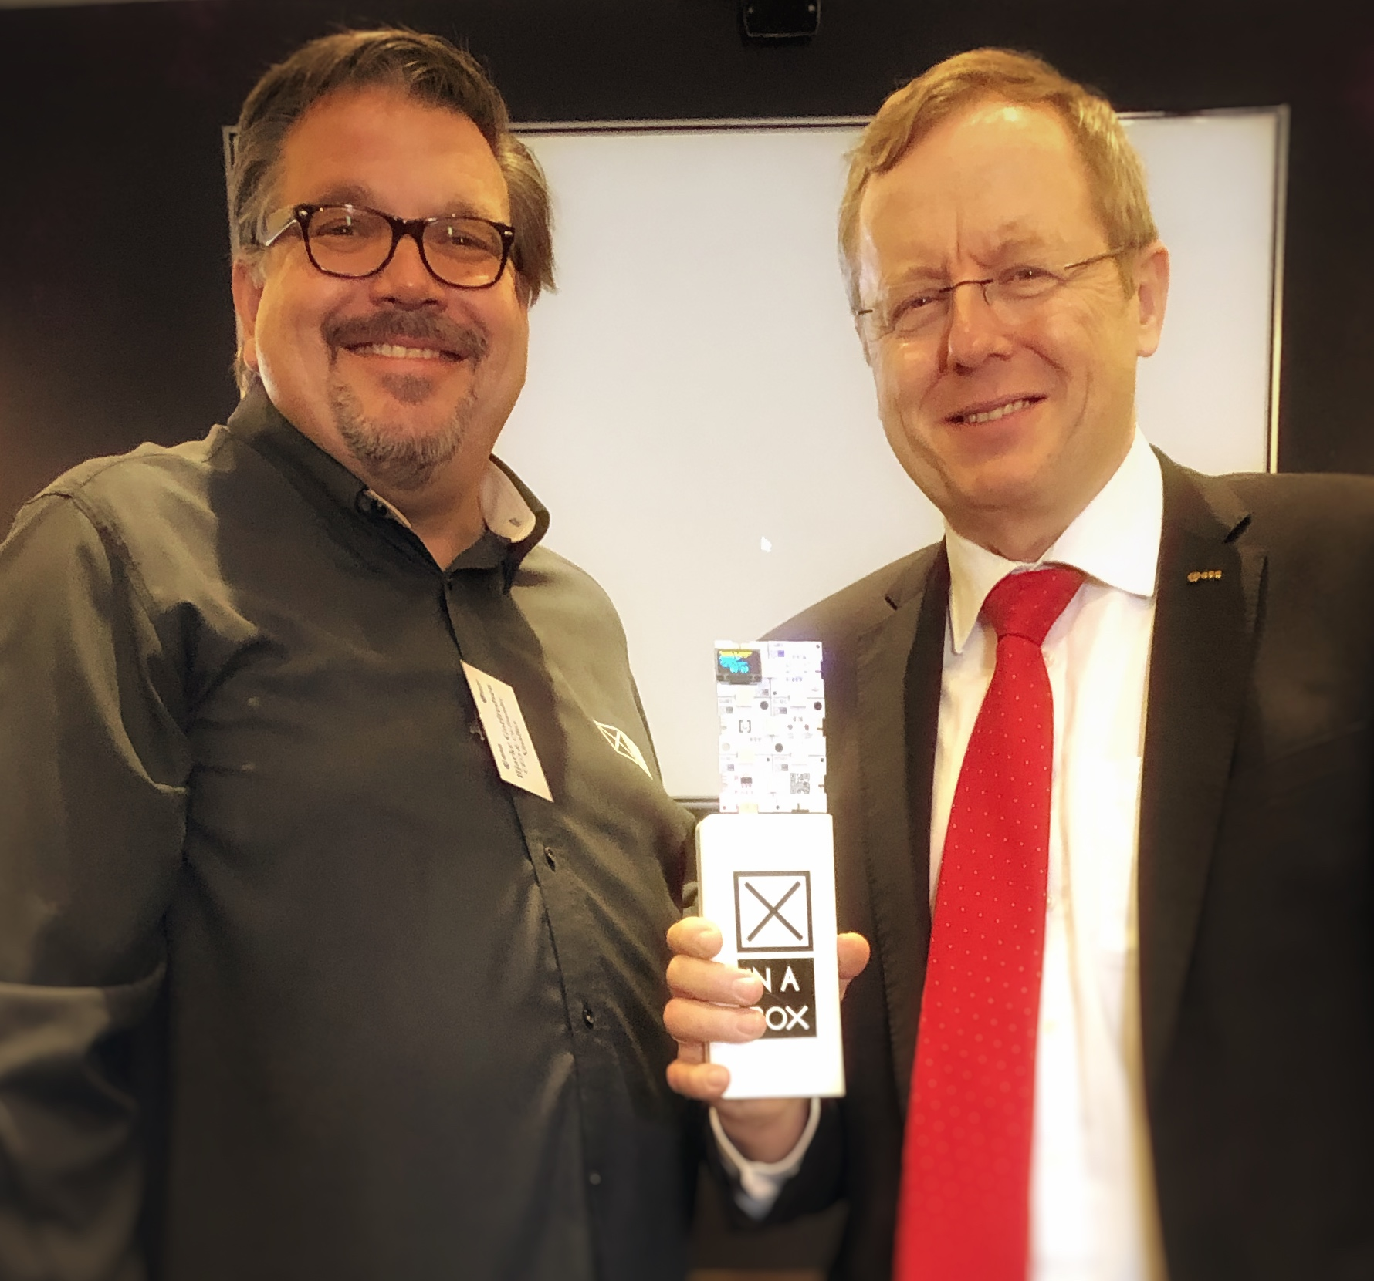
XinaBox Founder Bjarke Gotfredsen
https://www.greatbigstory.com/stories/the-teens-launching-africa-s-first-private-satellite?playall=1481

Slide 7
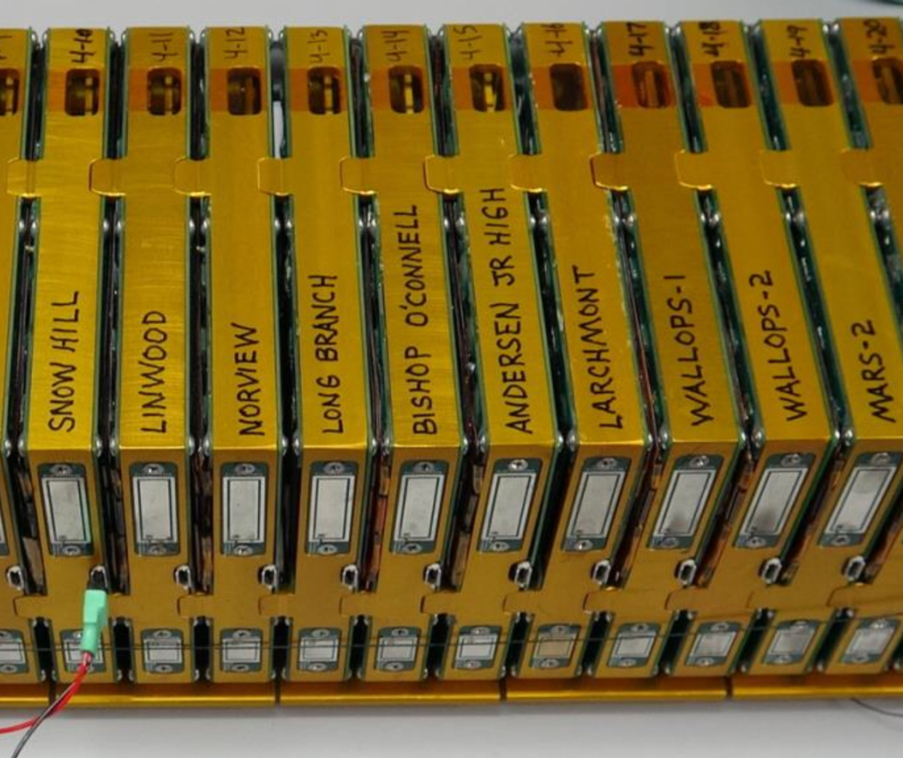
3-2-1 LAUNCH!
XinaBox at Bishop O’Connell
HAB Flights
ThinSat launch April 17, 2019
DJOSpaceToast-1

Slide 8
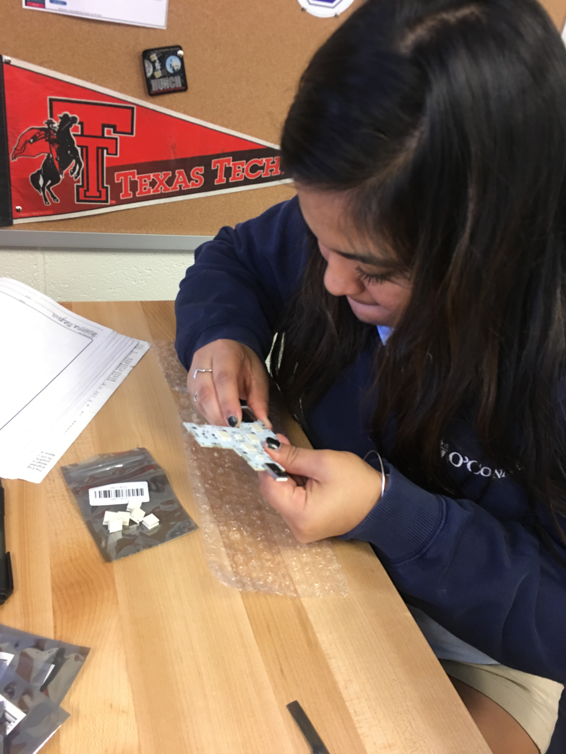
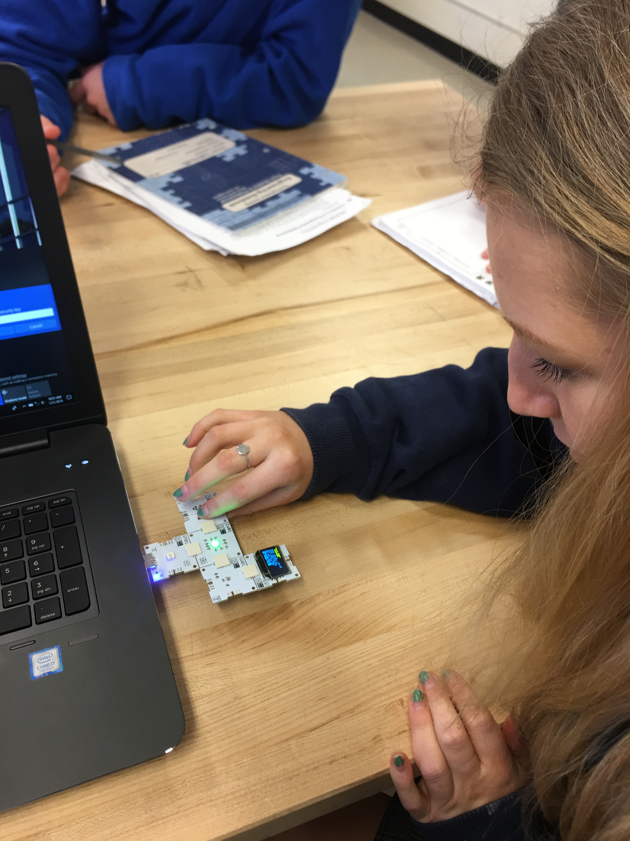
Connect and Power Chips

Slide 10
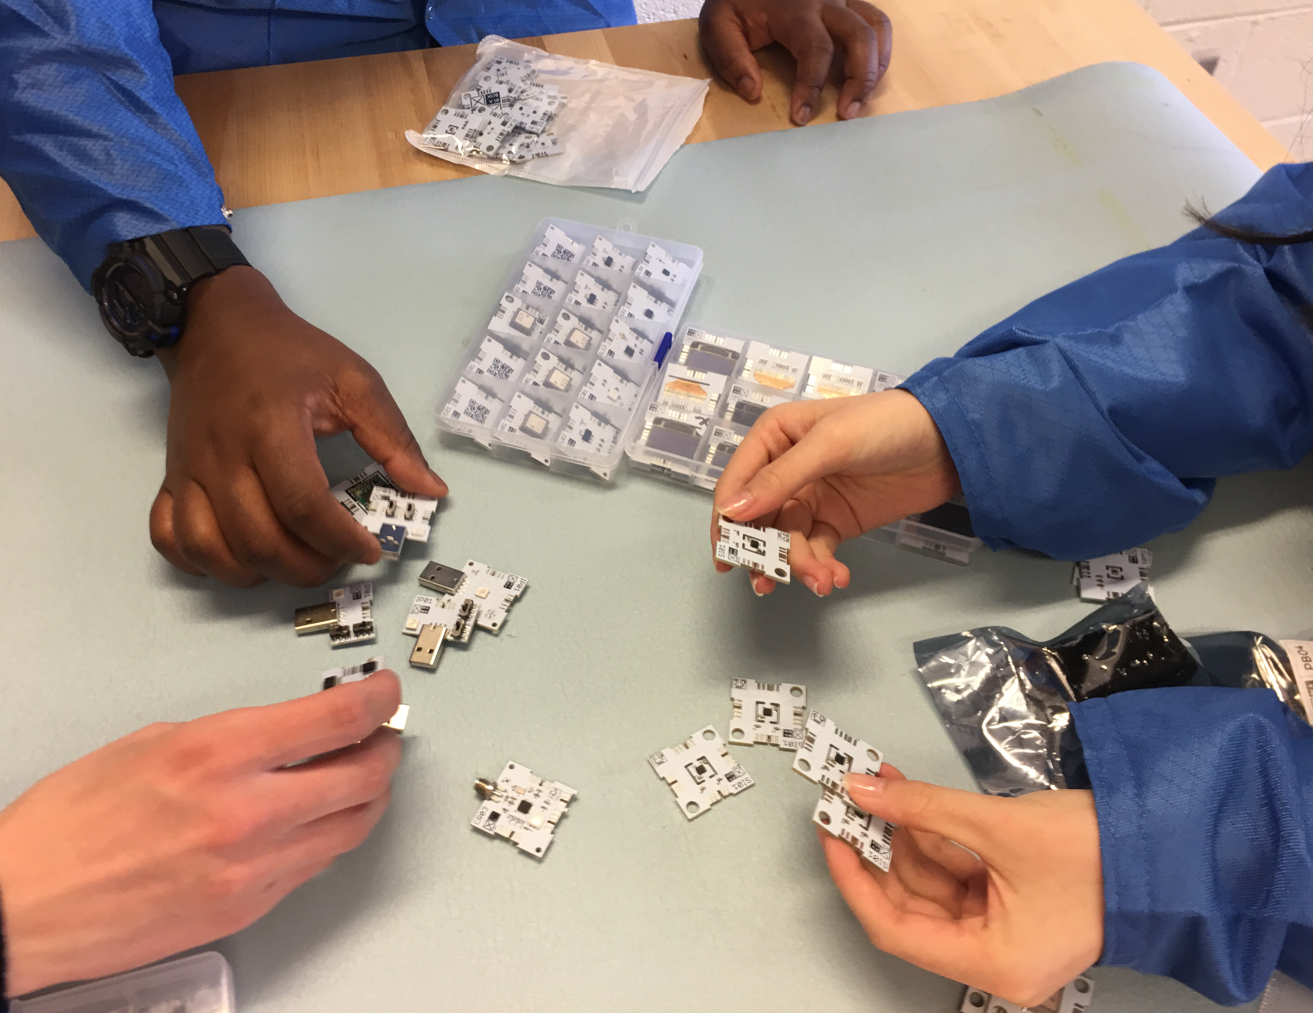
Out of the Box with XinaBox!
Open up kits in groups.
Identify components.
Construct weather stations.
View data on LED screen.

Slide 11
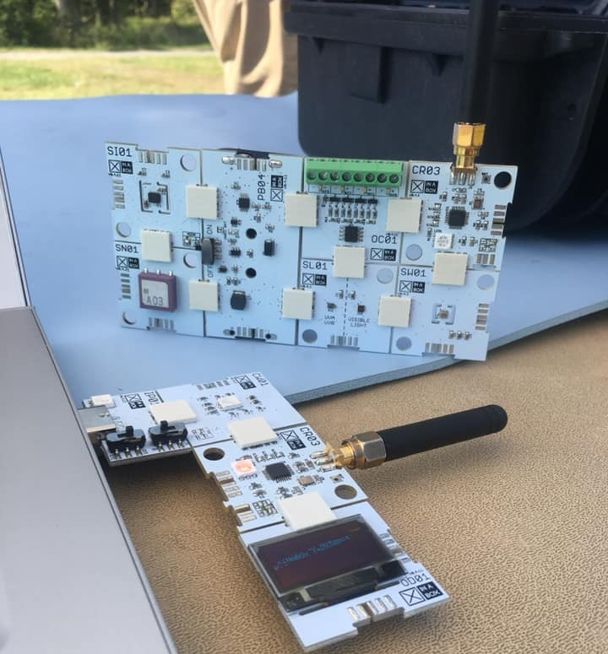
Your turn! – Let’s Build a Weather Satellite!
1. With your mission team, you will collect data in three different locations in the room.
2. Record the temperature and air pressure.

Slide 12
Predict, Collect, Analyze, and Conclude
Flip the classroom & Assign Jobs:
Mission Manager – Watch timer, make sure all jobs are being fulfilled, keep on task.
Weather Scientist – Read data.
Electronic Engineer – Build device.
Systems Engineer – Record data.
What is the relationship between temperature and pressure?
Gay-Lussac's Law: The Pressure Temperature Law. This law states that the pressure of a given amount of gas held at constant volume is directly proportional to the Kelvin temperature. As the pressure goes up, the temperature also goes up, and vice-versa.

Slide 13
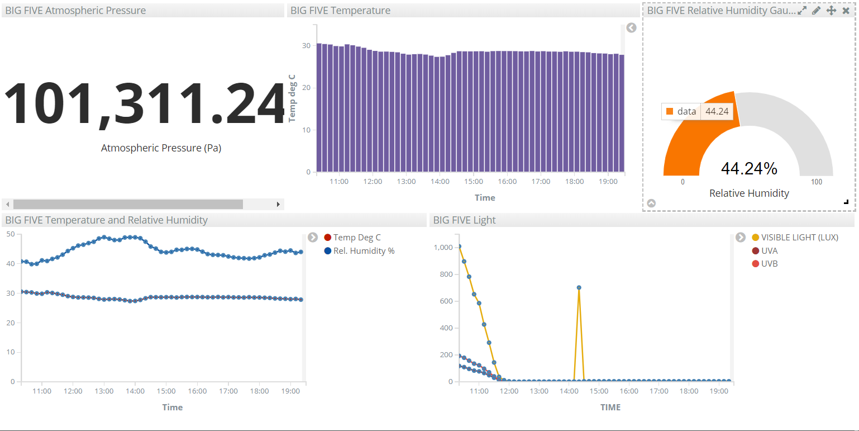
Analyze and Interpret

Slide 14
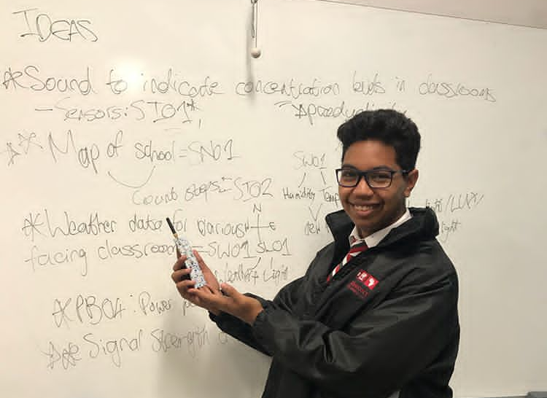
Open Discussion
How can we apply XinaBox at our school?

Slide 15
Try out some fun STEM activities in your classroom!
10 FREE Xinabox weather stations
“Into the Unknown” – Teacher/student documentary about the James Webb Telescope
Deep Space Network Activities - https://scan-now.gsfc.nasa.gov/scan
Center for Near Earth Object Studies - https://cneos.jpl.nasa.gov/
Sally Ride EarthKam Project
Space Place Games
Talk to an Astronaut with ARISS!
You can subscribe to the XinaBox YouTube channel by joining below:
https://www.youtube.com/channel/UCG2DQOp0cfLojcvvDGvWCHA?sub_confirmation=1

Slide 16
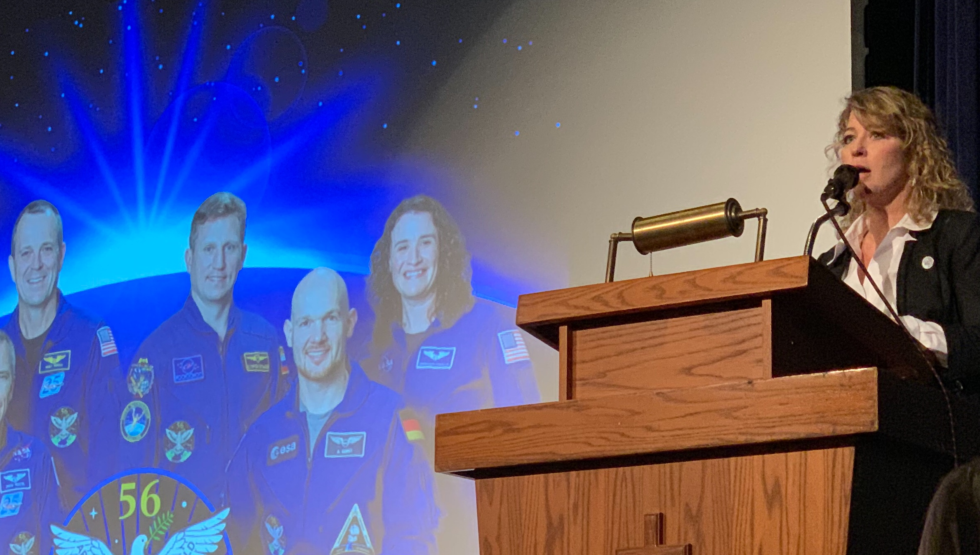

Slide 17
Amateur Radio on the International Space Station (ARISS)
Contact with Bishop O’Connell High School in Arlington, VA on November 8, 2018
with Astronaut Serena Auñón-Chancellor

Slide 19
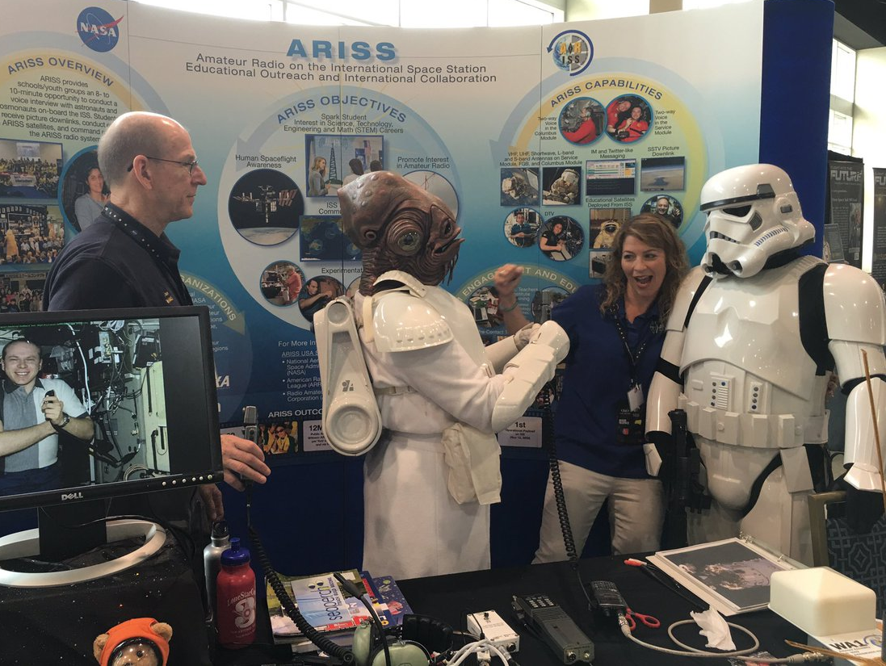

Slide 20
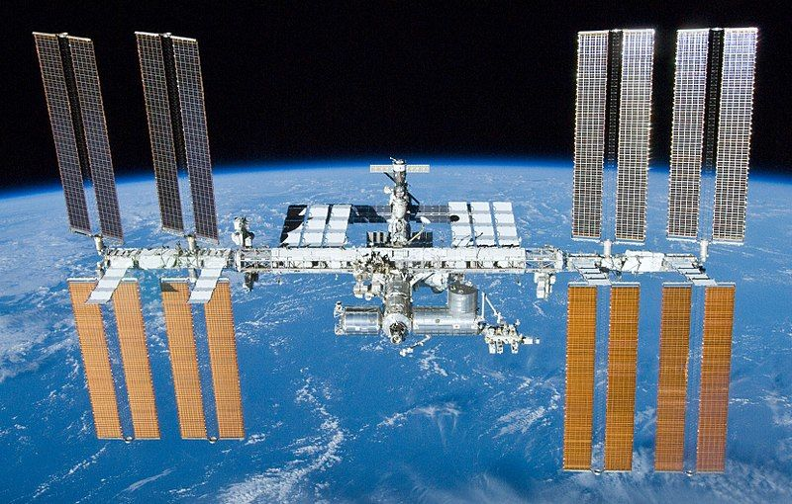
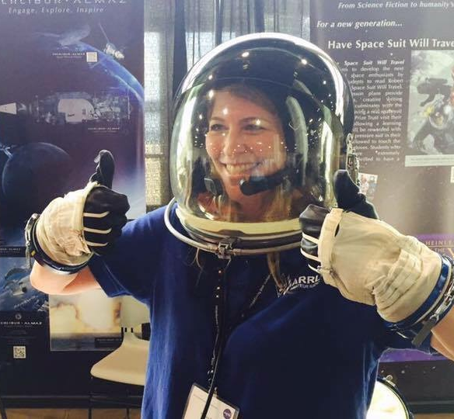
DJOSpaceToast-1 Launch Date
April 17, 2019
NASA Wallops Flight Facility

