Slide 1
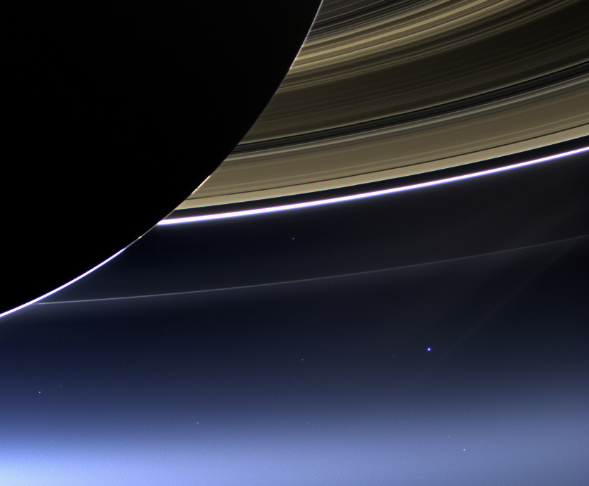
Earth, from 900 million miles away
Laura Tomlin
Colleen Gilchrest
Karen Ewton
Salado Junior High
You are here

Slide 2
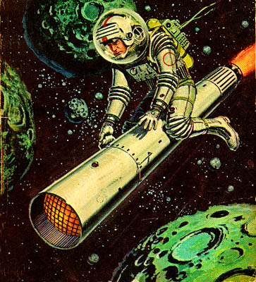
Who was the first person to launch into space?
Neil Armstrong
Lance Armstrong
Yuri Garagin
Buzz Lightyear

Slide 3
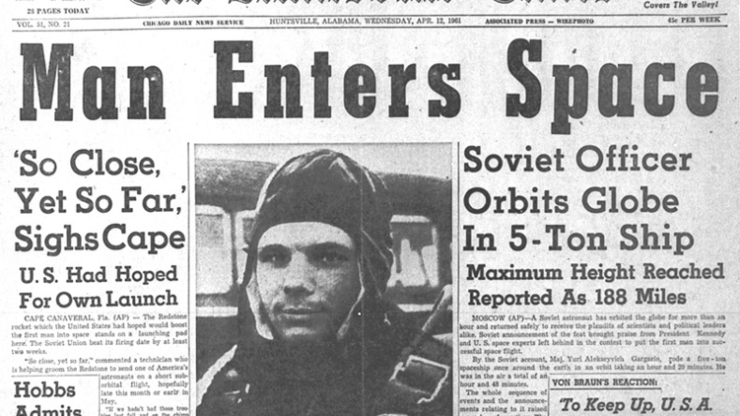
Who was the first person to launch into space?
Neil Armstrong
Lance Armstrong
Yuri Garagin
Buzz Lightyear

Slide 4
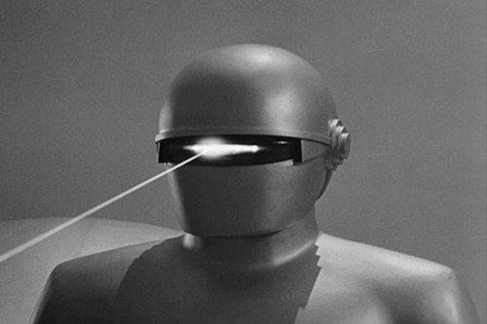
Which of the following is TRUE?
There is water on Mars
There was once water on Mars
There is a laser-shooting robot on Mars

Slide 5
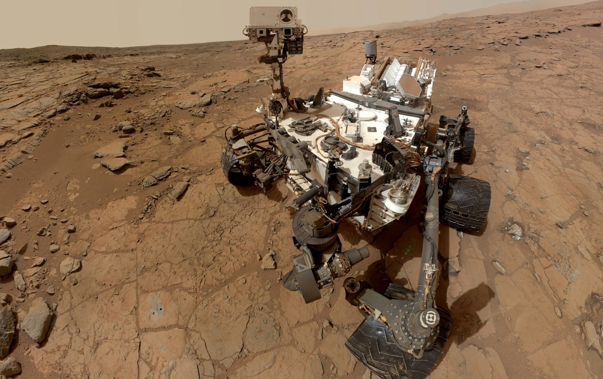
Which of the following is TRUE?
There is water on Mars
There was once water on Mars
There is a laser-shooting robot on Mars
ALL TRUE!!

Slide 6
Fact or fiction?
There are huge oceans of water in our outer solar system!
Like Earth, Saturn’s moon Titan has rain, lakes, and rivers !
If you were standing on asteroid Bennu you could jump into outer space!

Slide 7
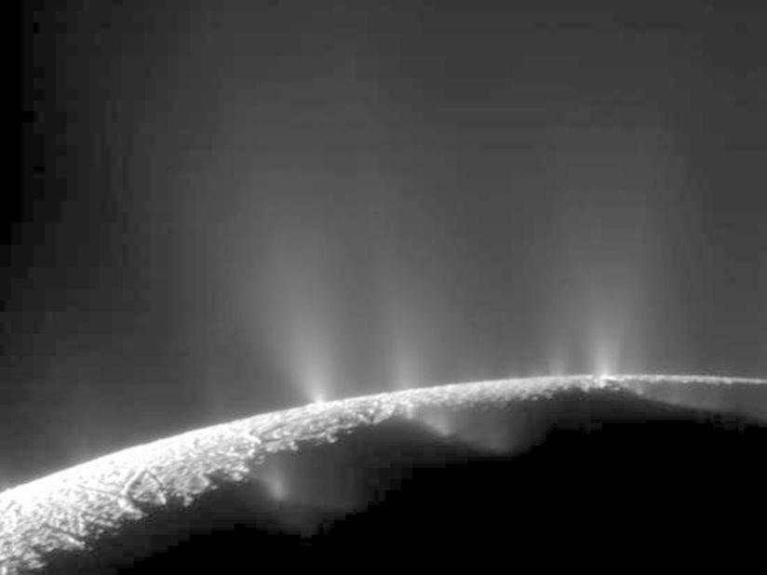
All Fact!
There are huge oceans of water in our outer solar system! (Enceledus and Europa)
Like Earth, Saturn’s moon Titan has rain, lakes, and rivers ! (Methane)
If you were standing on asteroid Bennu you could jump into outer space! (.000005 x gravity of Earth)

Slide 8
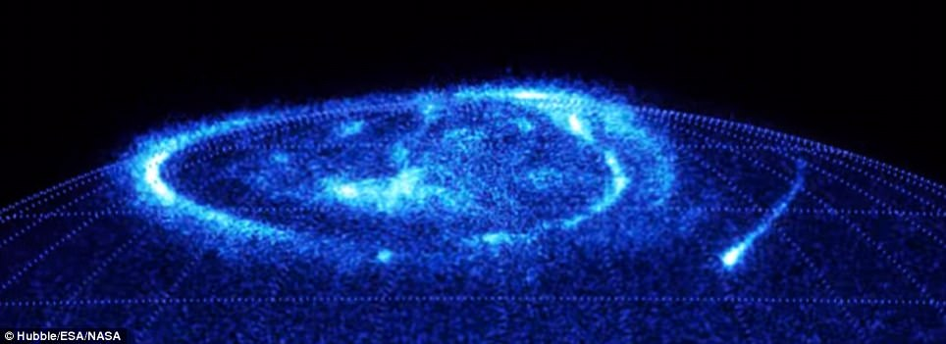
Exploring our solar system with thermal energy and magnetism

Slide 9
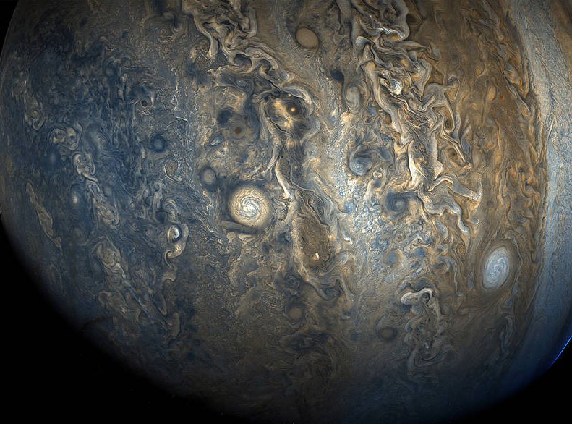
Image by NASA
Jupiter- taken by Juno spacecraft with JunoCam

Slide 10
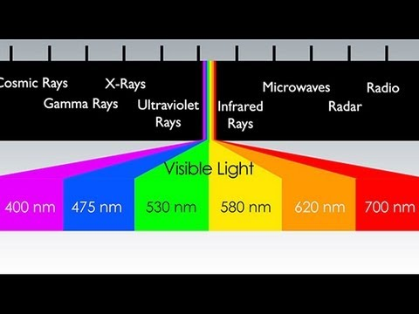
Infrared: More Than Your Eyes Can See
1:36-3:00
https://www.youtube.com/watch?v=2--0q0XlQJ0

Slide 11
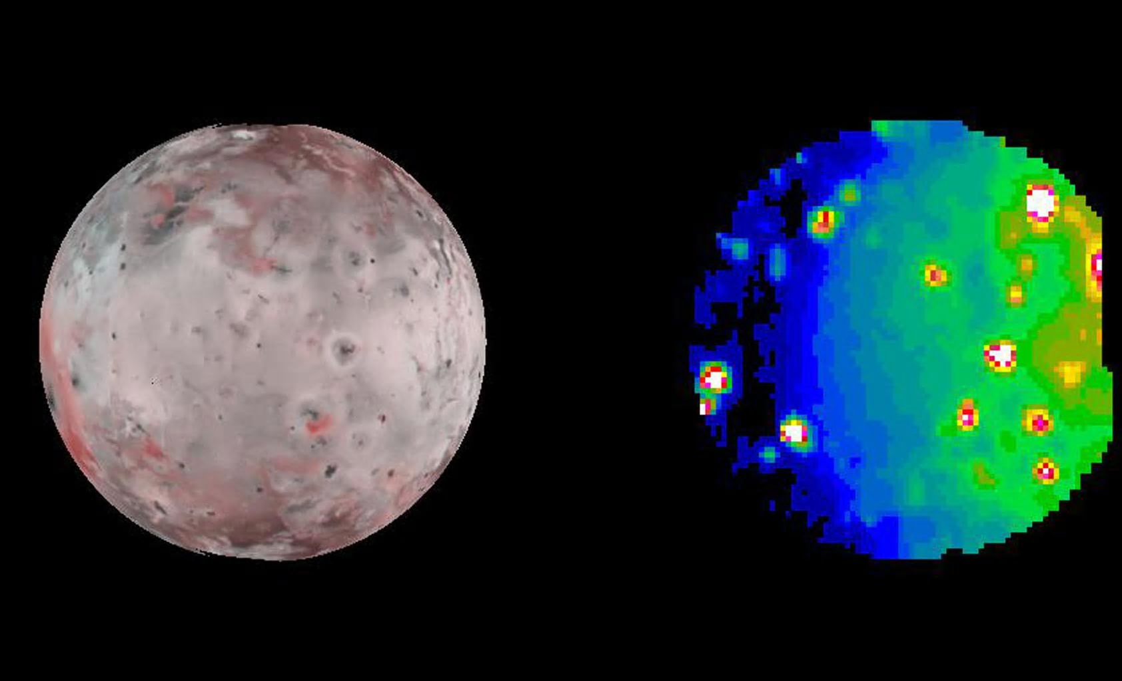
Jupiter’s moon Io taken by Galileo spacecraft, 2001
image left: visible wavelengths
image right: infrared wavelengths

Slide 12
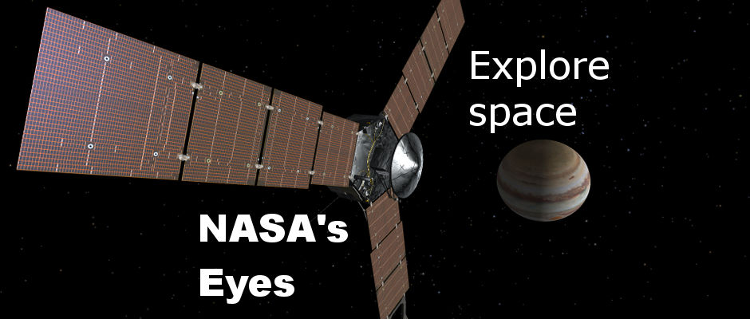
https://eyes.nasa.gov/
https://www.missionjuno.swri.edu/media-gallery/instruments

Slide 13
A planet beyond Pluto has been discovered! A spacecraft has been sent to collect data.
Objective:
Use “thermal sensors” to create an infrared map.
Locate changes in thermal energy
Mark and label 4 coordinates around the perimeter of hot / cold spots (x axis, y axis)
Outline the perimeter of hot / cold spots
Color map (dark=cold, bright=hot)

Slide 14
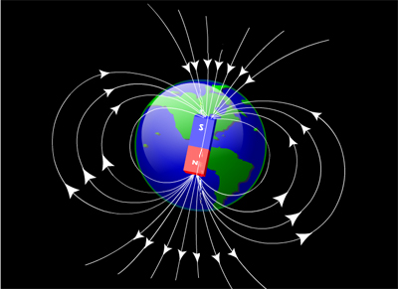
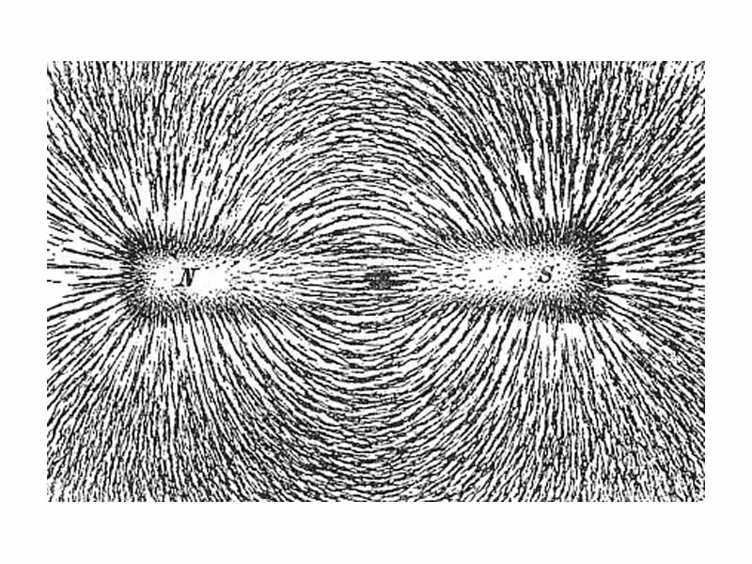
What is a MAGNETIC FIELD?

Slide 15
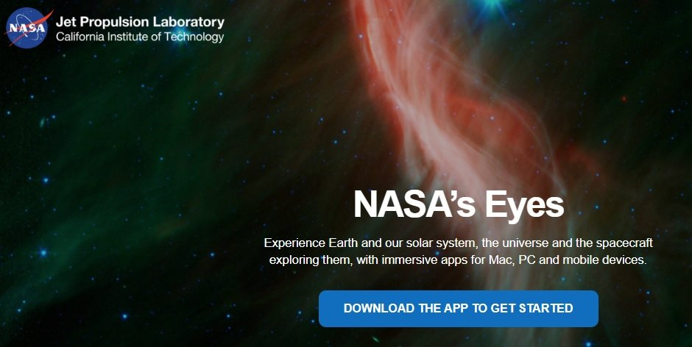
https://eyes.nasa.gov/
https://www.missionjuno.swri.edu/media-gallery/instruments

Slide 16
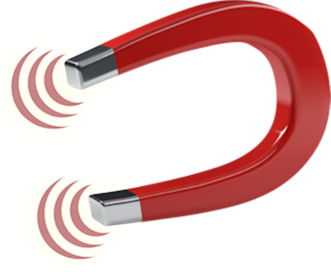
Locate areas of magnetism
CHALLENGE: As a team build a device that will detect areas of magnetism on your planet
No more than 30 cm2
2 minute planning
1 supply retriever
1 “test magnet” per table
15 minutes to construct / test / reconstruct
Use device to locate and mark areas of magnetism. Device may not touch the surface of the planet!
Mark center of magnet field with and X
Highlight the perimeter of the magnetic field

Slide 17
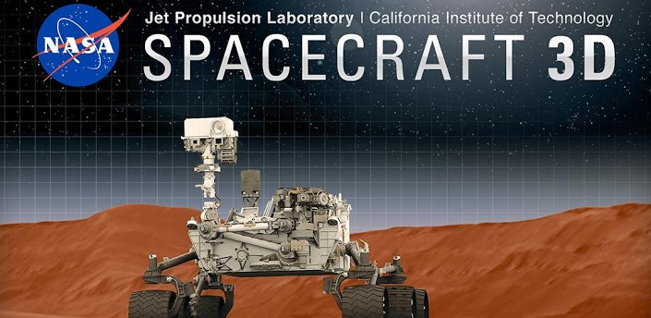
Free App!
-iPhone or Android

Slide 18
Thank you!!
•Check your folder for great NASA resources (including those used in this presentation), and other fun activities for your classroom!
•Emails for Laura and Colleen are on the front of folder
•Don’t forget the evaluation forms!
And thank you SEEC!

