Slide 1

Steven C. Smith, MIPM
Education Specialist
NASA Johnson Space Center
Perseverance: Sticking the Landing
with NASA Resources
Notes:
Introductions here

Slide 2





Aeronaut-X:
A focus on the Future of NASA Aeronautics Innovation
Quiet Supersonic Flight– X-59 QueSST
Commercial Crew Program:
A Focus on Human Spaceflight to Space Station with our Commercial Partners
Moon to Mars:
A Focus on Transportation Systems
for Moon to Mars Missions
OSTEM Opportunities
Middle School students collect data as part of a national citizen science activity to support the testing of quiet supersonic aviation technologies.
Students are immersed in emerging technologies to explore Commercial Crew Launch facilities and missions.
Middle School and High School students engage in student challenges to contribute to missions.
Notes:
We’re focusing on supporting three mission areas to begin with in our current pilot activities. First is the Small Steps to Giant Leaps theme that focuses on the future of aeronautics innovation. The second theme focuses on human spaceflight to the space station with our commercial partners. And the third theme is Moon to Mars that focuses on transportation systems for deep space exploration beyond low-Earth orbit.

Slide 3
Notes:
Phase one explained.

Slide 4

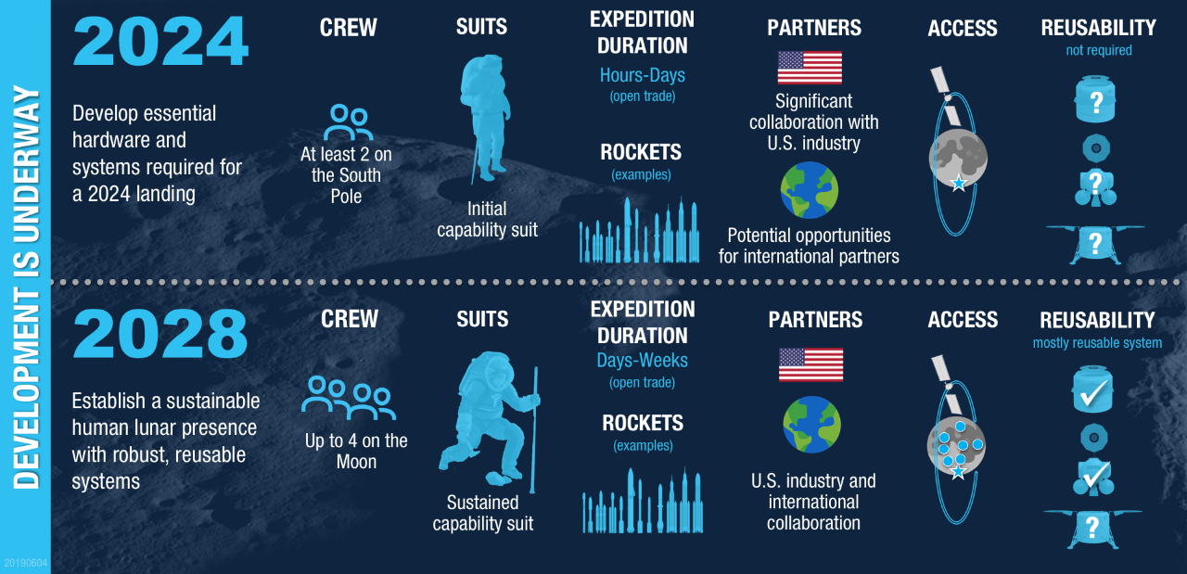
Notes:
Artemis is in two phases: Top is phase one, bottom is phase two. Phase one is getting us there. Phase two is building and maintaining sustainable presence to do the work of learning how to live and work for trip to Mars in 2030’s.

Slide 5
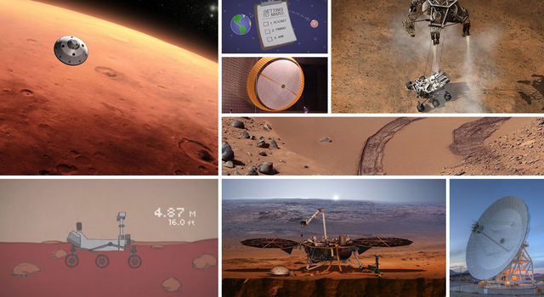
The Next Step

Slide 6
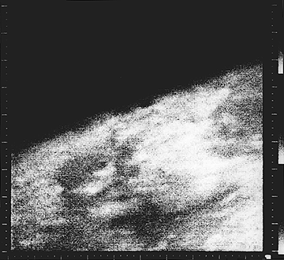


The History of Mars Rovers
Mariner Flyby Close-up
First Viking Panorama
Viking Color Image

Slide 7
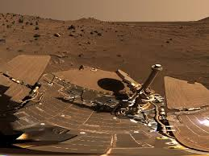
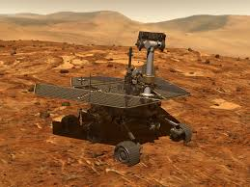
Spirit and Opportunity

Slide 8
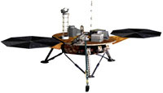
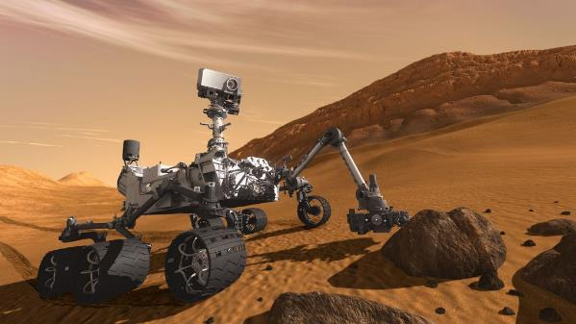
Phoenix, Insight, and Curiosity

Slide 9
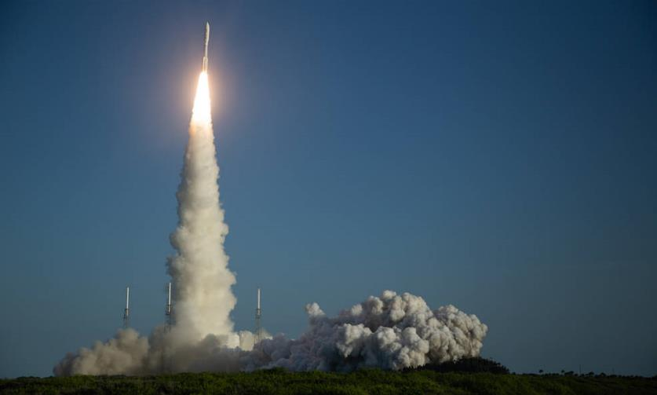
Mars 2020
https://eyes.nasa.gov/apps/orrery/#/sc_perseverance

Slide 10
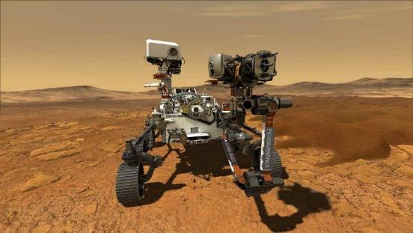
Perseverance
Notes:
On June 30, NASA provided the following public update on the Mars 2020 target launch date:
Due to launch vehicle processing delays in preparation for spacecraft mate operations NASA and United Launch Alliance have moved the first launch attempt of the Mars 2020 mission to no earlier than July 30. A liquid oxygen sensor line presented off-nominal data during the Wet Dress Rehearsal and additional time is needed for the team to inspect and evaluate. Flight analysis teams have expanded the mission launch opportunities to Aug. 15, and they’re examining whether the launch period may be extended further into August.
Mission objectives are:
Search for signs of ancient microbial life in a crater that billions of years ago might have been a body of water the size of Lake Tahoe.
Characterize the geology and climate of Mars
Help pave the way for human exploration beyond the Moon
Take samples to leave on the surface for return to Earth in a few years. First leg of a round trip to Mars.
Key points:
The Perseverance rover is the next mission in NASA’s storied Mars Exploration Program Perseverance joins a fleet that right now includes a rover, a lander and multiple spacecraft in orbit of the Red Planet.
This mission carries the most sophisticated instruments ever sent to Mars.
Perseverance addresses high-priority science goals for Mars exploration -- including key astrobiology questions about the potential for past life on Mars, what the environment was like billions of years ago, what might be preserved in the unique rocks of Jezero Crater, and what the environment is like today.
Mars 2020 is part of America’s larger Moon to Mars exploration approach, which includes astronaut missions to the Moon beginning in 2024 that prepare for human exploration of the Red Planet in the 2030s.
Perseverance will gather knowledge and demonstrate technologies that address the challenges of future human expeditions to Mars, including an oxygen-generating experiment and the first helicopter on another planet.
Perseverance is the beginning of the first round-trip to another planet. The rover will collect rock and soil samples for return to Earth by future missions.
The public will get to ride along. The mission has more cameras than any previous interplanetary mission, and two microphones for us to hear Mars for the first time.
The Perseverance name embodies the agency’s spirit in finding solutions to challenges, and the mission itself personifies the human ideal of persevering toward the future.

Slide 11
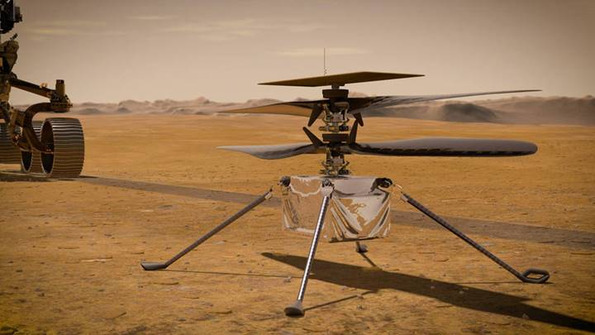
Ingenuity

Slide 12
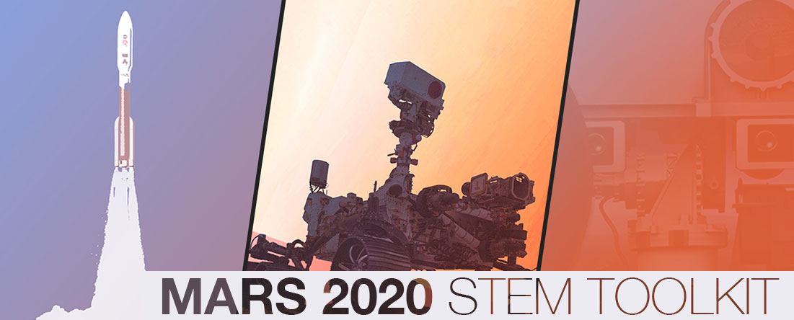
www.nasa.gov/stem/nextgenstem/moon_to_mars/mars2020stemtoolkit

Slide 13
Mission to Mars Student Challenge:
Participants will receive:
5-week education plan with mission related lessons and activities from NASA
Weekly newsletter with tips and resources related to the mission phase of the week
Video conversations with mission scientists and engineers highlighting how their work relates to what students are learning
Q&As with mission experts and submit student questions and work that could be featured during NASA broadcasts leading up to and on landing day.
Livestream events for students and educators during landing week (February 16-18, 2021)
https://www.jpl.nasa.gov/edu/mission-to-mars-student-challenge/

Slide 14

NASA STEM Stars
Webchat for students ages 13+
STEM Career, STEM Topic, NASA Mission
Highlights a STEM Activity for students
Q&A after interview for students
English and Spanish
https://www.nasa.gov/stem/nextgenstem/nasa-stem-stars/index.html

Slide 15
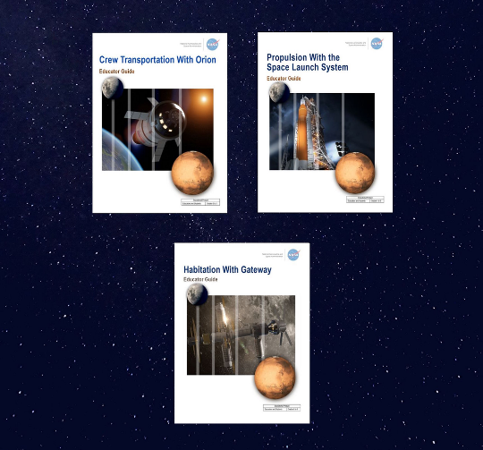
Educator Guides and More Challenges
https://www.nasa.gov/stem/nextgenstem/moon_to_mars/index.html

Slide 16
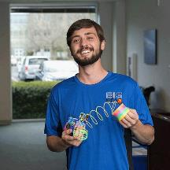
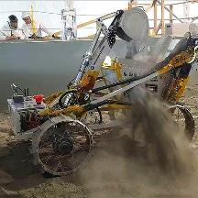
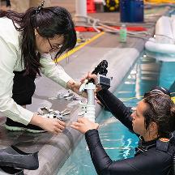
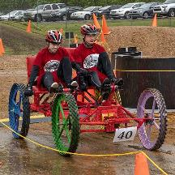
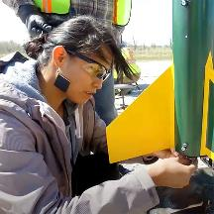
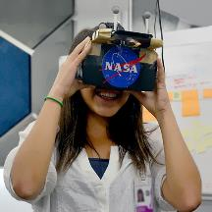
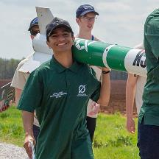
Artemis Student Challenges
Big Idea Challenge
Lunabotics
Micro-G NExT
Human Exploration Rover Challenge
First Nations Launch
SUITS
Student Launch
https://stem.nasa.gov/artemis/

Slide 17
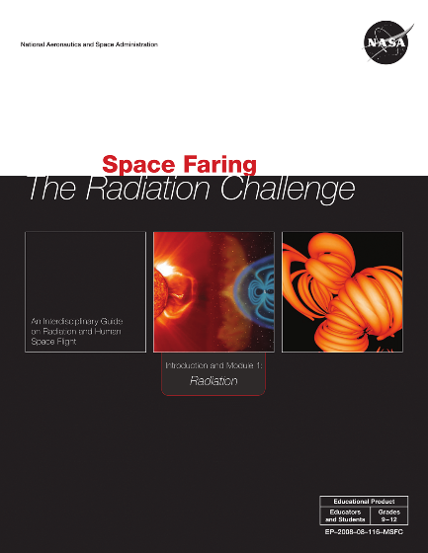
Radiation Challenge
Middle and High School Versions
Include Educator guides, Mulitmedia and videos
https://www.nasa.gov/stem-ed-resources/space-faring-radiation.html

Slide 18
Engineering Design Process

Slide 19

The 5 Hazards of Deep Space
https://www.nasa.gov/feature/5-hazards-of-human-spaceflight

Slide 20


Slide 21
Why are Shields important?
Protection from micrometeorites (can be seen)
Radiation (cannot be seen)
  Deadly
Other Examples (opportunity for CRT)?

Slide 22
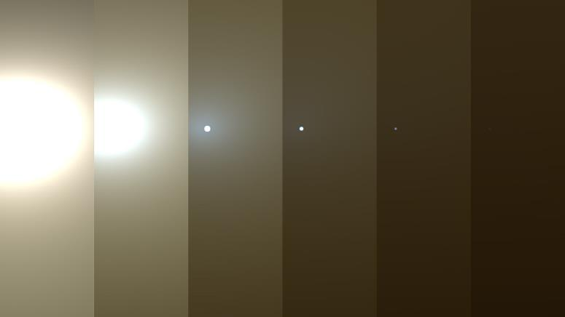
Mars Conditions

Slide 23
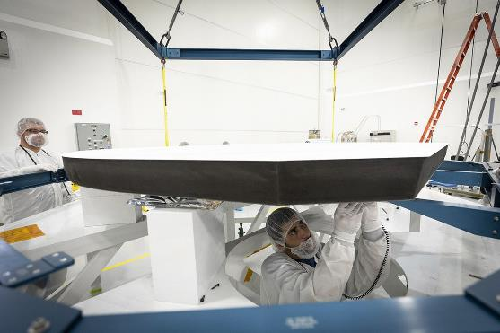
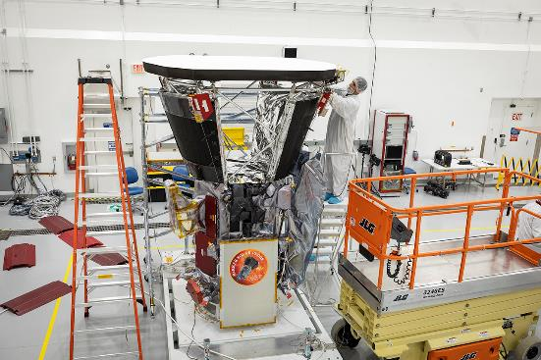
A Great Example: Parker Solar probe

Slide 24
Real World Connection:
Parker Solar Probe Specs
Shield must be light (160 pounds)
Two layers of carbon carbon composite
Thick core of foam
Withstand speeds in excess of 430,000 miles per hour
White coating to reflect sun’s heat
  Temps in excess of 2,500 degrees F
  Probe will stay at 85 degrees F

Slide 25
Group Roles
Project Manager- Ensures everyone is working as a team.
Materials Engineer- Suggests and gathers building materials.
Systems Engineer- Sketches or draws and labels design plan.
Data Specialist- Records accurate data from trial testing.

Slide 26
Objective
Analyze different materials to simulate space radiation on a space craft
Select the best material to build a spacecraft
Justify choices
Collect data
Develop conclusions
Apply findings to a real life application

Slide 27

Materials
Each team:
  Scales
  Rulers
  Flashlight, or….
  Various Materials: Smith’s Big Box of Cr…Stuff

Slide 28
Safety
Don’t look directly at flashlight
Don’t shine the light in your friend’s eyes either
Wear safety glasses

Slide 29
Steps
Make hypothesis (Don’t skip this bit)
Weigh materials
Test materials
Record material amounts (mass) it took to block out the light
Repeat test with all types of materials

Slide 30

Observations

Slide 31
Share out
Take the time to let students process verbally
Encourage discussion
Cooperation vs. Competition

Slide 32
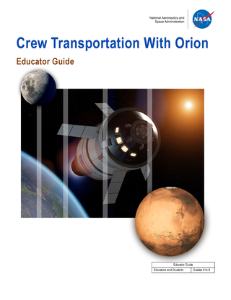

National Aeronautics and Space Administration
Use geometry to find the area of the vertical and horizontal cross sections of a crew module.
Construct and test a model of a target docking system and crew module.
Design a heat shield to protect the contents of a crew module during a simulated atmospheric reentry.
Design and build a crew module model that will secure two 2-cm astronaut figures during a drop test.
https://www.nasa.gov/stem-ed-resources/transportation.html

Slide 33
Standards Addressed
Engineering Design
MS-ETS1-1. Define the criteria and constraints of a design problem with sufficient precision to ensure a successful solution taking into account relevant scientific principles and potential impacts on people and the natural environment that may limit possible solutions.
MS-ETS1-2. Evaluate competing design solutions using a systematic process to determine how well they meet the criteria and constraints of the problem.
MS-ETS1-3. Analyze data from tests to determine similarities and differences among several design solutions to identify the best characteristics of each that can be combined into a new solution to better meet the criteria for success.
MS-ETS1-4. Develop a model to generate data for iterative testing and modification of a proposed object, tool, or process such that an optimal design can be achieved.

Slide 34
NGSS Continued
Science and Engineering Practices
Asking questions and defining problems
Developing and using models
Planning and carrying out investigations
Analyzing and interpreting data
Using math and computational thinking
Constructing explanations and designing solutions
Engaging in argument from evidence
Obtaining, evaluating, and communicating information

Slide 35
Performance Indicators
Critical thinking, problem solving, and decision making
a. Identify and define authentic problems and significant questions for investigation
b. Plan and manage activities to develop a solution or complete a project
c. Collect and analyze data to identify solutions and/or make informed decisions
d. Use multiple processes and diverse perspectives to explore alternative solutions

Slide 36
The Engineering Design Challenge
Teams of up to four students will design and build a CEV model that can safely transport two astronauts on a mission to the Moon, Mars, or other destinations in space.
A drop test will determine how well the CEV will protect the astronauts during landing. During the drop test, the CEV will be deployed, or dropped, from a height of at least three meters to simulate landing.
The astronauts must stay securely in their seats during the drop test. It must also have an internal tank for fuel.

Slide 37
Criteria
The CEV must meet the following criteria and constraints:
The CEV must carry two astronauts safely. Each astronaut is 3- to 7-cm long.
You must design and build secure seats for both astronauts.
The astronauts should stay in their seats during each drop test without being glued or taped in place.
The CEV must have one hatch that opens and closes, and is sized so that your astronauts can enter or exit easily.
The hatch should remain closed during all drop tests.
The CEV must have a radiation shield based on your earlier work.
The CEV must fit within the provided oatmeal tin. (This item serves simply as a size constraint. The CEV should not be stored in or launched from this item.)
The CEV must include a model of an internal holding tank for fuel with a volume of 30 cm3 (Note: Your tanks will not actually be filled with a liquid.)
The total mass cannot exceed 100 grams.

Slide 38
Identify Your Materials:

Slide 39
The Process:
Allow time for each step
Difference between a fun activity and on that creates understanding

Slide 40
Get Your Design Approved:

Slide 41
Budget Planning:
Support:
• Use one cost (i.e., every material is $0.25)
Complexity:
• Have students use the Internet to determine realistic costs for the materials they are using
• Item costs can be raised (budget increase) or lowered (budget cut)

Slide 42
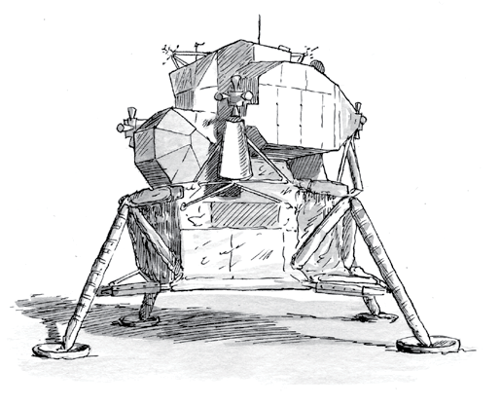
Touchdown
https://www.jpl.nasa.gov/edu/teach/activity/touchdown/

Slide 43
Education Standards
National Council of Teachers of Mathematics Standards (Grades 3-8)
  Problem Solving
    Build new mathematical knowledge through problem solving
    Solve problems that arise in mathematics and in other contexts
    Apply and adapt a variety of appropriate strategies to solve problems
  Measurement
    Understand measurable attributes of objects and units, systems, and processes of measurement
    Apply appropriate techniques, tools, and formulas to determine measurements

Slide 44
Curriculum Connections
  Potential and kinetic energy — When the lander hits the surface, its motion (kinetic) energy is changed into stored (potential) energy, which gets stored in the shock absorbers.
  Acceleration due to gravity — The lander accelerates (speeds up) as it falls due to Earth’s gravitational pull.
  Air resistance — Air exerts a force on the lander as it falls, slowing it down.
  Measurement — Kids measure the various heights from which they drop the lander.

Slide 45
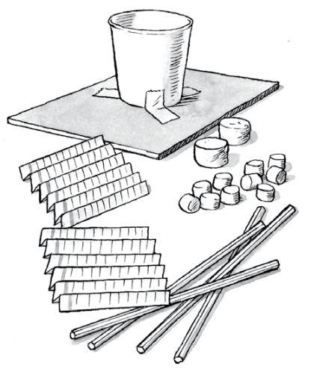
The Design Challenge
WE CHALLENGE YOU TO:
Design and build a shock-absorbing system that will protect two “astronauts” when they land.
CEV with landing “gear” must weigh no more than 150 grams.

Slide 46
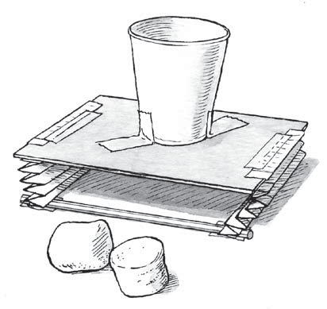
What to Avoid:
Cabin (paper cup)
Platform (cardboard)
Spring
(folded index card)
astronauts
(marshmallows)

Slide 47
Test, Evaluate, & Redesign
Ready to test? Drop your lander from a height of one foot (30 cm). If the “astronauts” bounce out, figure out ways to improve your design. Study any problems and redesign. For example, if your spacecraft:
Tips over as it falls through the air — Make sure it’s level when you release it. Also check that the cup is centered on the cardboard. Finally, check that the weight is evenly distributed.
Bounces the astronauts out of the cup — Add soft pads or change the number or position of the shock absorbers. Also, make the springs less springy so they don’t bounce the astronauts out.

Slide 48
Questions to Consider
What forces affected your lander as it fell?
After testing, what changes did you make to your lander?
Engineers’ early ideas rarely work out perfectly. How does testing help them improve a design?
What did you learn from watching others test their landers?
The Moon and Mars are covered in fine dust and dirt. How might this be an advantage? A disadvantage?

Slide 49
Extensions
Hold a “How High Can You Go” Contest. Have kids drop their landers from two feet. Eliminate all landers that bounce out their “astronauts.” Or Try three marshmallow astronauts.
Test Springs of different sizes. Have kids see if the number of folds in an index card makes a difference in the amount of force the spring can absorb

Slide 50
Find Out More
Explore more about engineering. The following Web sites offer fun projects, videos of engineers doing innovative work, and videos of real-world STEM connections:
NASA eClips at www.nasa.gov/audience/foreducators/nasaeclips
NASA E.D. Challenges at www.edc.nasa.gov
Engineer Your Life at www.engineeryourlife.org
Discover Engineering at www.discoverengineering.org
Design Squad at www.pbs.org/designsquad

Slide 51
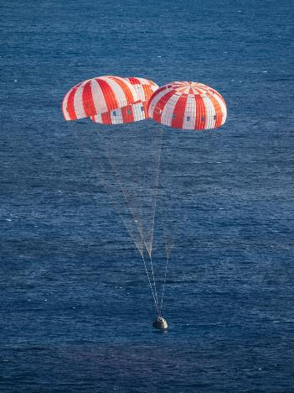
Parachute Challenge

Slide 52
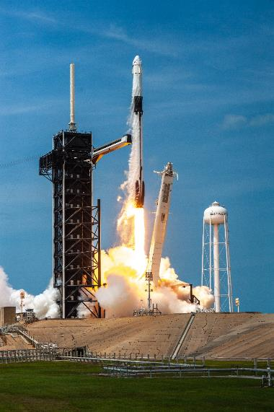
Crew-1 STEM Mission Toolkit
Calling all teachers, parents and students of the Artemis Generation! Share your excitement on the next Commercial Crew Program milestone by using these classroom and at-home educational resources. Watch the #LaunchAmerica
mission on NASA TV Live.
https://go.nasa.gov/CCPLaunchKit

Slide 53
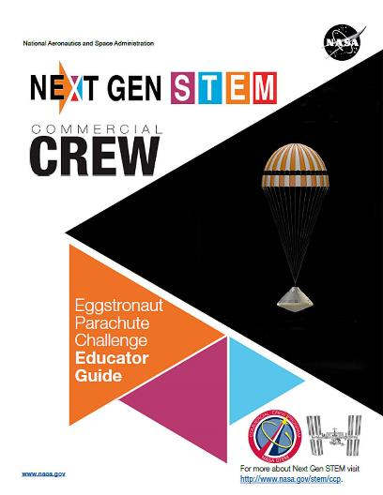
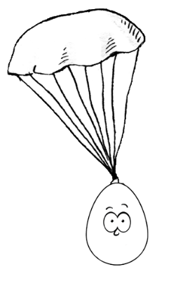
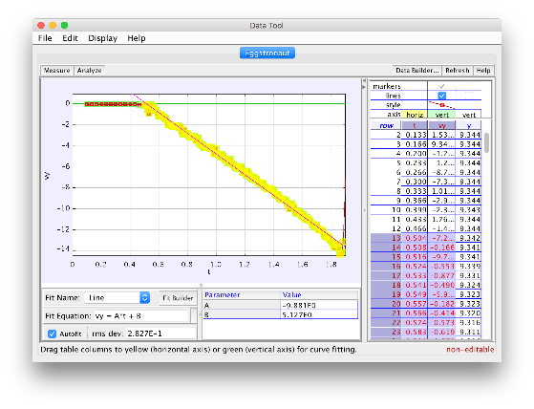
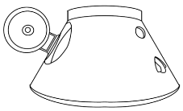
Egg-stronaut
https://www.nasa.gov/stem-ed-resources/eggstronaut-parachute-challenge-educator-guide.html

Slide 54
Design Challenge
In teams of 3-4 you must design and build an Orion crew spacecraft with a parachute system that will allow the module to descend at a rate of 1 meter per second.
The spacecraft must safely land two astronauts. The crew must not fall out of the capsule.
Your team must sketch your plans before you begin constructing your spacecraft.
Your design must be approved by an adult before your team can begin building.
Final design must remain under 150 grams.

Slide 55
Budget Constraints
Wax Paper - $10,000 / 30cm
A Foil – $15,000 / 30cm
Plastic wrap - $15,000 / 30cm
Baking cup - $5,000 each
String - $5,000 / 30cm
Tape $1000 / 10cm
Paper clips - $1000 for small each $2000 large each
Styrofoam cups - $5000
Paper roll $5000
Mass measurement fee - $5,000 one time fee
Test fee – $10,000

Slide 56
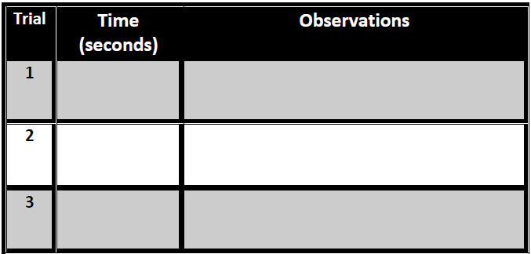
Record Your Data

Slide 57
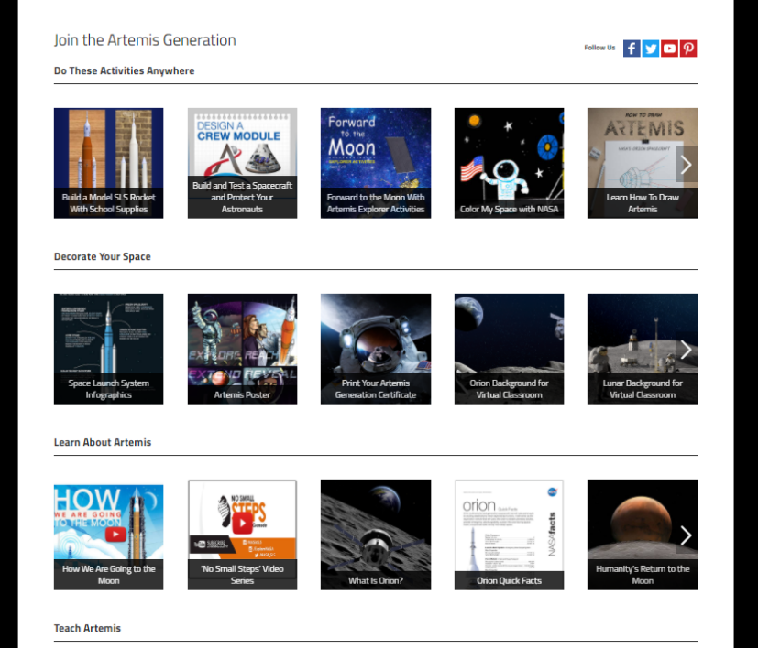



@NASAArtemis
@NASAArtemis
@nasaartemis
nasa.gov/joinartemis
STAY UPDATED!
NASA Express
nasa.gov/stem/express

Slide 58
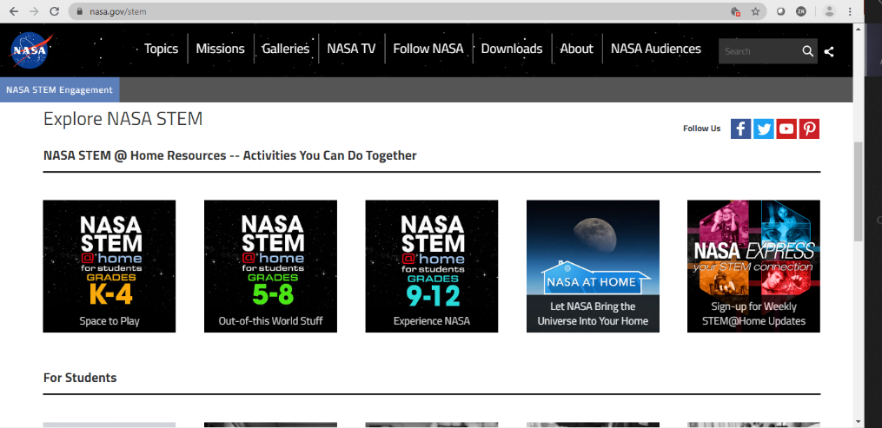
NASA.GOV/STEM

Slide 59


Digital Learning Opportunities: https://www.txstate-epdc.net/
Badges
Webinars
Notes:
NASA’s Educator Professional Development Collaborative (EPDC) is supporting Next Gen STEM with online badging for students and educators along with educational webinars correlated with the three pilot themes. The badges will highlight some of the activities we’ve shared with you as well as careers at NASA.

Slide 60


Website / Blogs / Social Media
BLOGS
Notes:
https://www.nasa.gov/exploration/commercial/crew/index.html
Facebook: https://www.facebook.com/NASACommercialCrew
Twitter: https://twitter.com/Commercial_Crew
Flickr: https://www.flickr.com/photos/nasakennedy/sets/72157647244171004
Blogs: https://blogs.nasa.gov/commercialcrew/

Slide 61

www.txstate-epdc.net
What an honor it has been to be with you today!
Thank you !
Steven C. Smith, MIPM
NASA EPDC Education Specialist
Johnson Space Center
steven.c.smith@nasa.gov
Twitter: @NASASTEMEducate

