Slide 1
NASA Missions: Primary Source Documents Bringing the Past to Life Anchored at the Intrepid Sea, Air & Space Museum

Slide 2
Presenters
Michael Stevens, Intrepid Museum
Gerrie Bay Hall, Intrepid Museum
Meghan Jacquot, Yeshiva of Greater Washington

Slide 3
Intrepid Museum Education
www.intrepidmuseum.org/education/pre-k-12-school-programs
Notes:
Our education programs are designed to provide meaningful and engaging experiences that leverage the Museum’s collection—a unique resource in the study of history, science and technology—for students in and out of school, teachers, adults and families. We engage learners of all ages and abilities with the lessons of the past in order to understand the present and envision the future. We offer resources for students and teachers in virtual space. We also offer teen, community, and programs for individuals with special needs.

Slide 4
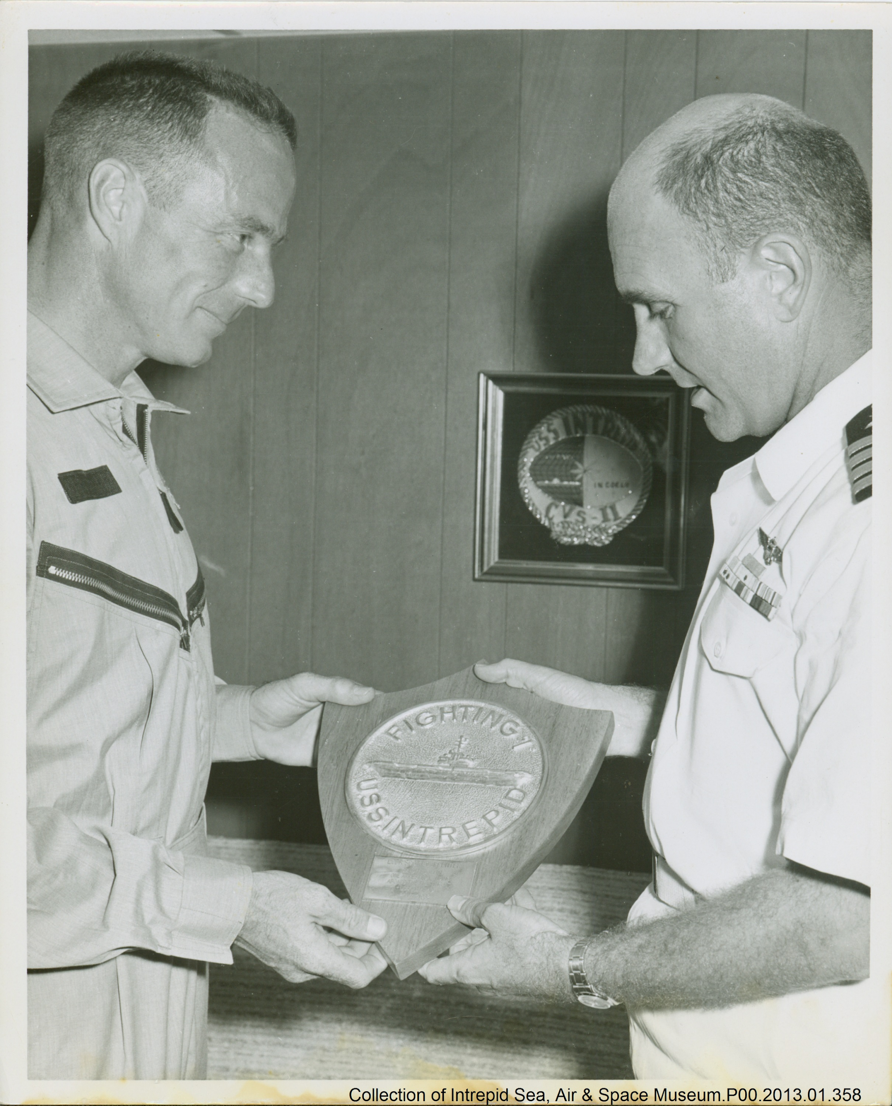
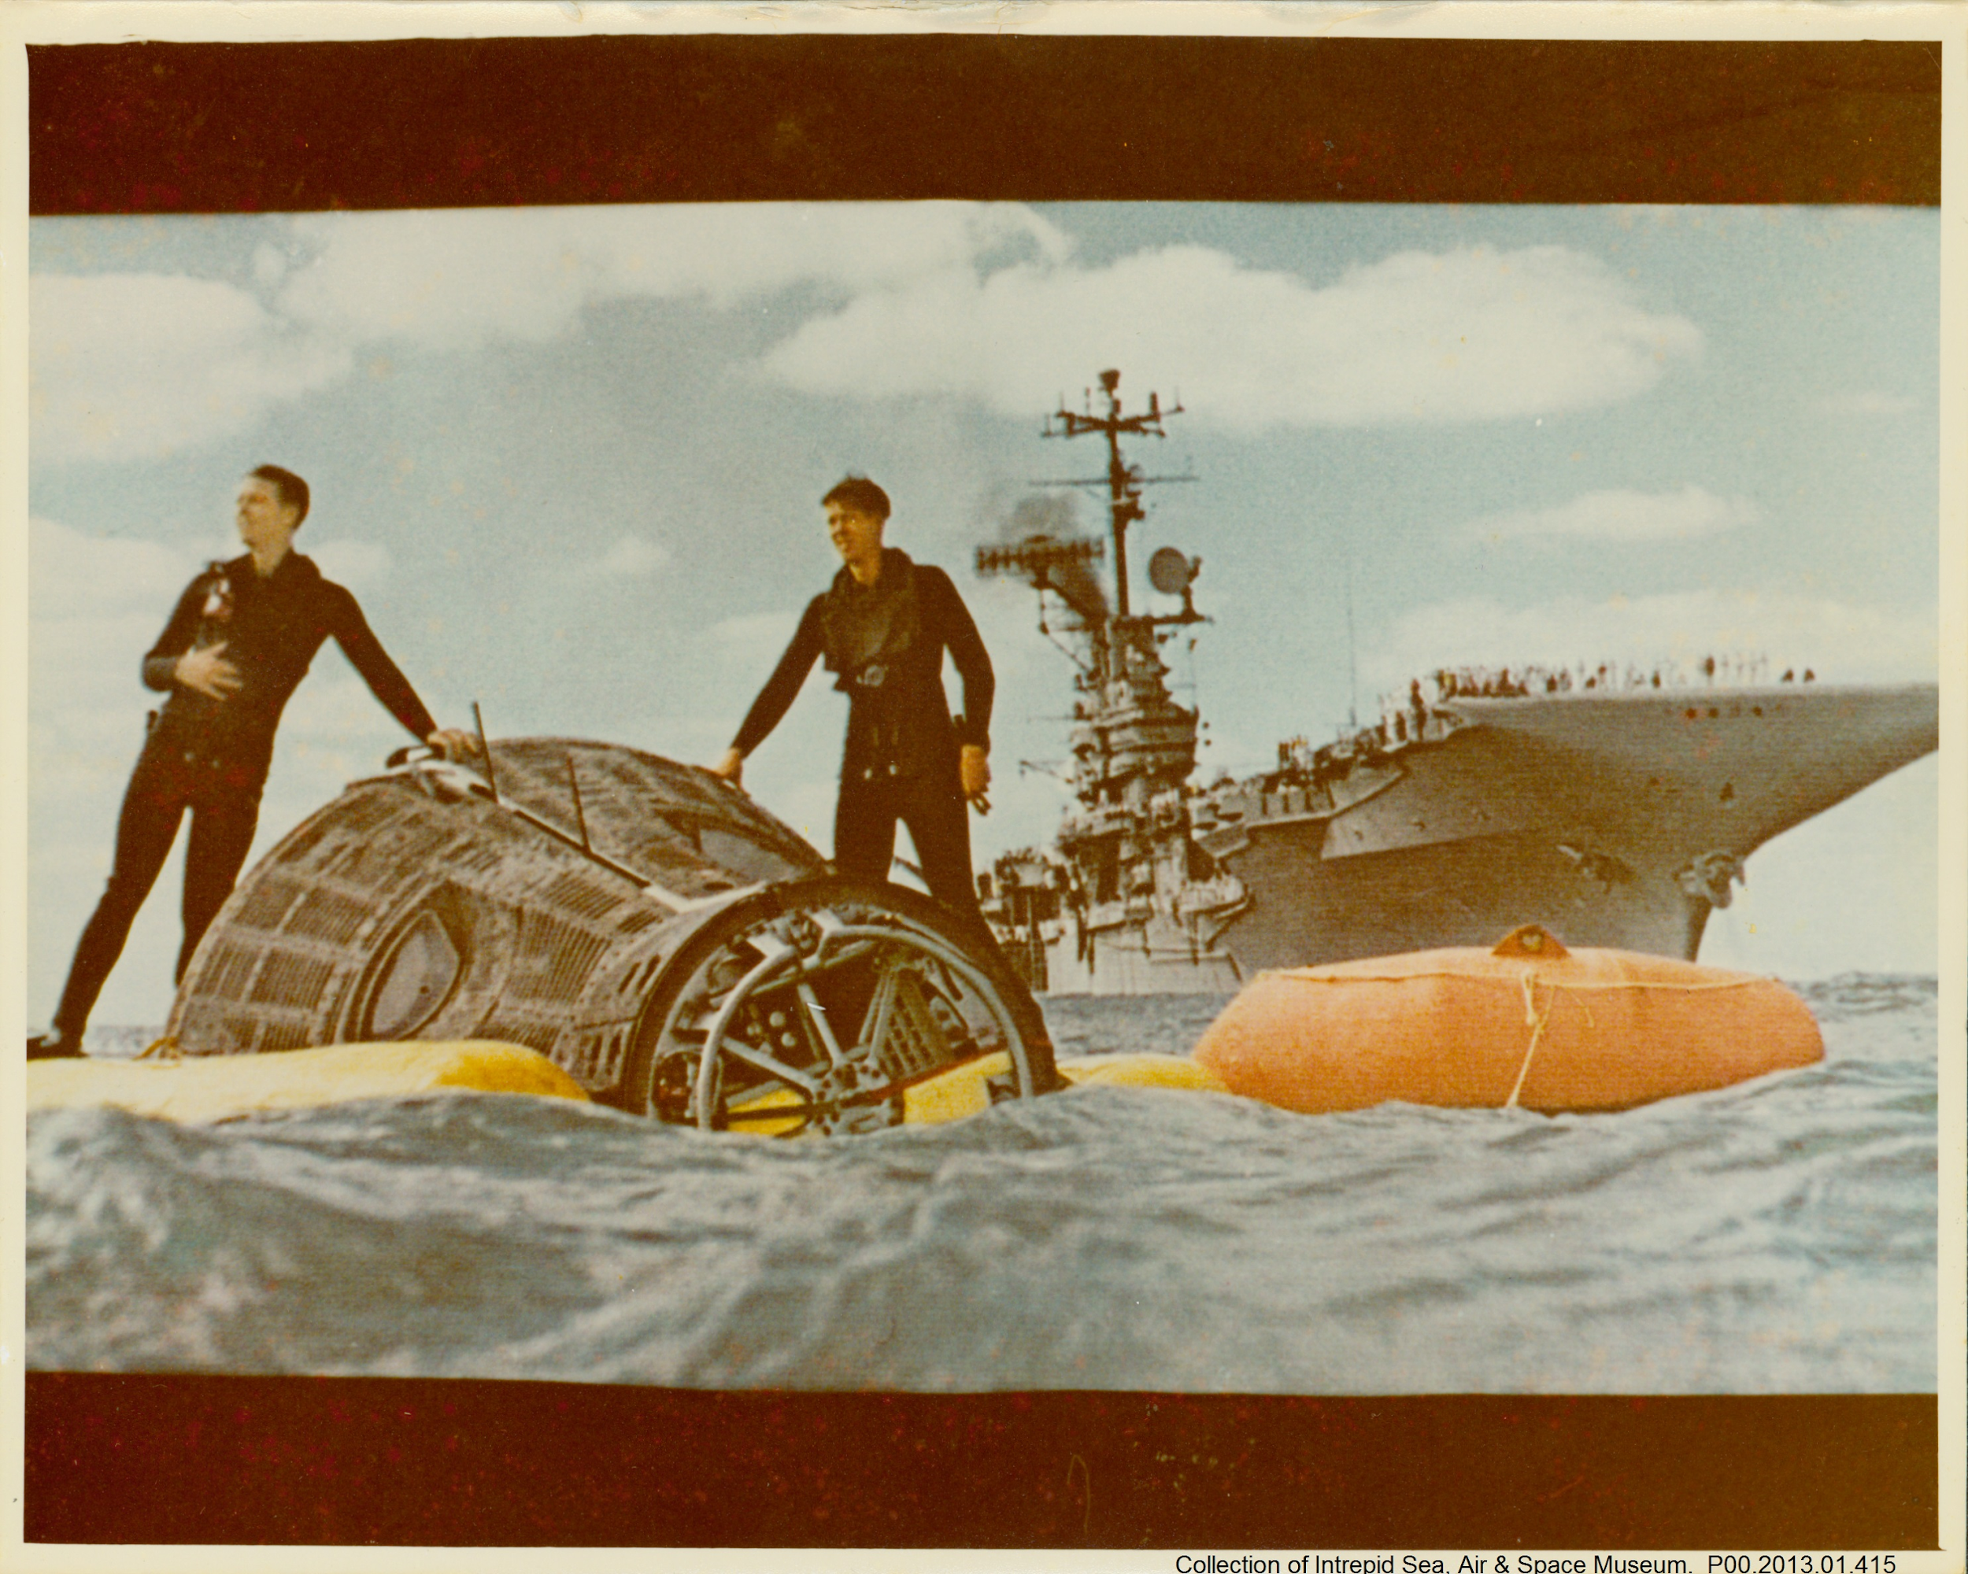
Intrepid’s NASA Connection
Plop in pictures from Mercury + Gemini

Slide 5
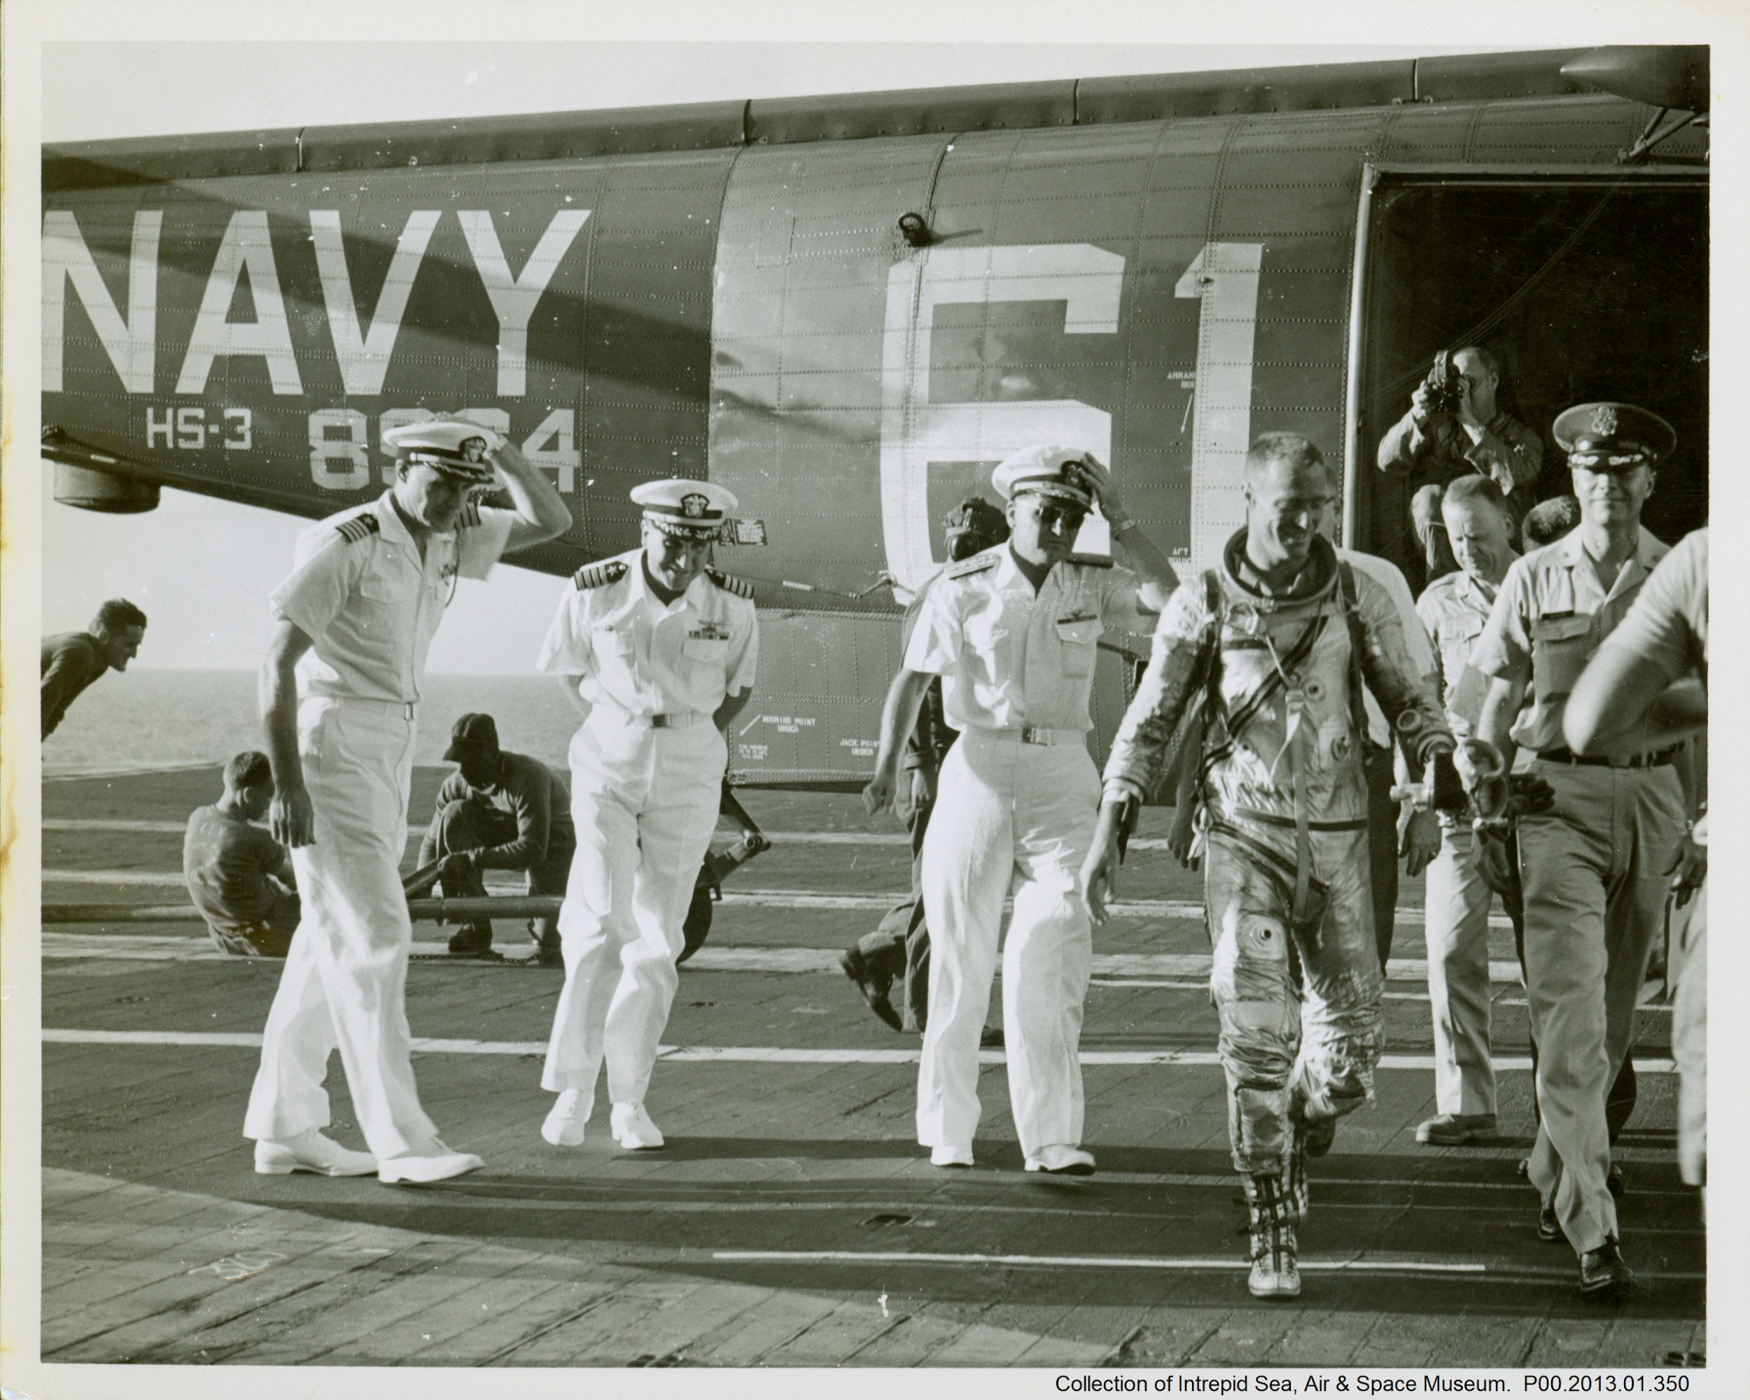
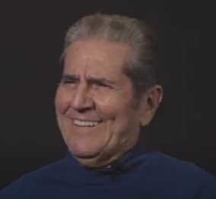
NASA Missions: Primary Source Documents Bringing the Past to Life
Add still of scott carpenter here
Add still of John Here
Notes:
Play 31:27-33:15, Click on Optimize before, and Click off Optimize immediately after

Slide 6
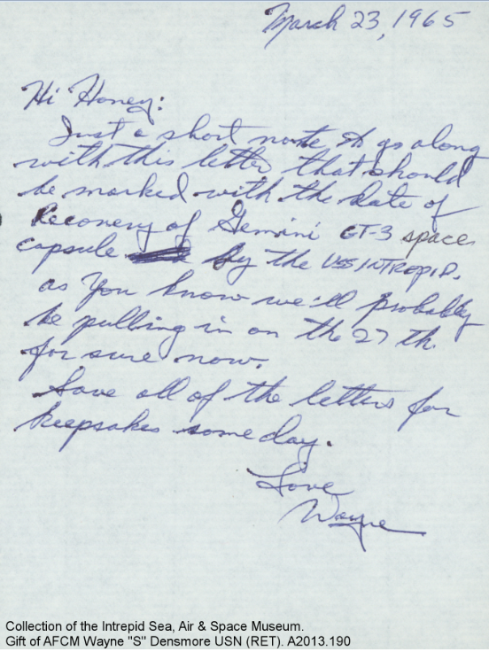
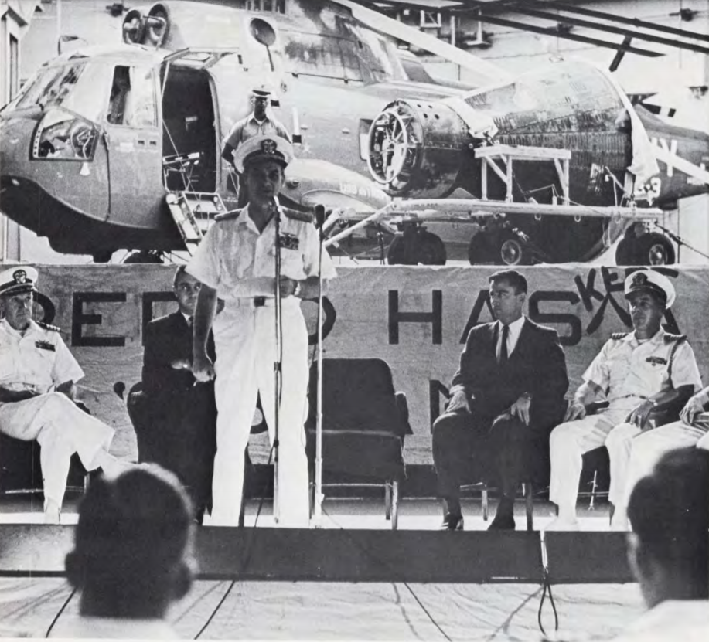
Resources at Intrepid Museum
Digital Collection
Archive Space
Add in pictures from archival materials
And look at a few docs…
Add in picture from archive space

Slide 7
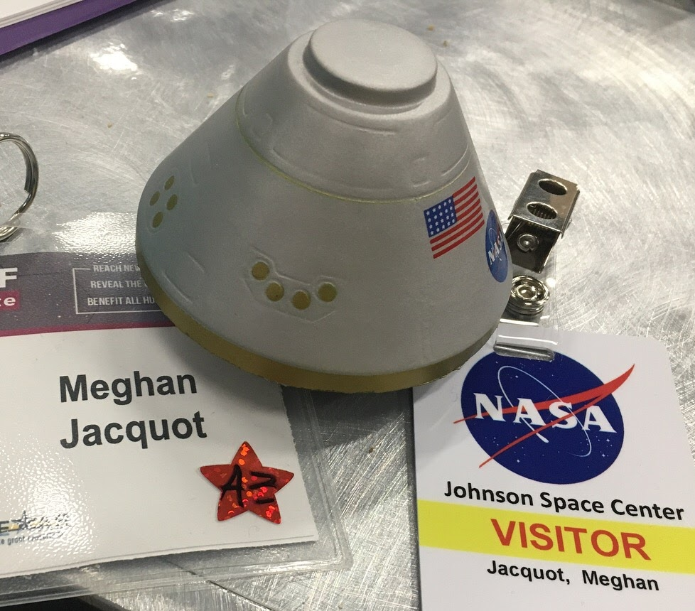
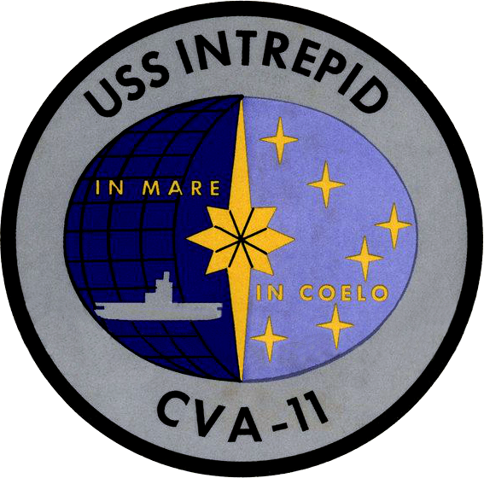
Practitioner’s Experience
Attended National Endowment of the Humanities program with USS Intrepid virtually - Summer of 2020
End product: Created a Unit based on Archival research that focused on STEM Design and connections to history - including historic NASA Missions
Unit Plan Visual
Unit Plan Document

Slide 8
Archives in the Classroom
In small groups, let’s explore two more archives and discuss how to use them in your individual classroom
National Archives
https://www.archives.gov/space
NASA | History - Finding Aids
https://history.nasa.gov/finding_aids.html
Notes:
Michael discuss, Meghan setting breakout rooms

Slide 9
Resources & Reflections
Wakelet with Websites Wakelet Resources
NASA Padlet for reflections NASA Padlet
National Archives Padlet for reflections National Archives Padlet
Notes:
Michael

Slide 10
Archives in the Classroom
What did you find?
How can archival materials be used in a science classroom?
How do we adapt for MLL learners or students with special needs?
Other considerations!
Notes:
All three

Slide 11
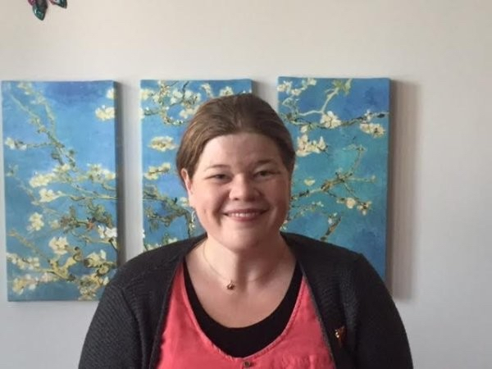
Contact Us!
Michael Stevens
Museum Educator
mstevens@intrepidmuseum.org
Gerrie Bay Hall
Director, School & Teacher Programs
ghall@intrepidmuseum.org
Meghan Jacquot
STEM & Humanities Educator
mjacquot@yeshiva.edu
https://www.linkedin.com/in/meghan-jacquot-carpe-diem/

