Slide 1

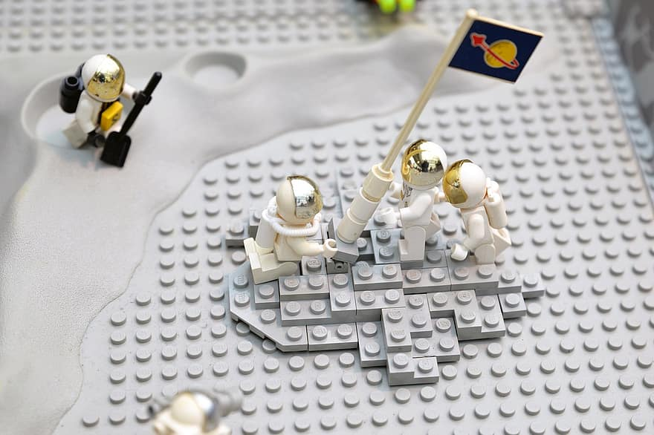
Red Rover, Red Rover, Teachers Come On Over!
Lego WeDo 2.0 Robotics
Dorinda Risenhoover
Education Coordinator
NASA Oklahoma Space Grant Consortium/
NASA EPSCoR
Cell: 405-314-9161
Office: 405-744-9701
Doris Biegler
Technology Trainer
Lawton Public Schools
580-713-4207 X2127

Slide 2


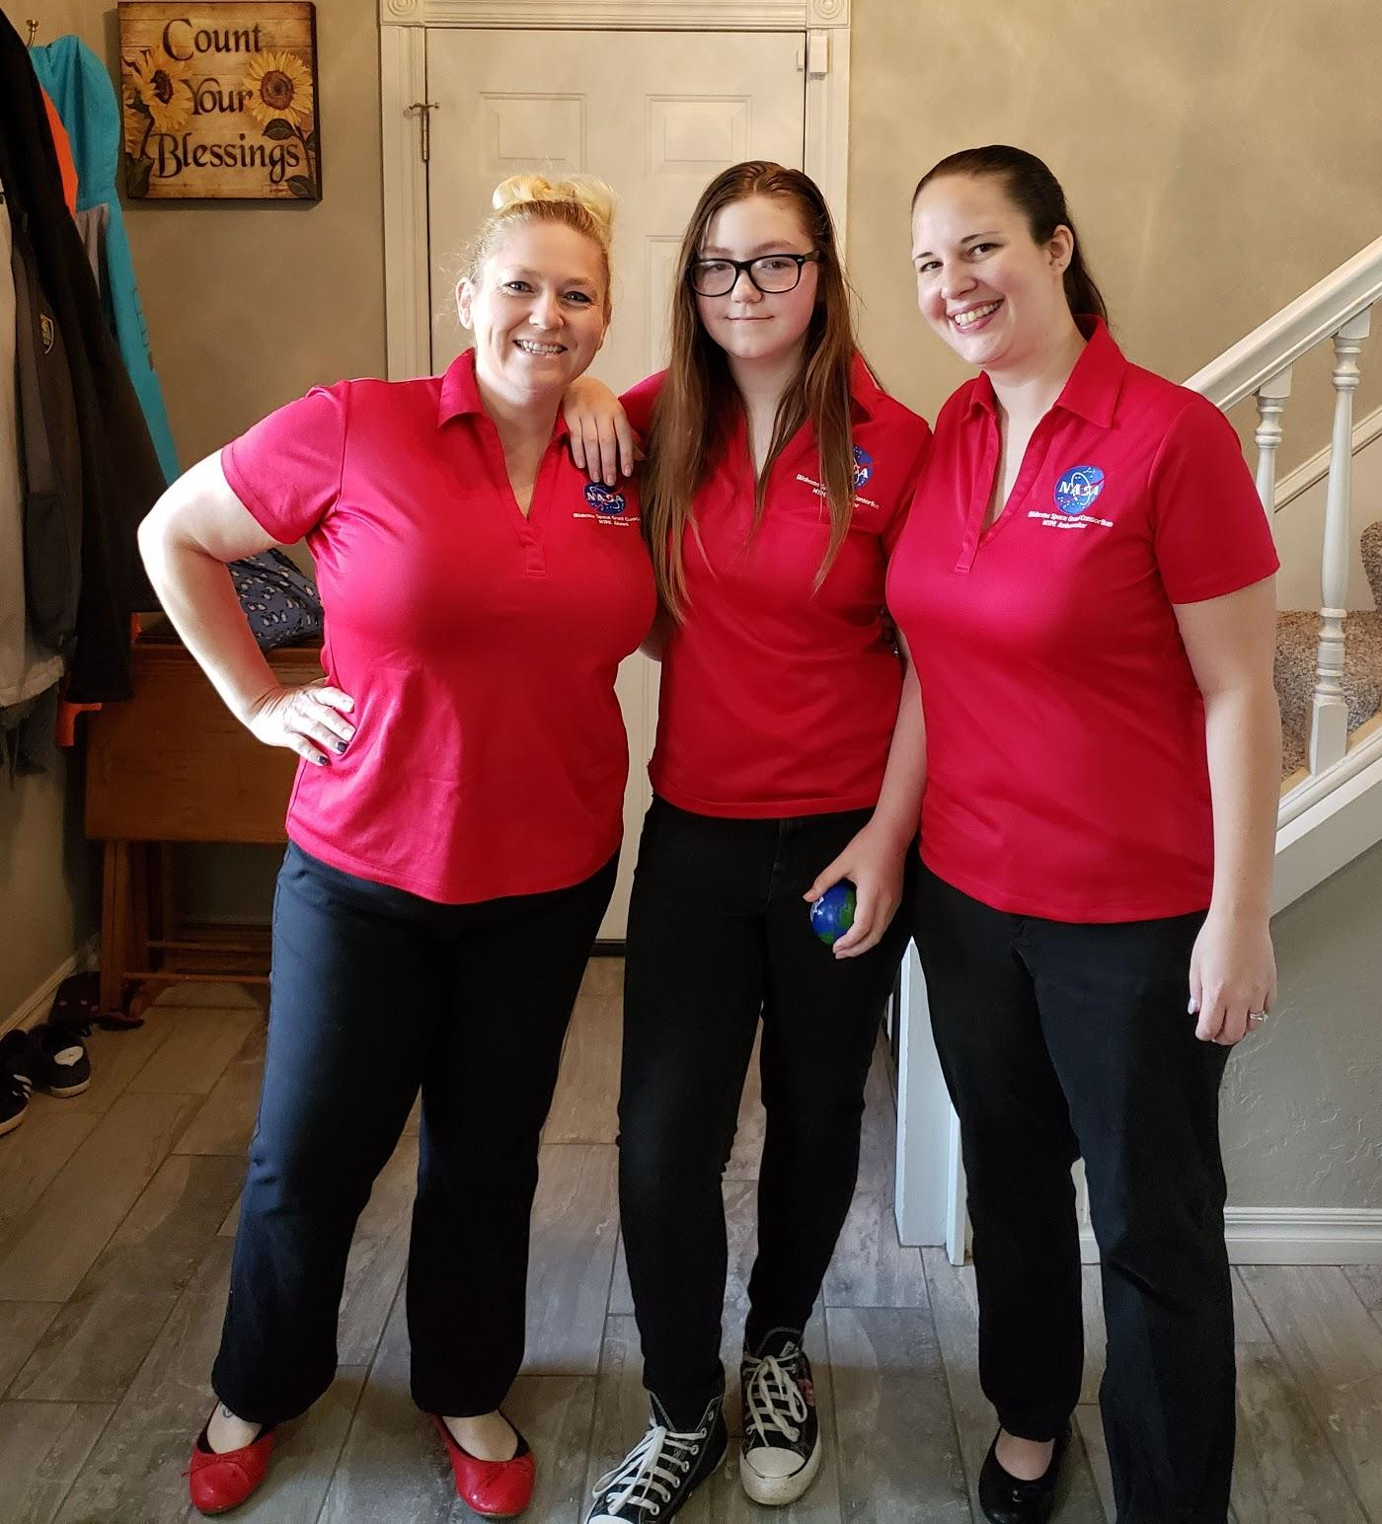

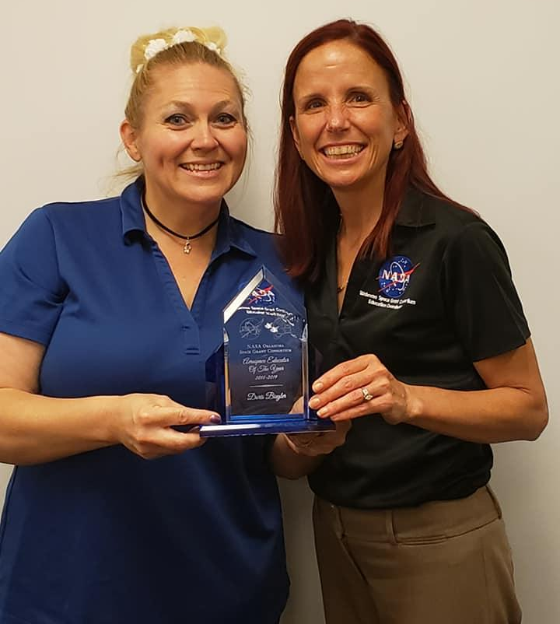
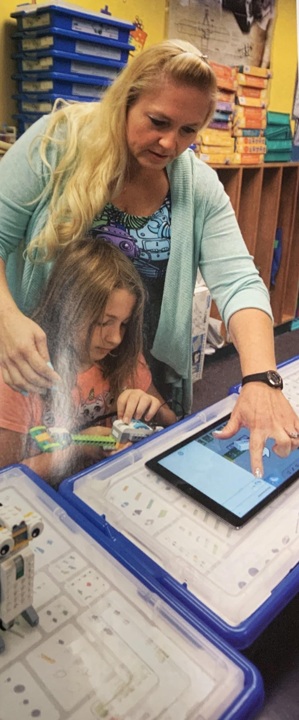



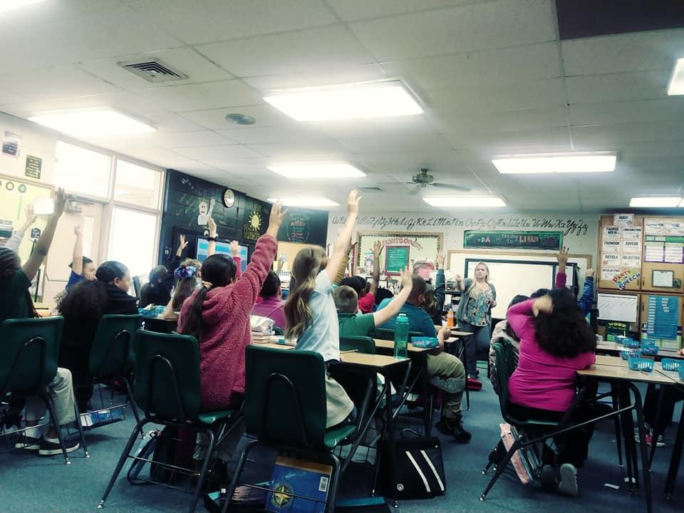



A little about me
Notes:
Where I work, what I do
Involvement with NASA OSG
Solar System Ambasador
Sphero Lead teacher
FAA ACE Camp
Kami Hero

Slide 3



Slide 4
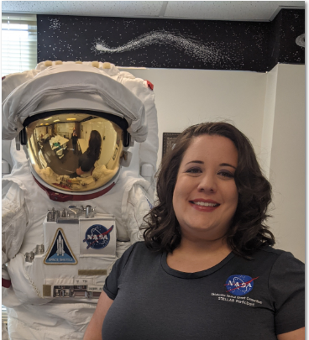
Eden Cook
NASA OKSG STELLAR Class of 2020-2021 Participant
Senior at The University Of Oklahoma
Majoring in Secondary Education

Slide 5

Alexis Cormier
NASA OKSG STELLAR Class of 2020-2021 Participant
Senior at Southern Nazarene University
Majoring in Mathematics Education

Slide 6


Slide 7


Slide 8


Slide 9
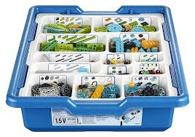
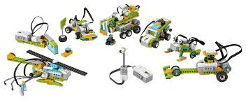
A Little About Lego WeDo 2.0
Cost: 214.00 (set)
WeDo 2.0 combines LEGO elements with intuitive block-based coding and standards-aligned lesson plans that make STEAM learning fun and accessible.
Notes:
Where you can buy them
Cost is around 215.00 (kit) Best used with 2 students per kit

Slide 10

Teacher tools

Slide 11


Slide 12


Slide 13


Slide 14


Slide 15
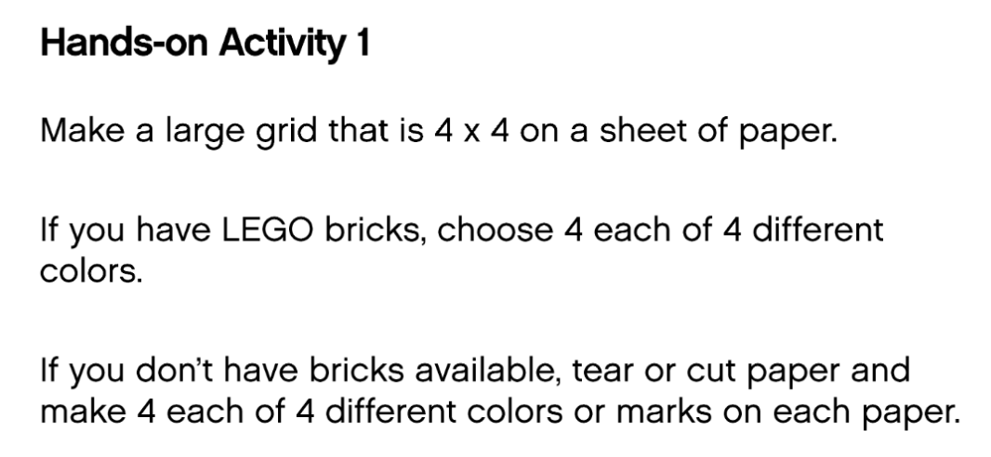

Slide 16


Slide 17
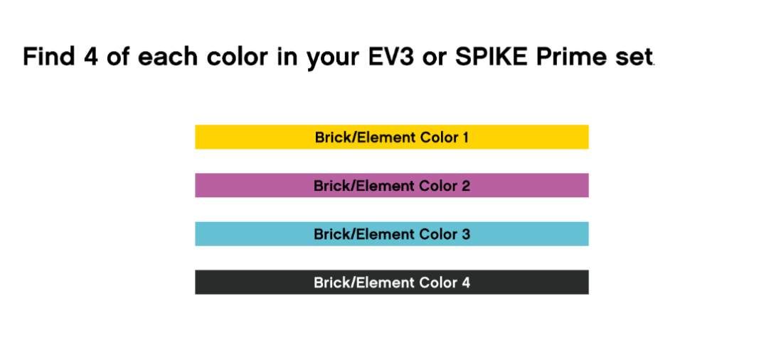
You can use color paper or if you have lego brick you may use them.

Slide 18
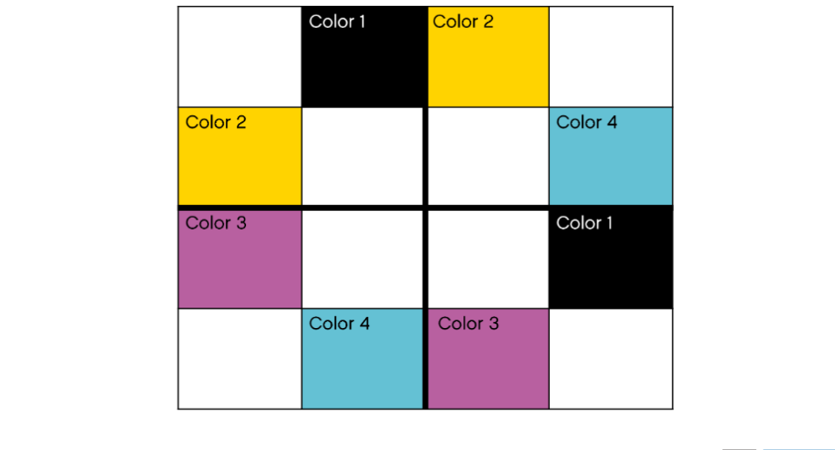
Set up your color bricks or paper pieces like you see them here.

Slide 19
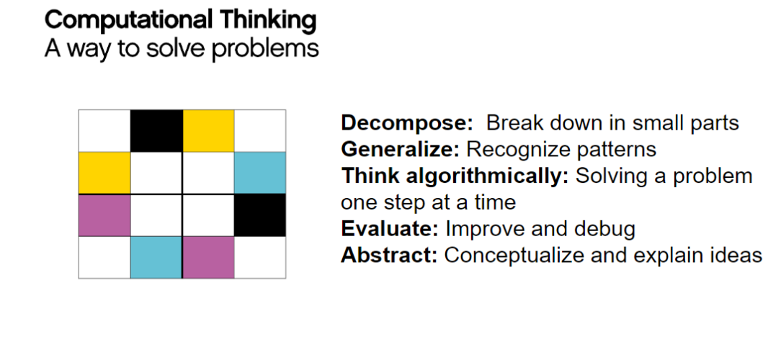

Slide 20
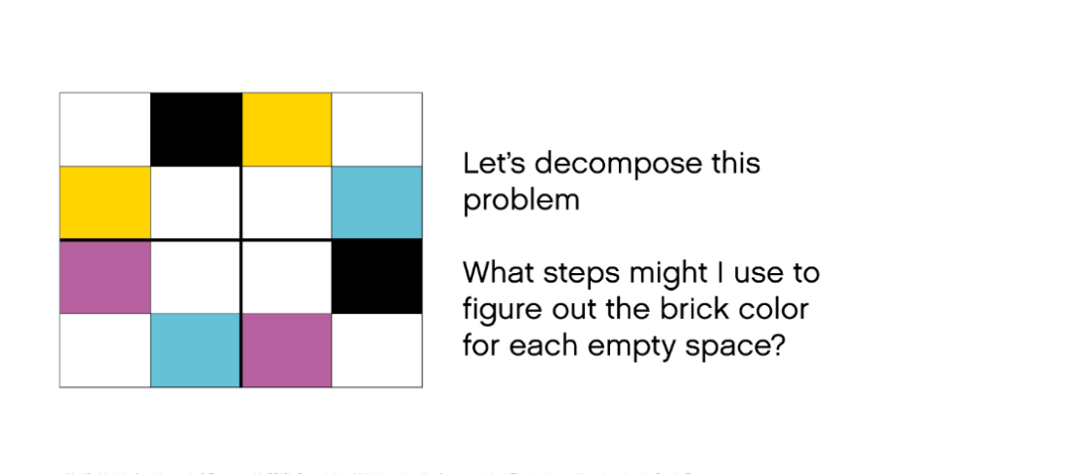

Slide 21
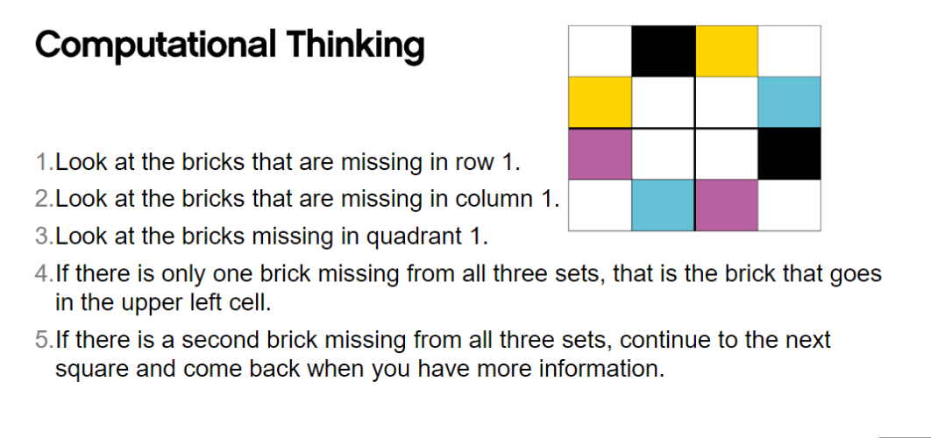

Slide 22
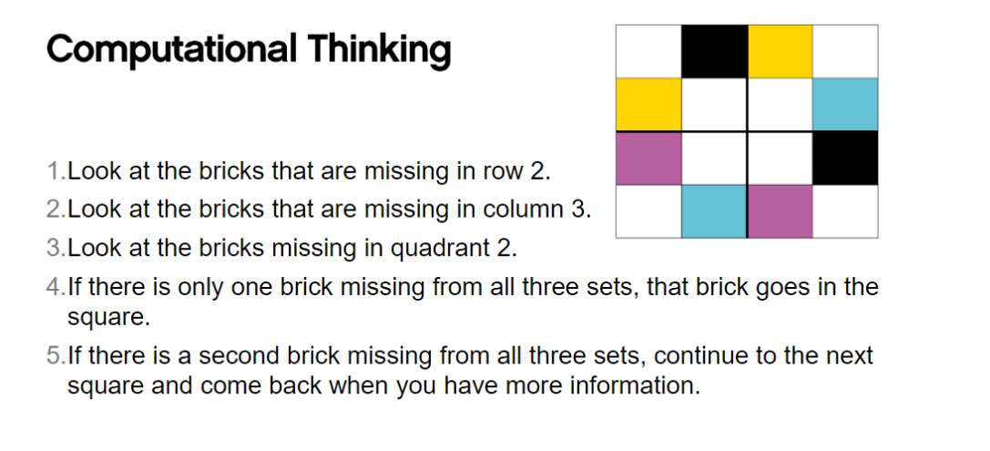

Slide 23
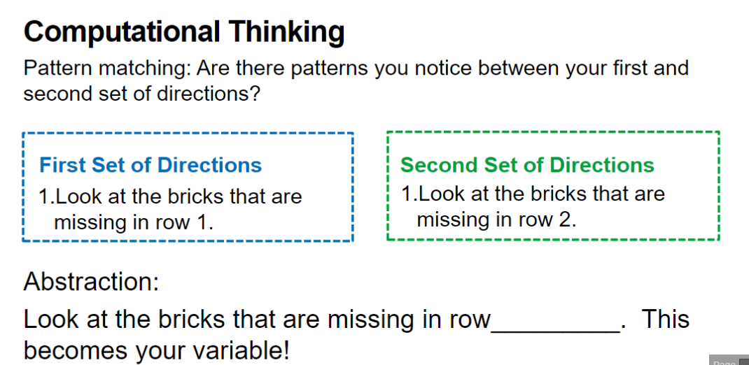

Slide 24
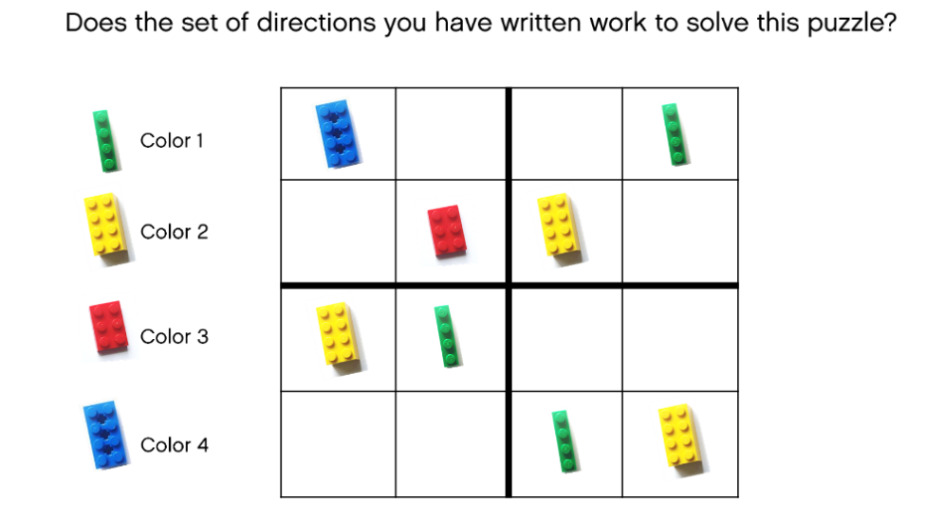

Slide 25


Slide 26
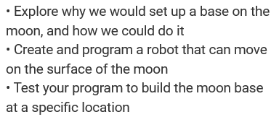
Objectives:

Slide 27
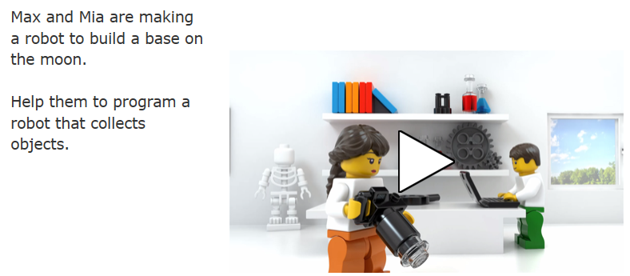

Slide 28
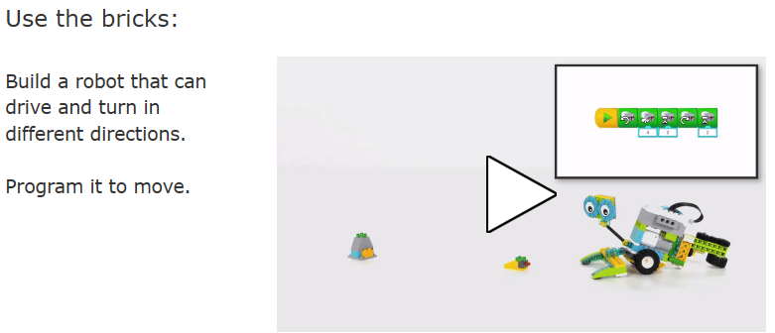

Slide 29
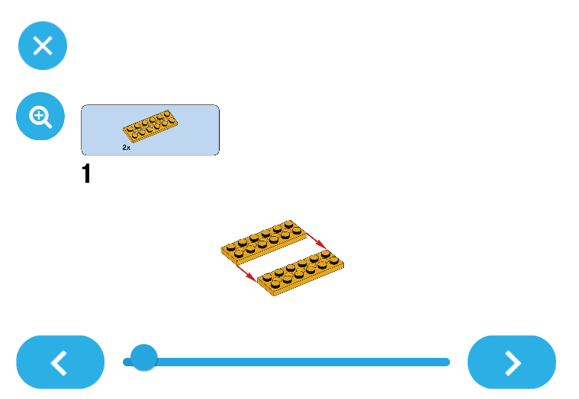

Slide 30
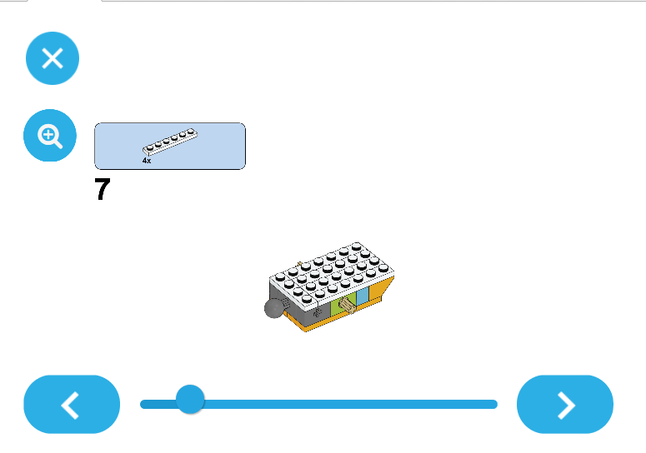

Slide 31
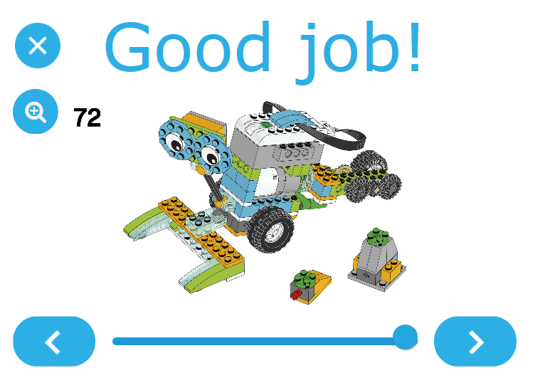

Slide 32
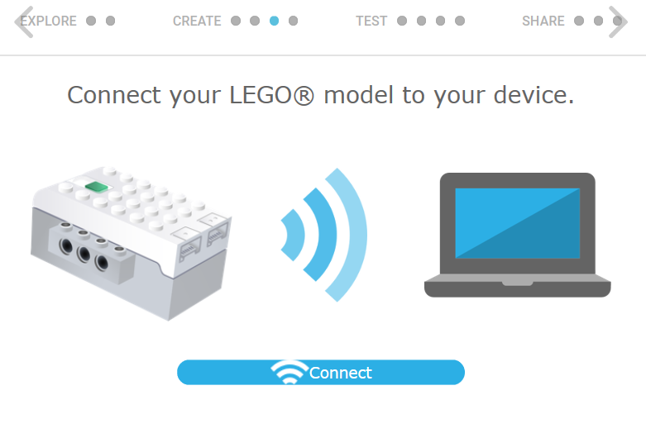

Slide 33
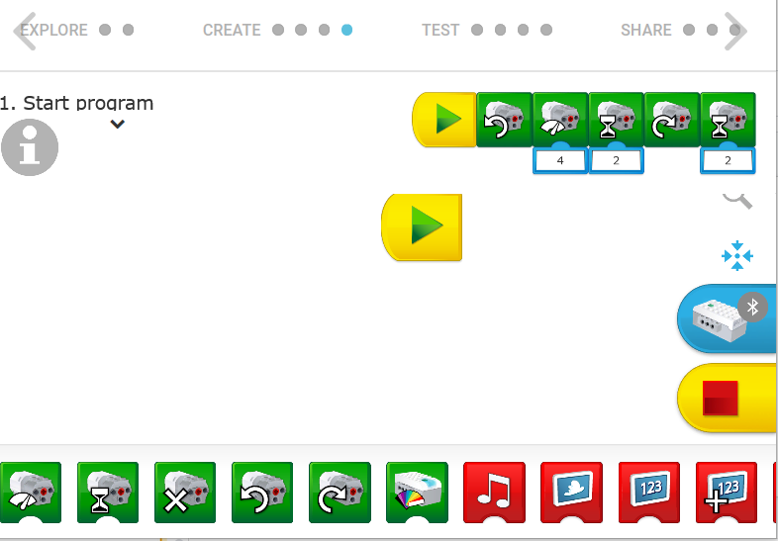

Slide 34
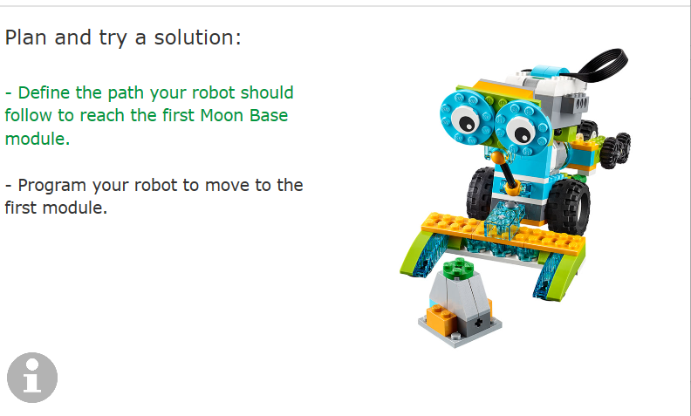

Slide 35
Now you create a code
Then
Send me your code
Google Jamboard SEEC 2021

Slide 36
Closing and Questions:
You don’t have to be in a classroom to teach robotics, there are ways to teach compositional skills virtually.
Lego WeDo 2.o Kits
Prices: 224.95 (Lego Website)
Options
Donors Choose
Foundation Grants
PTA/PTO
Sponsorship

