Slide 2
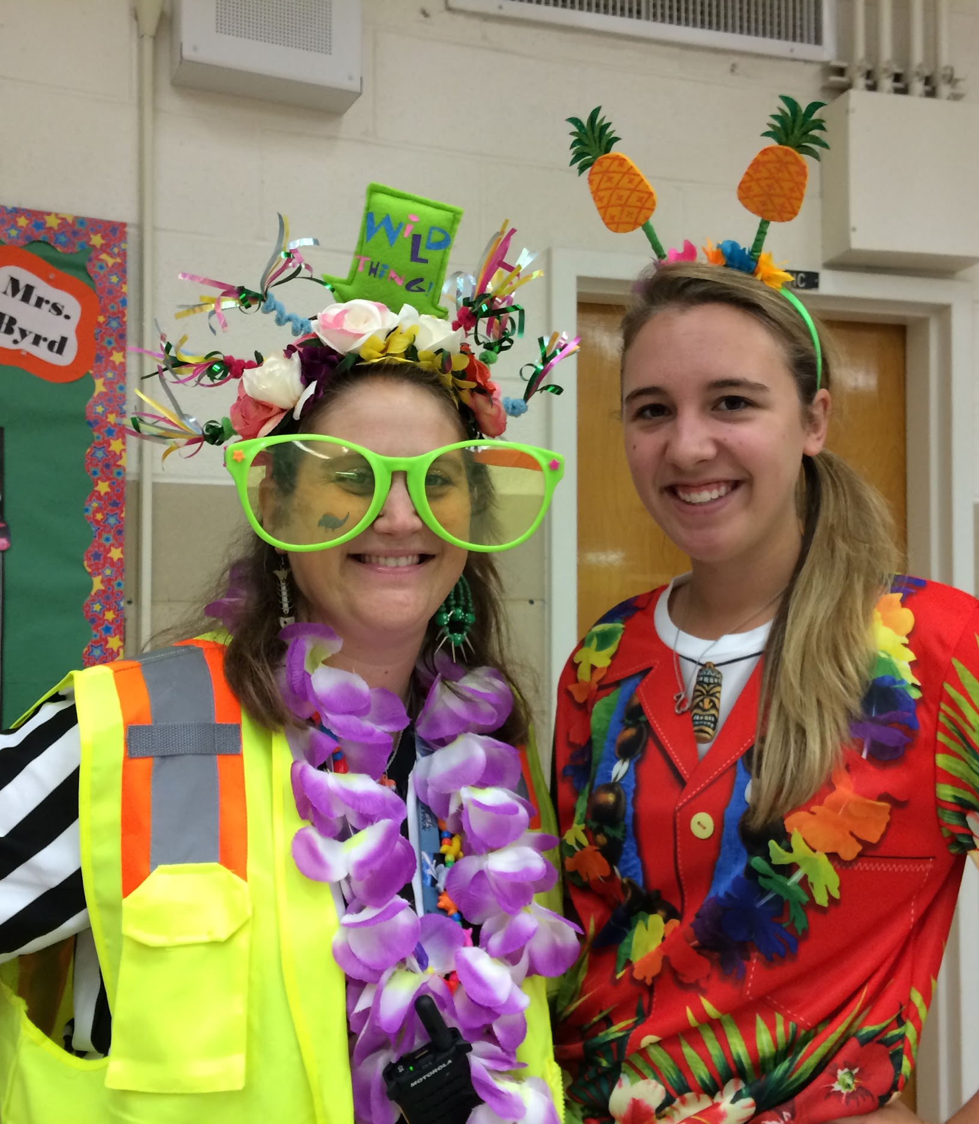
Introduction
Miranda Meadows
Second Grade Teacher
Megan Tucker
STEAM Specialist/ Many hats
Hillsboro Charter Academy
Why we created this lesson

Slide 3
Payload Specialist 1
Charles D. Walker
Second spaceflight
Mission Specialist 2
Stanley David Griggs
Only spaceflight
Congressional Observer
Edwin J. 'Jake' Garn
Commander
Karol J. Bobko
Second spaceflight
First elected official to go to space.
Mission Specialist 3
Jeffrey A. Hoffman
First spaceflight
Pilot
Donald E. Williams
First spaceflight
Astronaut Physician
Margaret Rhea Seddon
First spaceflight

Slide 4
After two reschedules and a delay the crew of mission STS 51-D definitely had a GROWTH MINDSET
On the day of launch it was rescheduled almost an hour due to a boat floating into the restricted solid rocket booster recovery area.
This was the 16th Space Shuttle mission and 4th flight for Discovery
Discovery launched April 12, 1985 at 8:59 am EST from the Kennedy Space Center in Florida.

Slide 5
Primary Objective
Deploy two communication satellites
Anik C-1
Syncom lV-3
Other Objectives
Continuous Flow Electrophoresis Experiment by Payload Specialist Charles Walker
The results from this experiment were groundbreaking in purification methods used on Earth to produced better quality medicine.
Informal science study on how simple mechanical toys work in space.
To continue to study how the human body works in space
Senator Garn experienced the worst case of “Space Sickness” (SAS) ever recorded on this mission. They eve informally named a scale for space sickness after him called the Garn Scale.

Slide 6
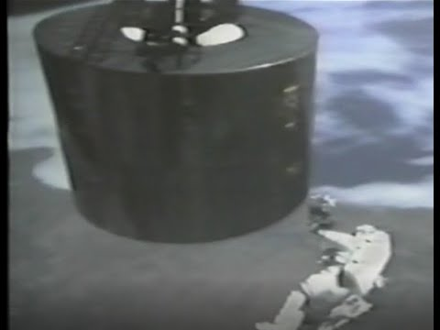
A few hours after launch the Crew deploys the first satellite Anik C-1 all goes well and the satellites booster kick motor propels it into orbit successfully.
The next day the crew deploys the second satellite the Syncom IV-3. But the booster stage did not fire.

Slide 7
So now the crew members have a few problems…
They currently have a seven ton satellite rotating twice a minute, that is drifting further away from them into space.
The power switch that they think needs to be flipped is a 4 inch lever attached to the side of the satellite
They cannot grab the satellite to bring it back in because of its flat surface design
They cannot bring the satellite back into the Discovery (or any other future shuttle) because they are unsure if the engines have attempted to fire and do not know if the satellite will explode.
The satellite cost a LOT of money and they do not want to waste it.

Slide 8
To design a flexible tool that can be gently held against the side of the spinning satellite to hook the lever as it spins by.
The tool needed to be strong enough to flip the switch but also had to be weak enough to break away after flipping the switch so as not to pull the satellite out of position and put the Discovery at risk.
The crew had very little resources on board to create this tool with.
Materials the crew used:
Plastic covers from flight plans
Rubber tubes
Pieces of aluminum foil from window shades
Duct tape

Slide 9
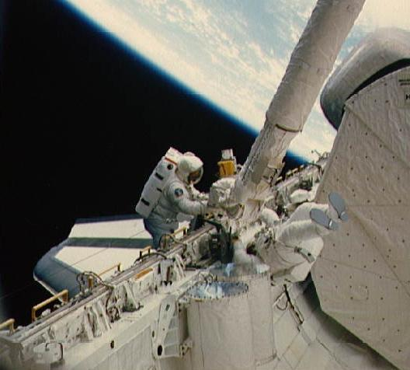
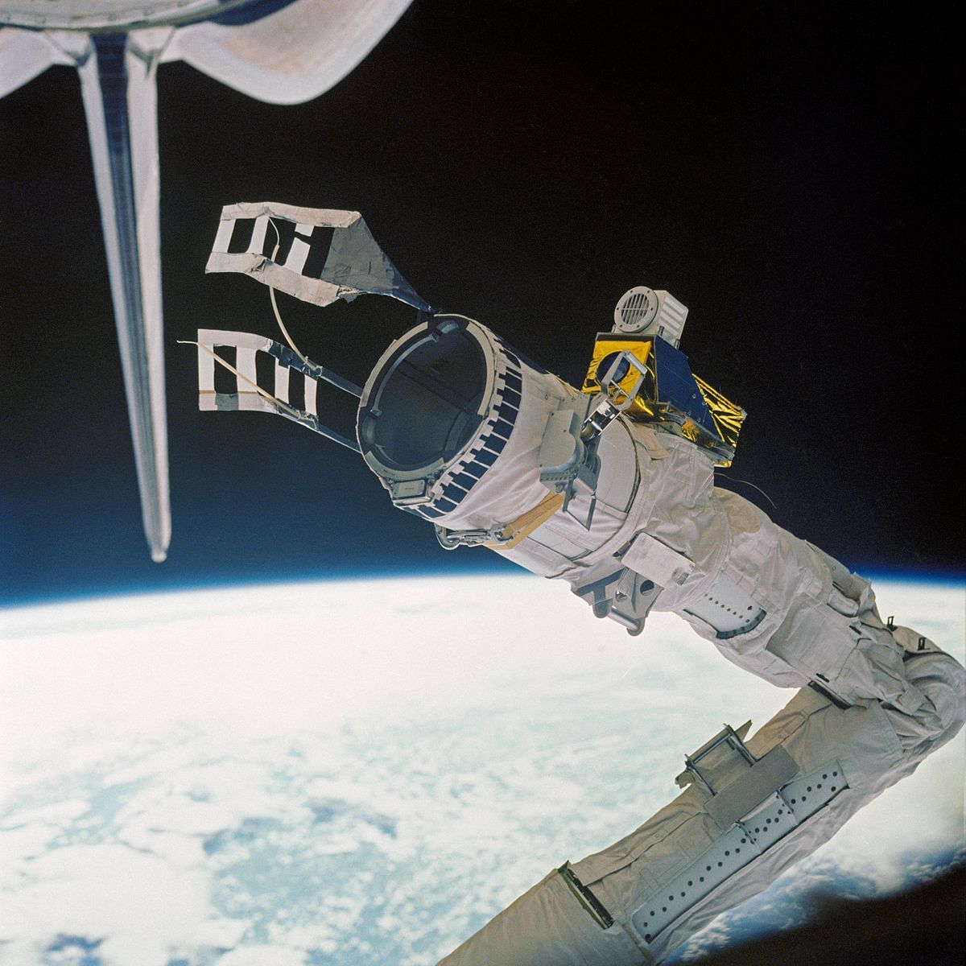
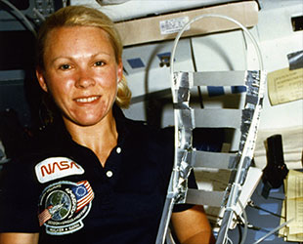
With the help of engineers on the ground, create the fly swatter tool using materials found on board the Shuttle.
Astronauts Hoffman and Griggs complete a space walk to attach the fly swatter to the robotic arm of the Discovery.
Discovery Commander Bobko and Pilot Williams Maneuver the space craft alongside the satellite.
Margaret Seddon operates the robotic arm of the discovery to gently lay the fly swatter in the position to catch the switch.
Step One:
Step Two:
Step three:
Step Four:
This was the first unrehearsed space walk in the history of the U.S. space program

Slide 10
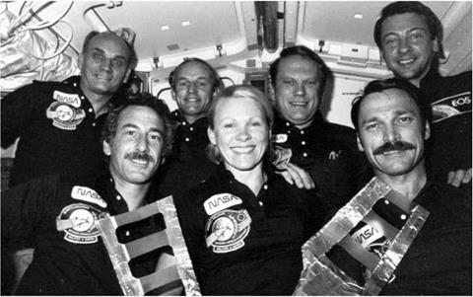
Almost...
Success: The fly swatter worked and was able to catch the lever and pull hard enough to confirm that it was already engaged fully.
Unfortunately the issue with the satellite was not the lever and the crew was unable to fix the satellite on this mission.

Slide 11
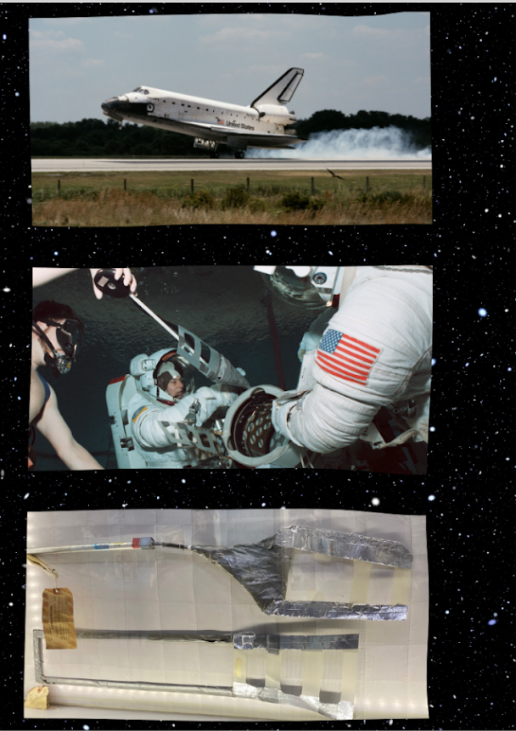
The Crew of Mission STS-51-D made it back to Earth safely after their trip was extended two days due to the satellite issue.
Four months later the crew of STS-51-I flew Discovery back out to the satellite and fixed the problem. It took two spacewalks totaling just over 11 hours to fix the satellites control lever. They also installed a remote transmitter that allowed the satellite to be controlled from Earth.

Slide 12
Join the Satellite “Swat” Team and follow the
Engineering Design Process!
Seesaw activity
Notes:
Megan

Slide 13
What is a Design Process?
A design process is a systematic problem-solving strategy, with criteria and constraints, used to develop many possible solutions to solve or satisfy human needs or wants and to narrow down the possible solutions to one final choice.
– ITEEA Standards for Technological Literacy
Notes:
megan

Slide 14
Notes:
megan

Slide 15
What do we need to know to get started?
What are we trying to accomplish?

Slide 16
STEAM DESIGN CHALLENGE
How can you engineer a prototype, following specific criteria and constraints, to help the team of the STS-51D solve the problem and flip the switch on the satellite?

Slide 17
How are we going to complete the task?
What materials will we use?

Slide 18
STEAM DESIGN CHALLENGE
“Swatter” should include the following elements:
Must be flexible, yet strong
Have a reach of at least 1 yard (3 feet)
Include a “catch and release” system
Fully flip the switch (light switch)
Be attached to the end of a ruler/yardstick

Slide 19
Time:
5 minutes to plan individually
10 minutes to plan collaboratively
30 minutes to build
Materials:
Aluminum Foil (1 sheet)
Plastic Page Protector (1 sheet)
Rubber Bands (6 assorted sizes)
Wooden dowel rod (1) (preferred, could substitute an unsharpened pencil)
1 Yard of Duct Tape (preferred, could also use Masking or Scotch Tape)
“Mystery Material” (ONE additional material that may have been on board)
Construction Tools (Not allowed in solution): Scissors and Ruler

Slide 20
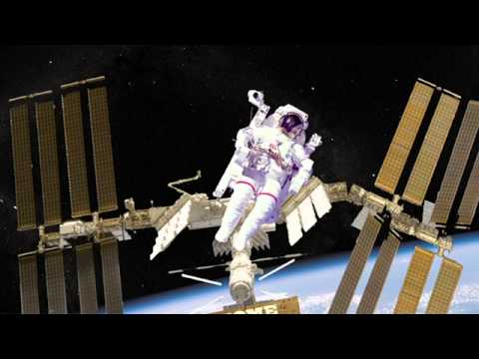
Sketch a technical drawing of your personal design.
Collaborate to combine ideas and sketch a 1 + 1 = 3 design.
Carry out your plan and test your prototype.
You have 5 minutes to brainstorm individually.
You have 10 minutes to brainstorm your design as a group and sketch and label a technical drawing.
Once the time is up, only those with a collaborative sketch will be able to start to build the prototype that was created.
You will have 30 minutes to build and test your solution to the challenge.

Slide 21
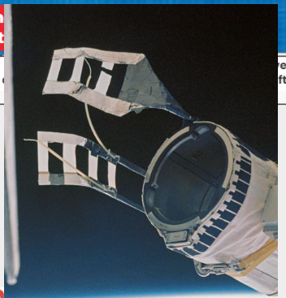
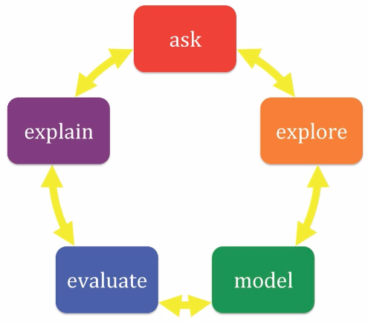
Model:
Sketch a technical drawing of your individual idea and 1+1=3 collaborative design.
Your Idea: Use the drawing tools or post a picture of your drawing here.
Your “1+1=3” Collaborative idea:
Now you try! Use a blank piece of paper and draw your design.

Slide 28
Was it successful?
Why or why not?
Sketch a technical drawing of the team’s final design.

Slide 29
Test Checklist:
Must be flexible, yet strong
Have a reach of at least 1 yard (3 feet)
Include a “catch and release” system
Fully flip the switch (light switch)
Be attached to the end of a ruler/yardstick
**If you don’t have all the boxes checked, please think about how to try to redesign your model to include what is missing.

Slide 31
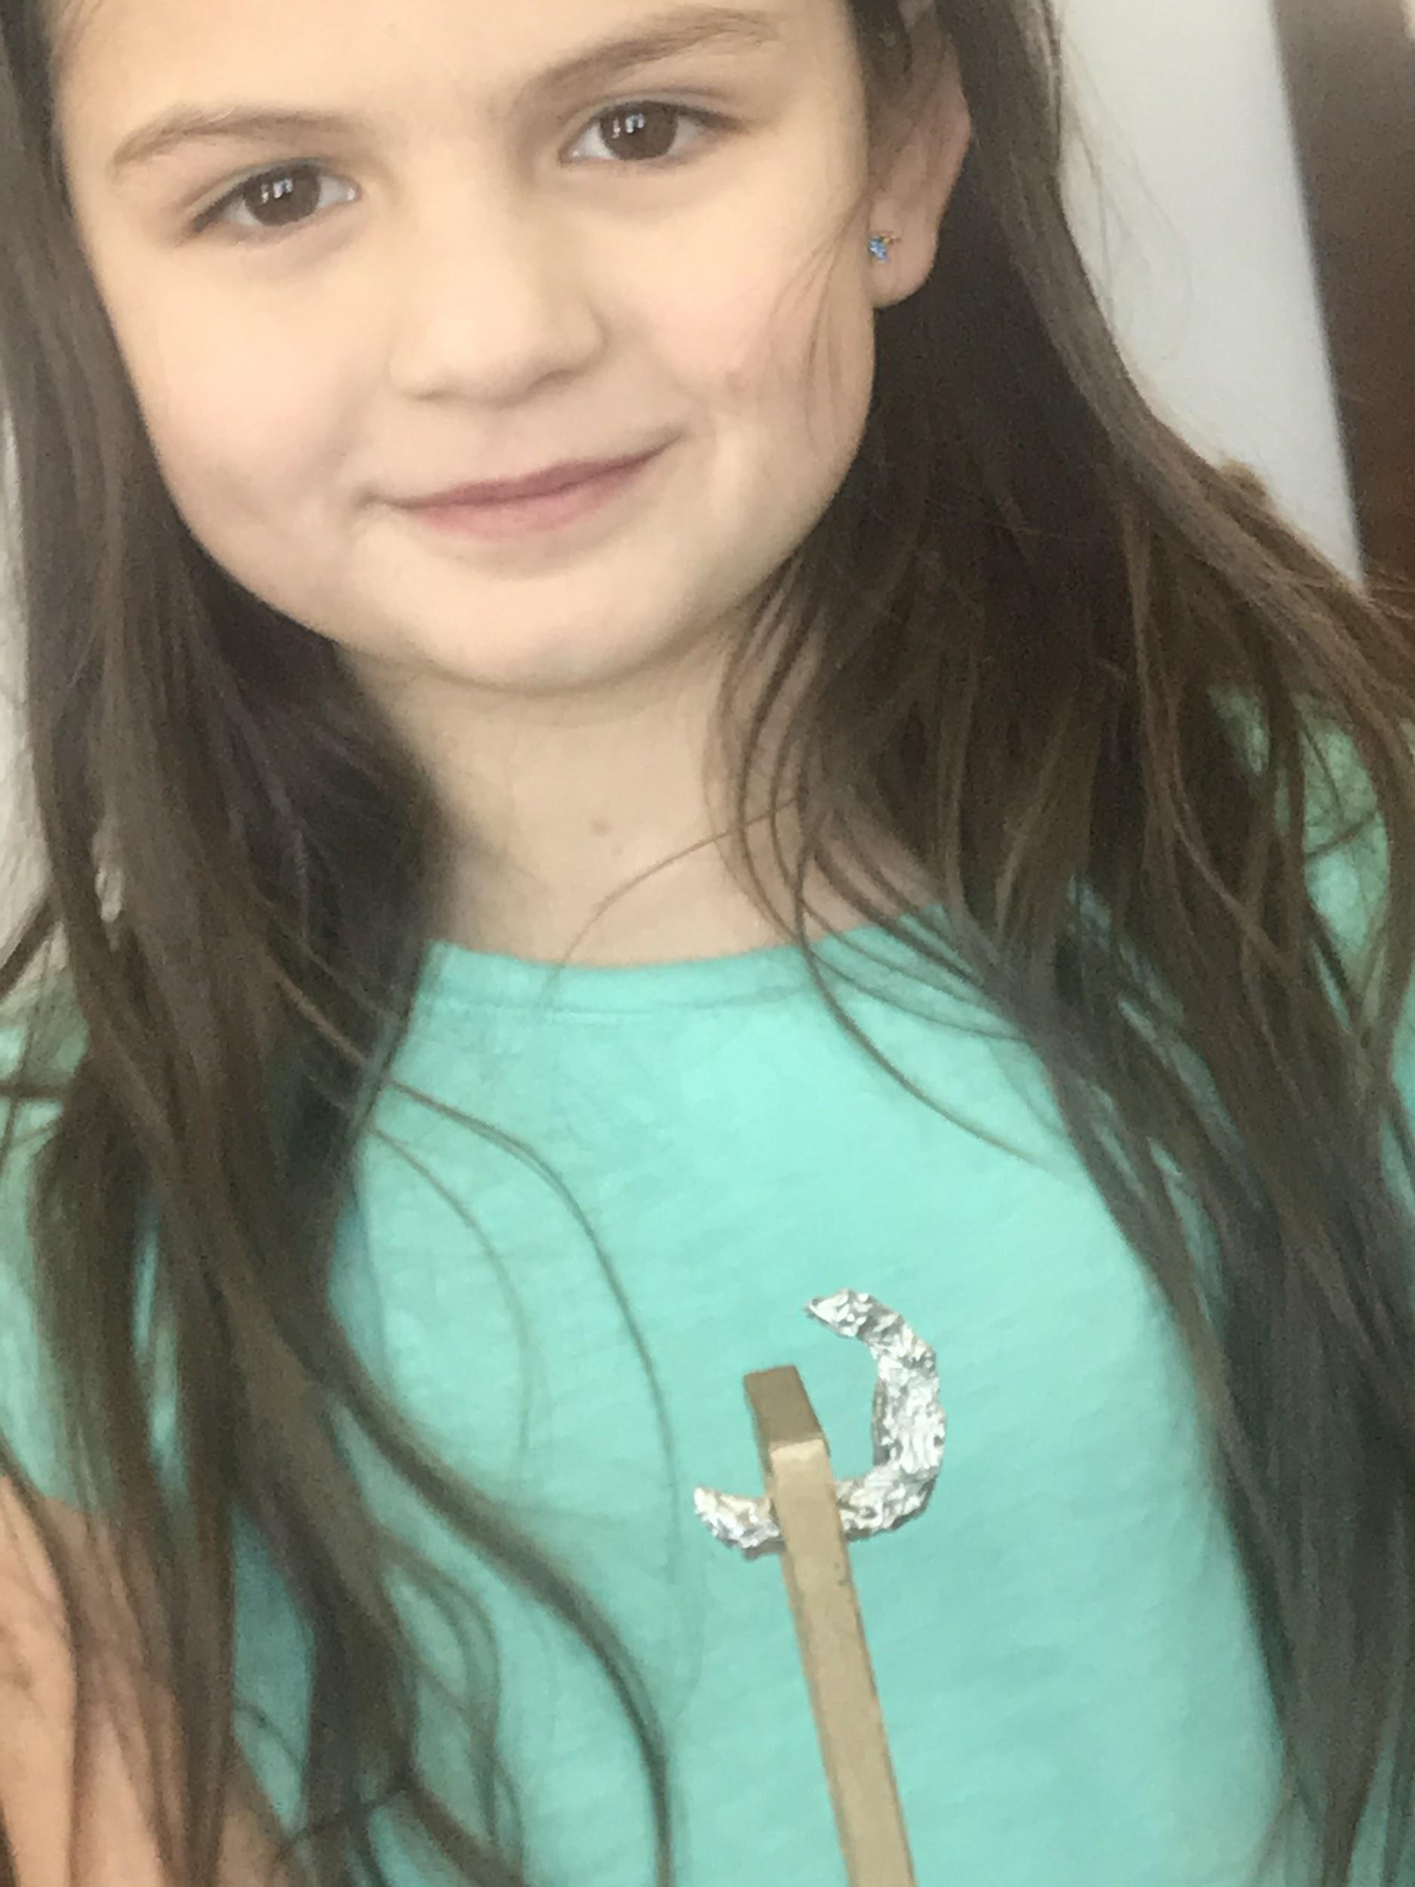
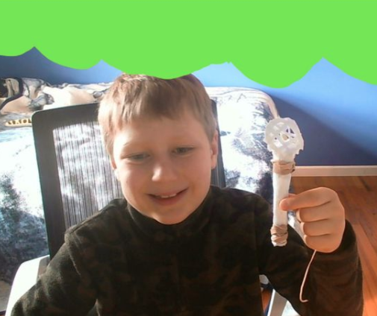

Slide 34
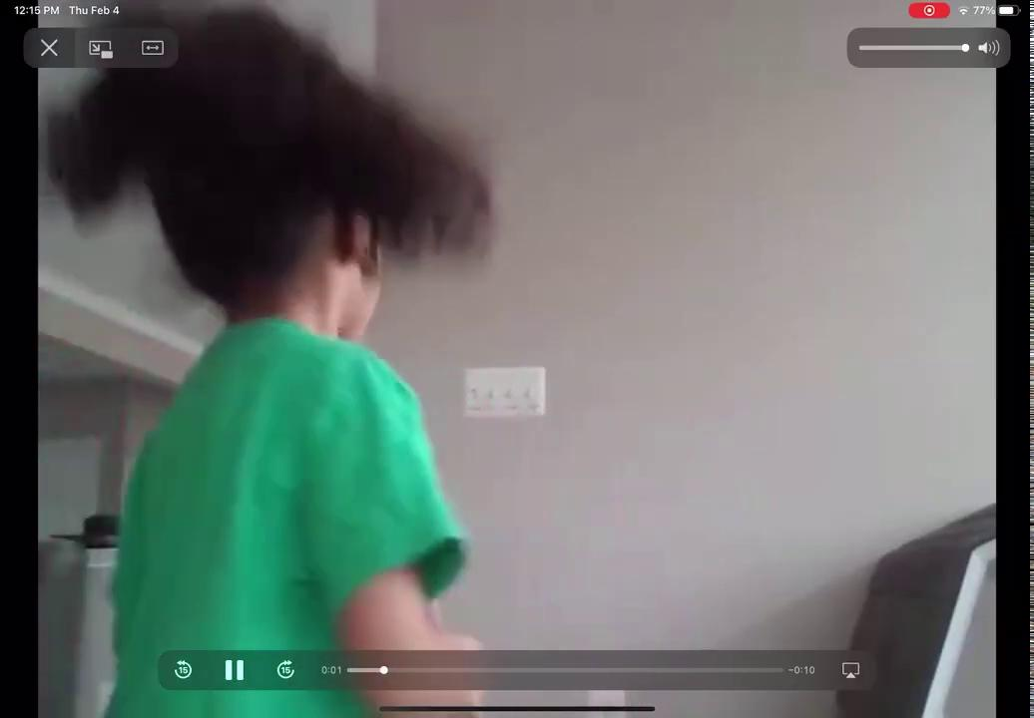

Slide 35
What piece of the prototype are you most proud of engineering?
What is an area for improvement?
What did you see that you liked in another group’s design?
How could you change your design for next time?

Slide 40
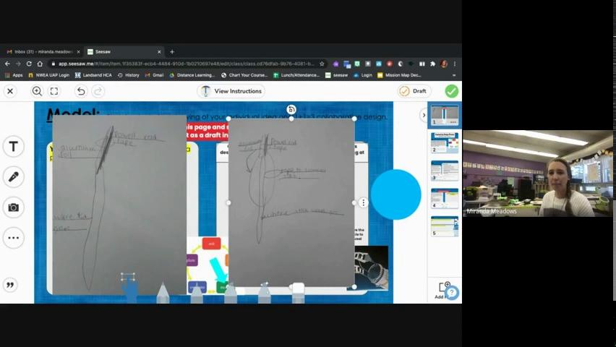
History and Introduction to the
Satellite SWAT Design Challenge
Satellite SWAT Sketch Sharing and Critique
Satellite SWAT Prototypes
Virtual Class Recordings

Slide 41
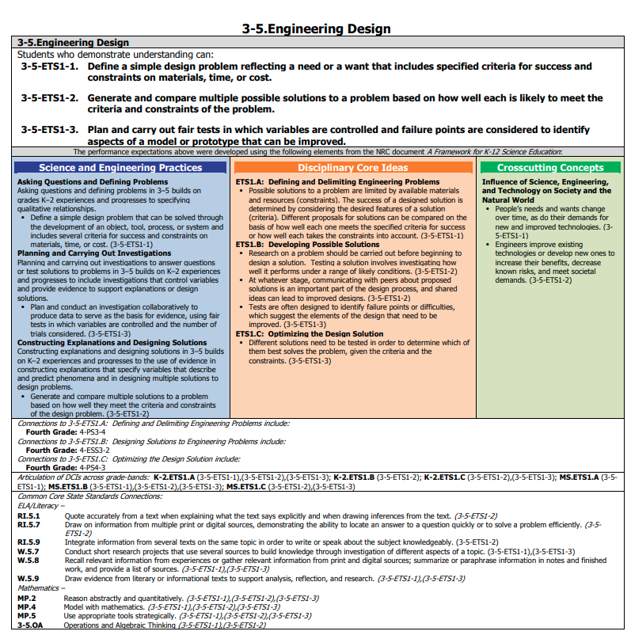
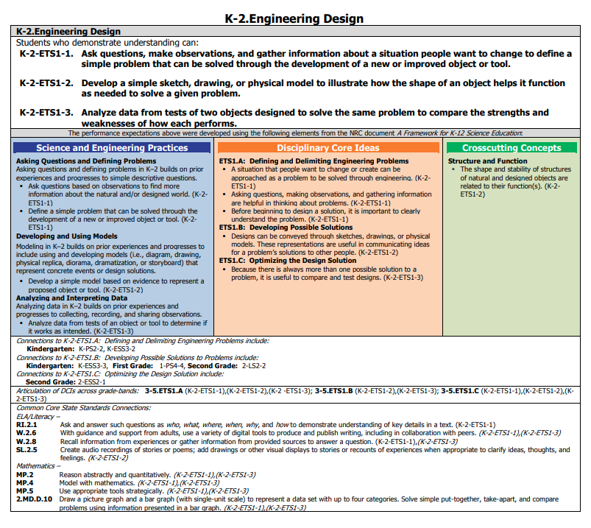

Slide 42
