Slide 1
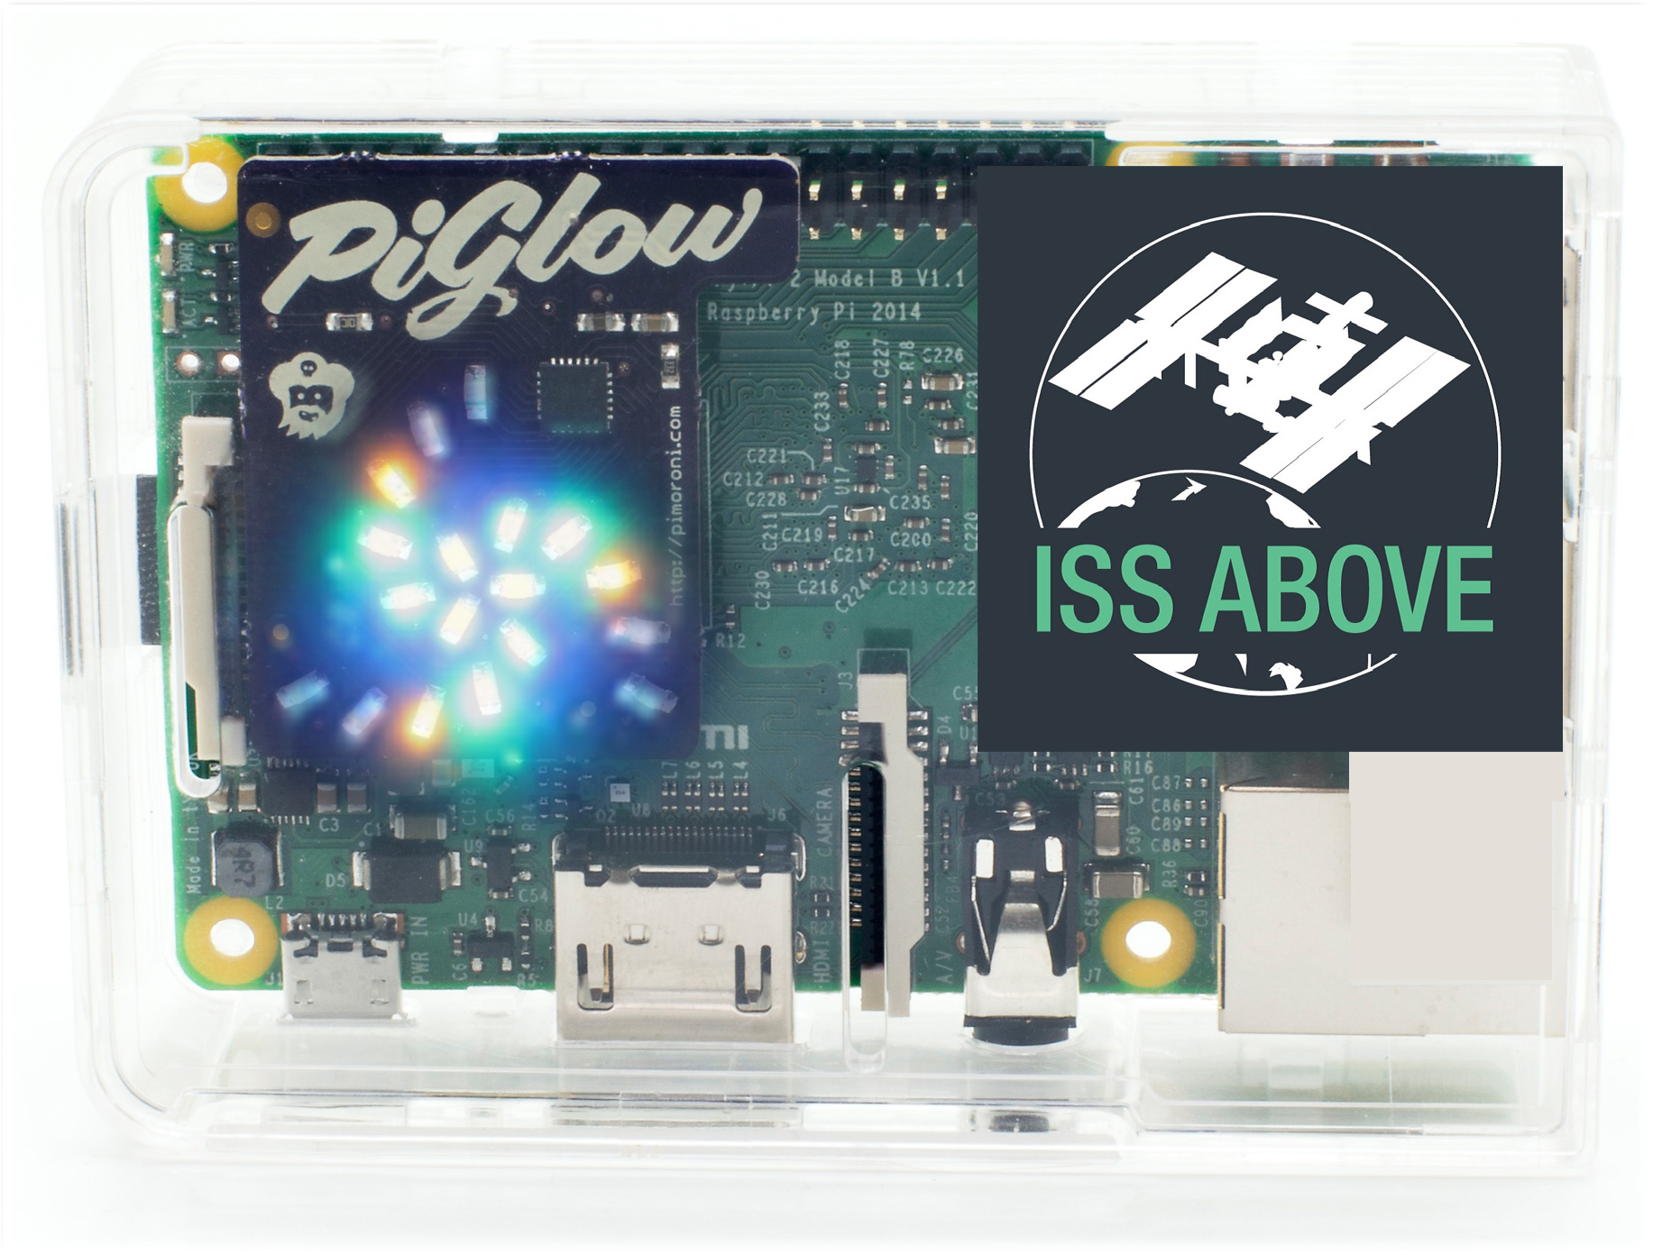
ISS-Above DEVICE
It displays:
Live video from the ISS including Real-time Information about : ISS-Location / News / Crew / Passes / Visible passes
Very bright LED indicates when the ISS is above your school (5-8 times every day)
3500+ installed worldwide
400+ in schools / science centers
Free Lesson Plans / Activities
ISS-Above is this little box. It connects to a TV or projector via HDMI

Slide 2
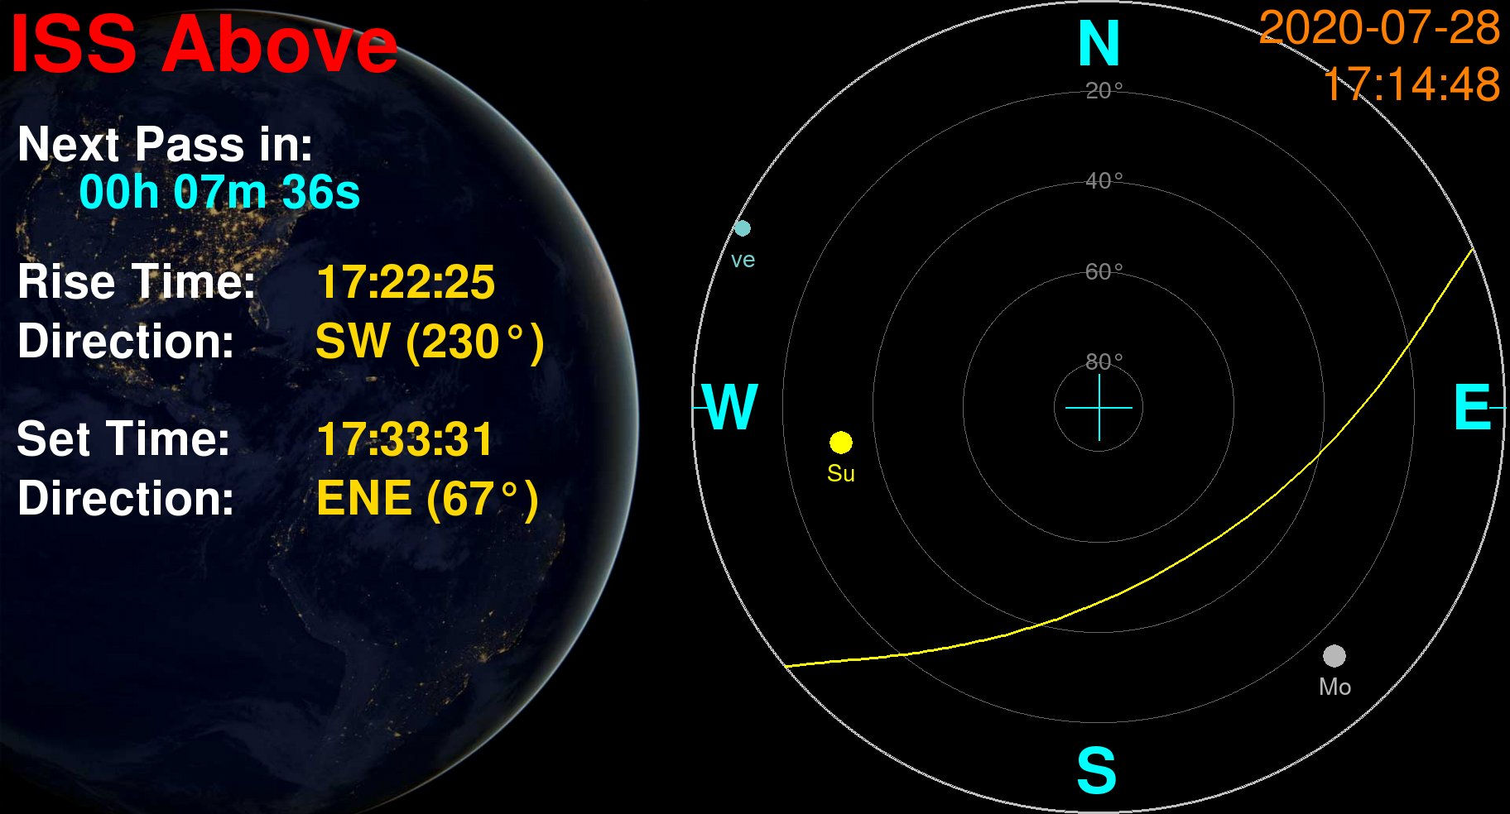
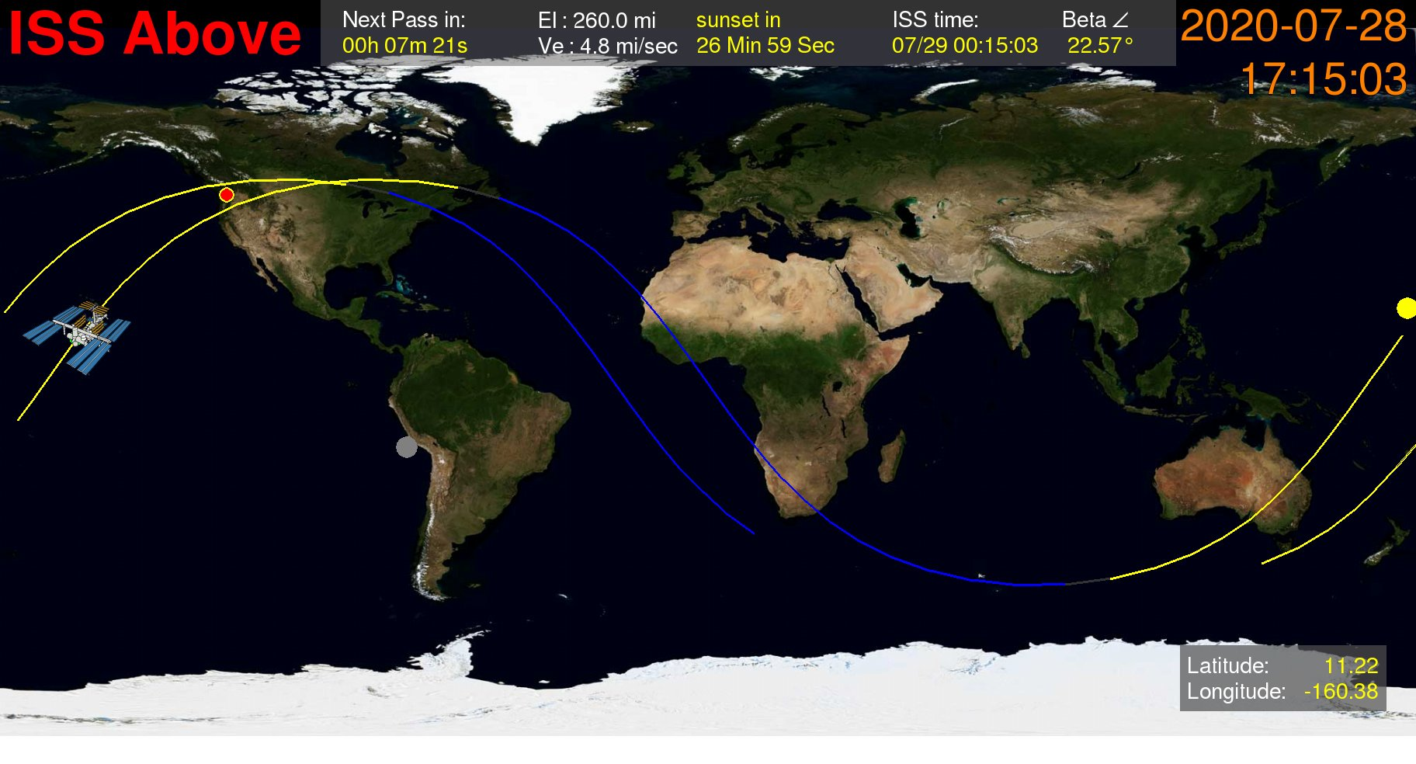
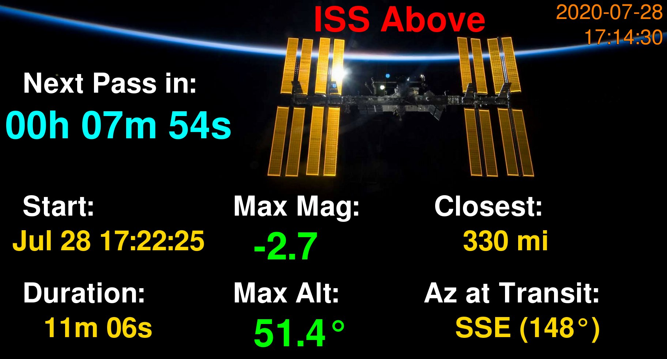
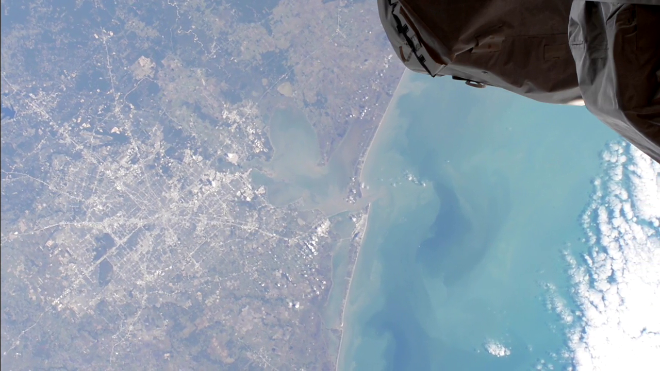
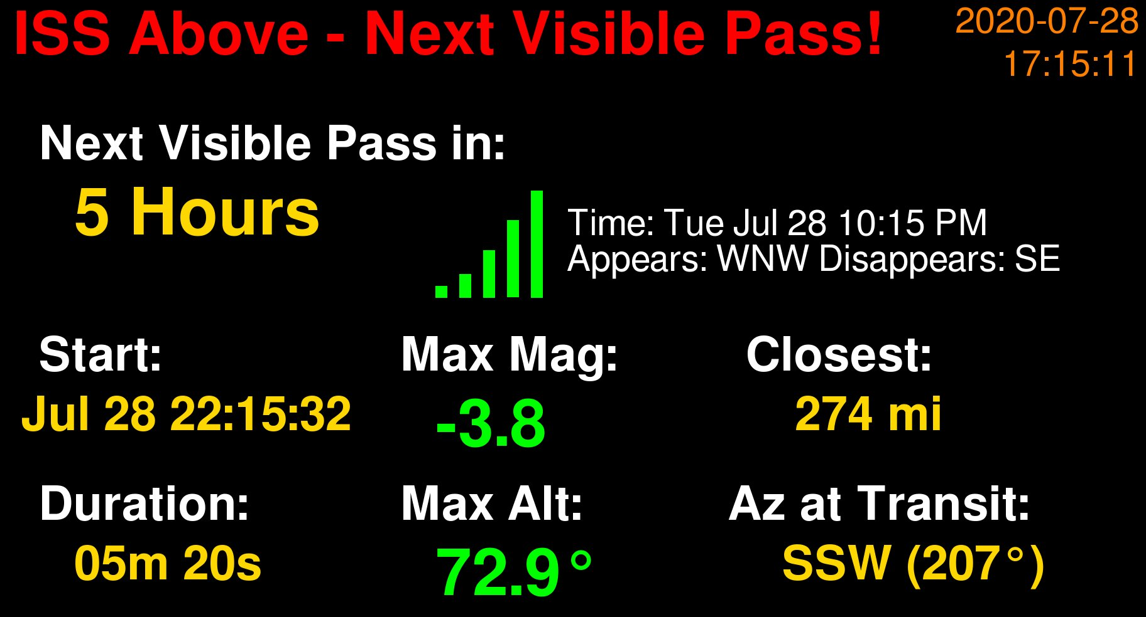
ISS-Above INFO SCREENS

Slide 3
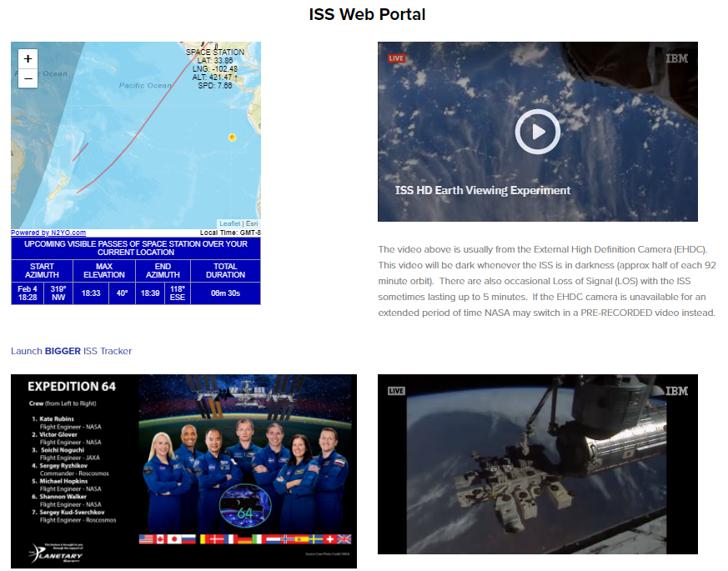
ISS-Above web portal
Free online resource combining an ISS tracker with both live feeds and other resources/information.
http://www.issabove.com/iss-web-portal

Slide 4
ISS Earth-viewing resources
Using resources from the ISS and other NASA / NOAA satellites to support student learning opportunities with Earth-Viewing.
External High-Definition Camera (EHDC)
ISS Live (SD quality)
http://www.ustream.tv/channel/iss-hdev-payload
https://www.ustream.tv/channel/live-iss-stream

Slide 5
ISS skydiving: STUDENT ACTIVITY
Demo :Using Live Video from the ISS and other NASA/NOAA resources to follow the ISS as it orbits over the earth
Checking orbital path of the ISS over an area you are interested in
Using NASA/NOAA Satellite imagery to check for cloud cover
Using Google Maps to dive down to the ground and follow the track
Students identify places/ features/ weather/ fires(!)/ Icebergs(!) and conduct further research based on what they see.
Advanced activity: Capturing the live video feed

Slide 6
TEXAS to Newfoundland
ISS Pass over USA on Jan 29, 2021 via : http://www.satflare.com/track.asp?q=25544#TOP

Slide 7
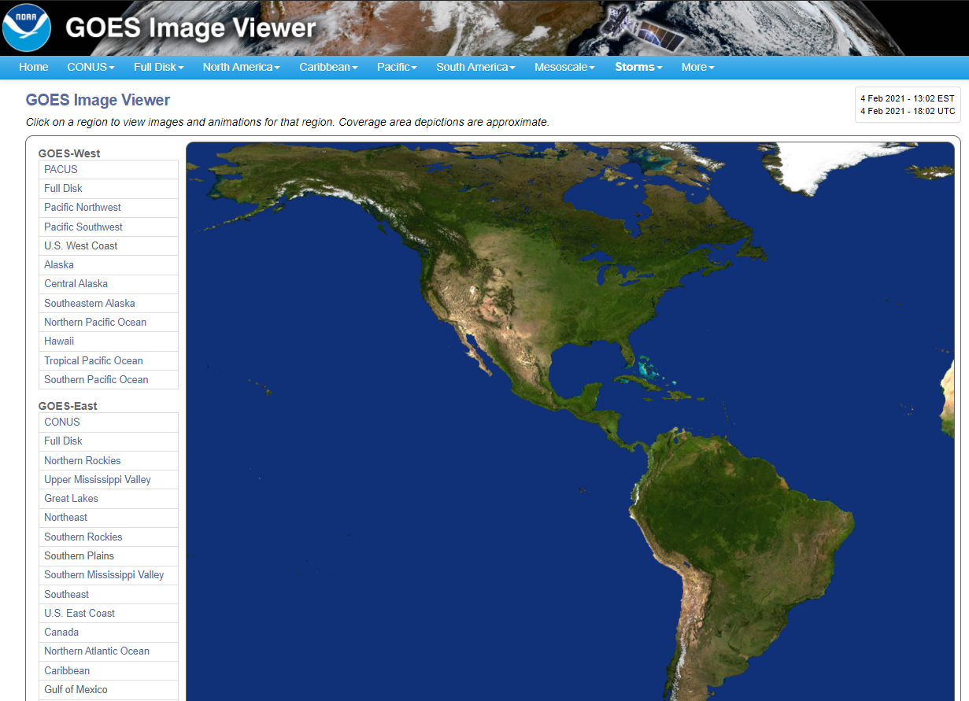
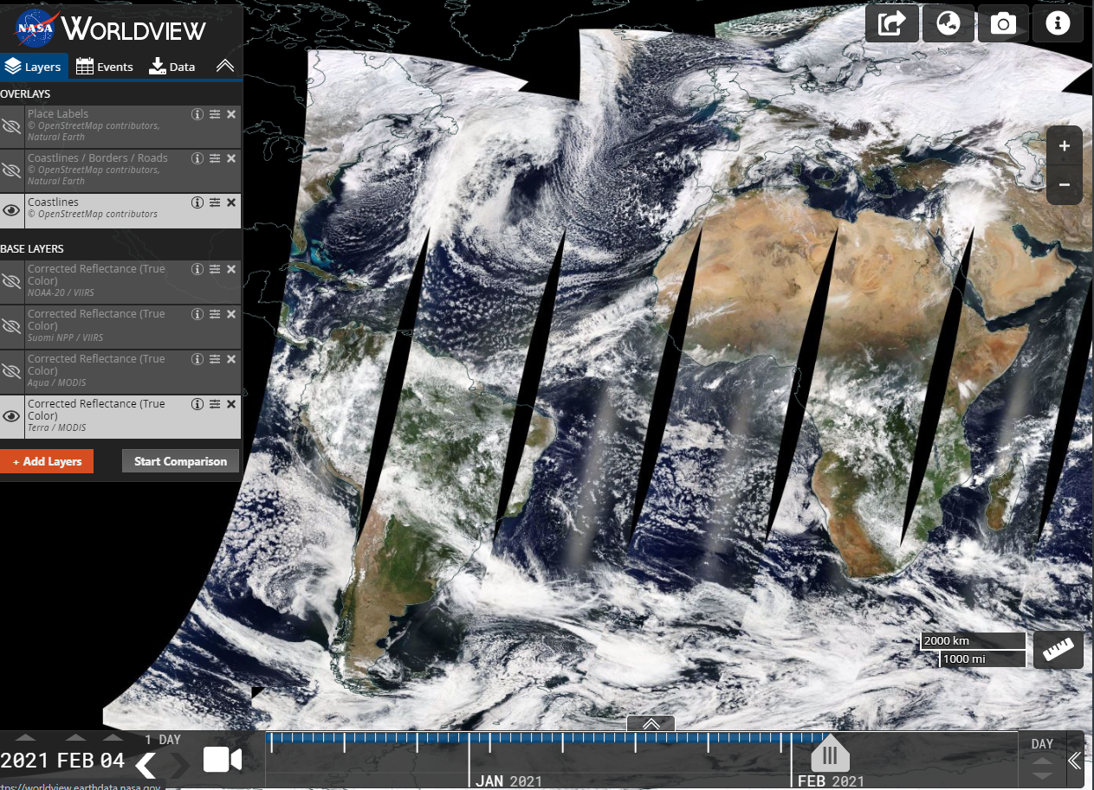
OTHER NASA/NOAA Earth-viewing resources
Checking cloud cover across the USA and other places around the world.
GOES EAST/WEST (North America)
NASA Worldview
https://www.star.nesdis.noaa.gov/GOES/index.php
https://worldview.earthdata.nasa.gov/

Slide 8
NOAA GOES
Using the GOES-East satellite image viewer to check for cloud cover.
https://www.star.nesdis.noaa.gov/GOES/index.php

Slide 9
TEXAS to Newfoundland
ISS Pass over USA on Jan 29, 2021 via : http://www.satflare.com/track.asp?q=25544#TOP

Slide 10
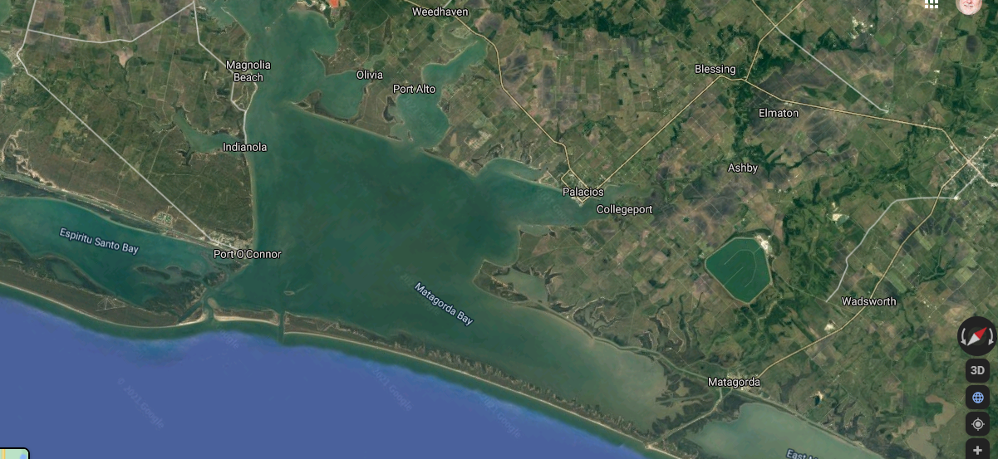
Google maps
Video frame captured from the NASA EHDC live feed.
Using Google maps (in 3D mode) you can dive down (skydive) to the same area the live feed is showing.
Top image is a video frame from the beginning of the pass
Bottom image shows the google map view of the same area
http://bit.ly/skydiveISS1
The same location shown using Google Maps – aligned to the same path.

Slide 11
ADVANCED: Capturing ehdc live video feed
The live video feed from the EHDC camera is archived every few hours here: http://www.ustream.tv/channel/iss-hdev-payload
You may want to actively capture the live feed to your own computer.
The way I do that is using a tool called STREAMLINK
You can install this for Windows / Mac or Linux here:
https://streamlink.github.io/install.html
Capture from a command prompt like this:
streamlink http://www.ustream.tv/channel/iss-hdev-payload best -o ehdc.mp4

Slide 12
acknowledgements
The term ISS skydiving was first coined by ISS-Above customer Kevin McLeod Check out his article here: https://deafscribe.medium.com/iss-skydiving-8800bdc763a
For EOSDIS Worldview:
"We acknowledge the use of imagery from the NASA Worldview application (https://worldview.earthdata.nasa.gov), part of the NASA Earth Observing System Data and Information System (EOSDIS).”

Slide 13
CONNECTING YOUR ISS-Above To your computer as a webcam
During my presentation I was asked about how to connect the ISS-Above up to Zoom. I do this using a bit of a fancy external hardware switcher – but you can do it using a simpler inexpensive HDMI to USB adaptor.
https://amzn.to/3rtDgcV just $30 from Amazon

Slide 14
ISS-ABOVE
Inspiring Wonder for human spaceflight
Liam Kennedy
Founder and Inventor
liam@issabove.com

